Slide 1

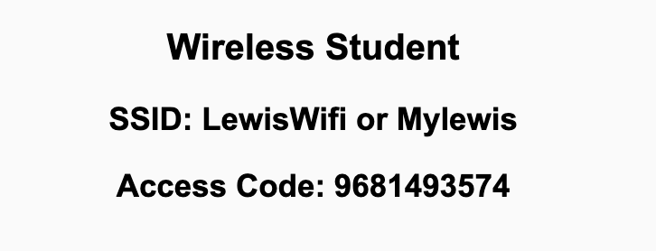
Preflight Check List
Sign into our Zoom meeting through our integrated Blackboard/Zoom link
Make sure that you can hear the conversation, see shared desktops, and view chat topics
Thank you if you choose to leave your camera on to help make our class more interactive
Be prepared to share your computer screen
Be prepared to utilize a headset with a microphone
In person participants also:
Make sure that your microphone and speakers are muted/off so that we don’t get an echo
Sit in a good spot near the classroom ceiling microphones if possible

Slide 2
Recordings
Discuss that recording are:
Opportunistic
Automatically available in Blackboard/Zoom
Sound Check… plus Video, and Desktop Sharing check
Start Recording

Slide 3
Agenda:
Prework & Announcements
Friendly Conversation Topic
Lab
Prework for Next Class
Discussion & Questions welcome at any time but please be present with no phones or email during our time together

Slide 4
Prework
Everything is due Sunday!
Be prepared for Lab on Friday

Slide 5
Friendly Conversation Topic
Who made the following statement?
This is my reality. I am not an emotionally empathetic kind of person and that probably doesn't come as a big surprise to anybody. Least of all me. The fact that I then misread people and don't realize (for years) how badly I've judged a situation and contributed to an unprofessional environment is not good. This week people in our community confronted me about my lifetime of not understanding emotions. My flippant attacks in emails have been both unprofessional and uncalled for. Especially at times when I made it personal. In my quest for a better patch, this made sense to me. I know now this was not OK and I am truly sorry. The above is basically a long-winded way to get to the somewhat painful personal admission that hey, I need to change some of my behavior, and I want to apologize to the people that my personal behavior hurt and possibly drove away from kernel development entirely. I am going to take time off and get some assistance on how to understand people’s emotions and respond appropriately.

Slide 6

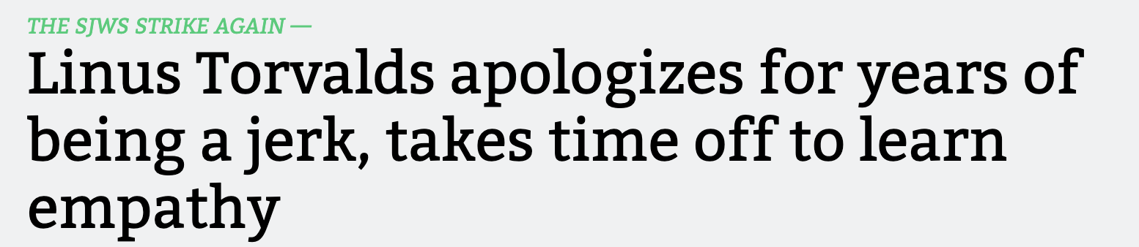
Friendly Conversation Topic

Slide 7

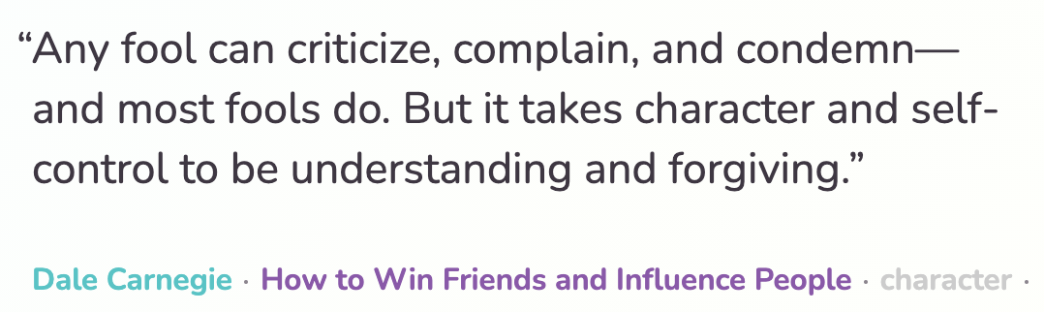
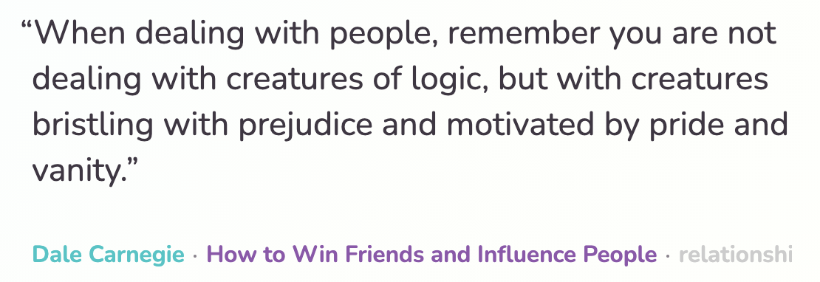

Slide 8
Lab
What can I/we do to help you be successful with your sprint 5 assignments?

Slide 9
Prework For Next Class
Everything is due Sunday!
Be prepared Sprint 6 Planning on Monday

Slide 10
End of Session

