Slide 1

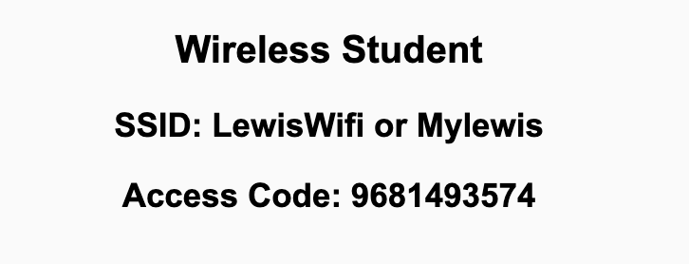
Preflight Check List
Sign into our Zoom meeting through our integrated Blackboard/Zoom link
Make sure that you can hear the conversation, see shared desktops, and view chat topics
Thank you if you choose to leave your camera on to help make our class more interactive
Be prepared to share your computer screen
Be prepared to utilize a headset with a microphone
In person participants also:
Make sure that your microphone and speakers are muted/off so that we don’t get an echo
Sit in a good spot near the classroom ceiling microphones if possible

Slide 2
Recordings
Discuss that recording are:
Opportunistic
Automatically available in Blackboard/Zoom
Sound Check… plus Video, and Desktop Sharing check
Start Recording

Slide 3
Agenda:
Prework
Public APIs and Possible Final Project Ideas
Lab
Discussion & Questions welcome at any time but please be present with no phones or email during our time together

Slide 4
Prework For Next Class
Be prepared for Lab
Everything is due Sunday!

Slide 5
Public APIs and Possible Final Project Ideas
Dogs, JavaScript & An API 🐶 Fetch, Promises & Async Await
Public APIs

Slide 6
Lab
Final Project Proposals
Personal Information Files
Mustang Lite
Note: Don’t be afraid to clear your browser cache if you see inconsistencies!

Slide 7
Prework For Next Class
Everything is due Sunday!
Be prepared for sprint 6 planning Monday

Slide 8
End of Session

