Slide 1

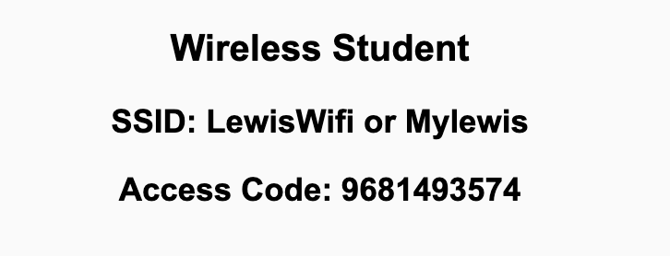
Preflight Check List
Sign into our Zoom meeting through our integrated Blackboard/Zoom link
Make sure that you can hear the conversation, see shared desktops, and view chat topics
Thank you if you choose to leave your camera on to help make our class more interactive
Be prepared to share your computer screen
Be prepared to utilize a headset with a microphone
In person participants also:
Make sure that your microphone and speakers are muted/off so that we don’t get an echo
Sit in a good spot near the classroom ceiling microphones if possible

Slide 2
Recordings
Discuss that recording are:
Opportunistic
Automatically available in Blackboard/Zoom
Sound Check… plus Video, and Desktop Sharing check
Start Recording

Slide 3
Agenda:
Prework
Sprint 6 Planning – Class
Sprint 6 Planning – Scrum Team
Prework for Next Class
Discussion & Questions welcome at any time but please be present with no phones or email during our time together

Slide 4
Prework
Complete Backlog Grooming including at least 8 story points worth of stories per team member
Be prepared for in-person Sprint 6 Planning
... Contact me if you will not be there Monday for Sprint 6 Planning (or if you will be remote).

Slide 5
Sprint Planning - Class

Slide 6
Sprint Planning
Sprint 6 Changes:
Similar to the previous sprints with Discussion, Quiz, Lab, and Reflection
This will be our first full sprint for your team
Sprints 7 and 8 will be very similar

Slide 7
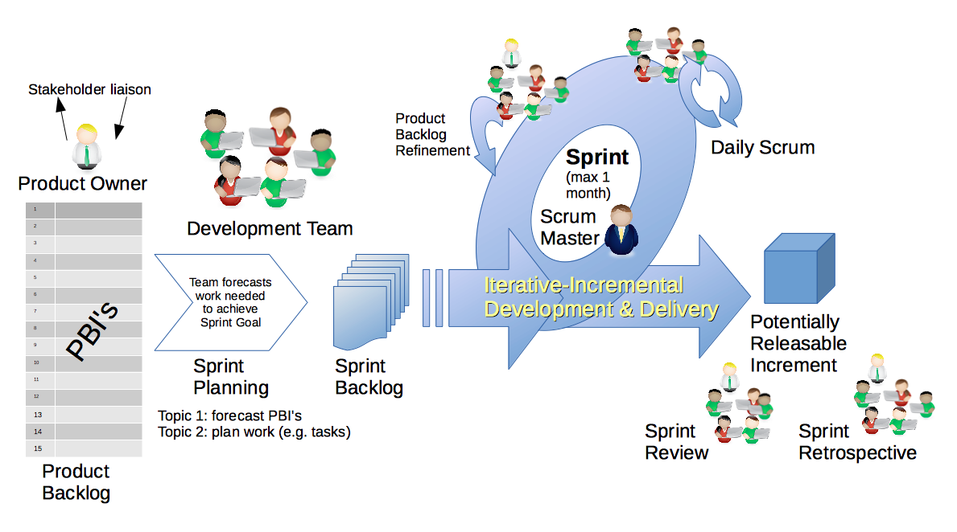
Scrum Process – Sprint Planning
By Dr ian mitchell - Own work, CC BY-SA 4.0, Link

Slide 8
Review Activities List
and Assignments (Abbreviated)

Slide 9
Prework For Next Class
Complete through activity 5
Each team should be prepared to demo “Best Story” and “Random Story”

Slide 10
Recall: Backlog Grooming
for Monday’s Sprint 6 Planning

Slide 11
INVEST to Write Good User Stories
Independent: Self contained, not dependent on other user stories
Negotiable: Leave space for discussion, discovery and invention
Valuable: Has immediate value to stakeholder.
Estimable: Constrained in size and scope, just enough information
Small: Ideally 1-2 days work with larger efforts being decomposed
Testable: Acceptance criteria makes clear when work is done

Slide 12
Sprint Planning Goal
By the end the class Monday every team member will have committed to multiple meaningful User Stories that are estimated at a total effort 8 or more Story Points per person
Steps:
Update “Done” definition prior to Monday’s session
Come into Sprint Planning with a fully Groomed Story Backlog of at least 8 story points per team member
Team members REQUEST stories, stories are assigned, and team members COMMIT to delivering stories by end of sprint
The TEAM is responsible for defining Done and having a fully Groomed Backlog.
The Product Owner maintains and updates the Backlogs.
Each team member is responsible for requesting and committing to stories. Stories must be deliverable within the sprint. Make it a priority to assign a story to a single team member.

Slide 13
This is Your Scrum Process

Slide 14
Backlog Grooming
for Sprint 6 Planning

Slide 15
Scrum Process
By Dr ian mitchell - Own work, CC BY-SA 4.0, Link

Slide 16
Backlog Grooming and Sprint Planning
Steps:
Priorities & Roles Assignment - Complete Friday
Epic Backlog Grooming – Complete Friday
Story Backlog Grooming – Complete Friday
Sprint Planning
Commitment to Sprint Backlog
Celebrate!

Slide 17
Step 1: Priorities & Roles
Recall Agile Priorities (associated scrum role):
Customer (Product Owner)
Technology (Architect)
Process (Scrum Master)
Recall the Agile Glossary [link]
Recall that one person can play multiple roles.
Recall that it is different/difficult for us because we are playing the role of the customer as well as the delivery team.

Slide 18
Step 2: Epic Backlog Grooming
Recall User Stories, Epics and Backlogs
Recall the Agile Glossary [link]… review User Story format

Slide 19
Scrum Process – Where is Epic Backlog Grooming?
By Dr ian mitchell - Own work, CC BY-SA 4.0, Link
Notes:
Epics are not part of Scrum.

Slide 20
Recall Scaled Agile

Slide 21
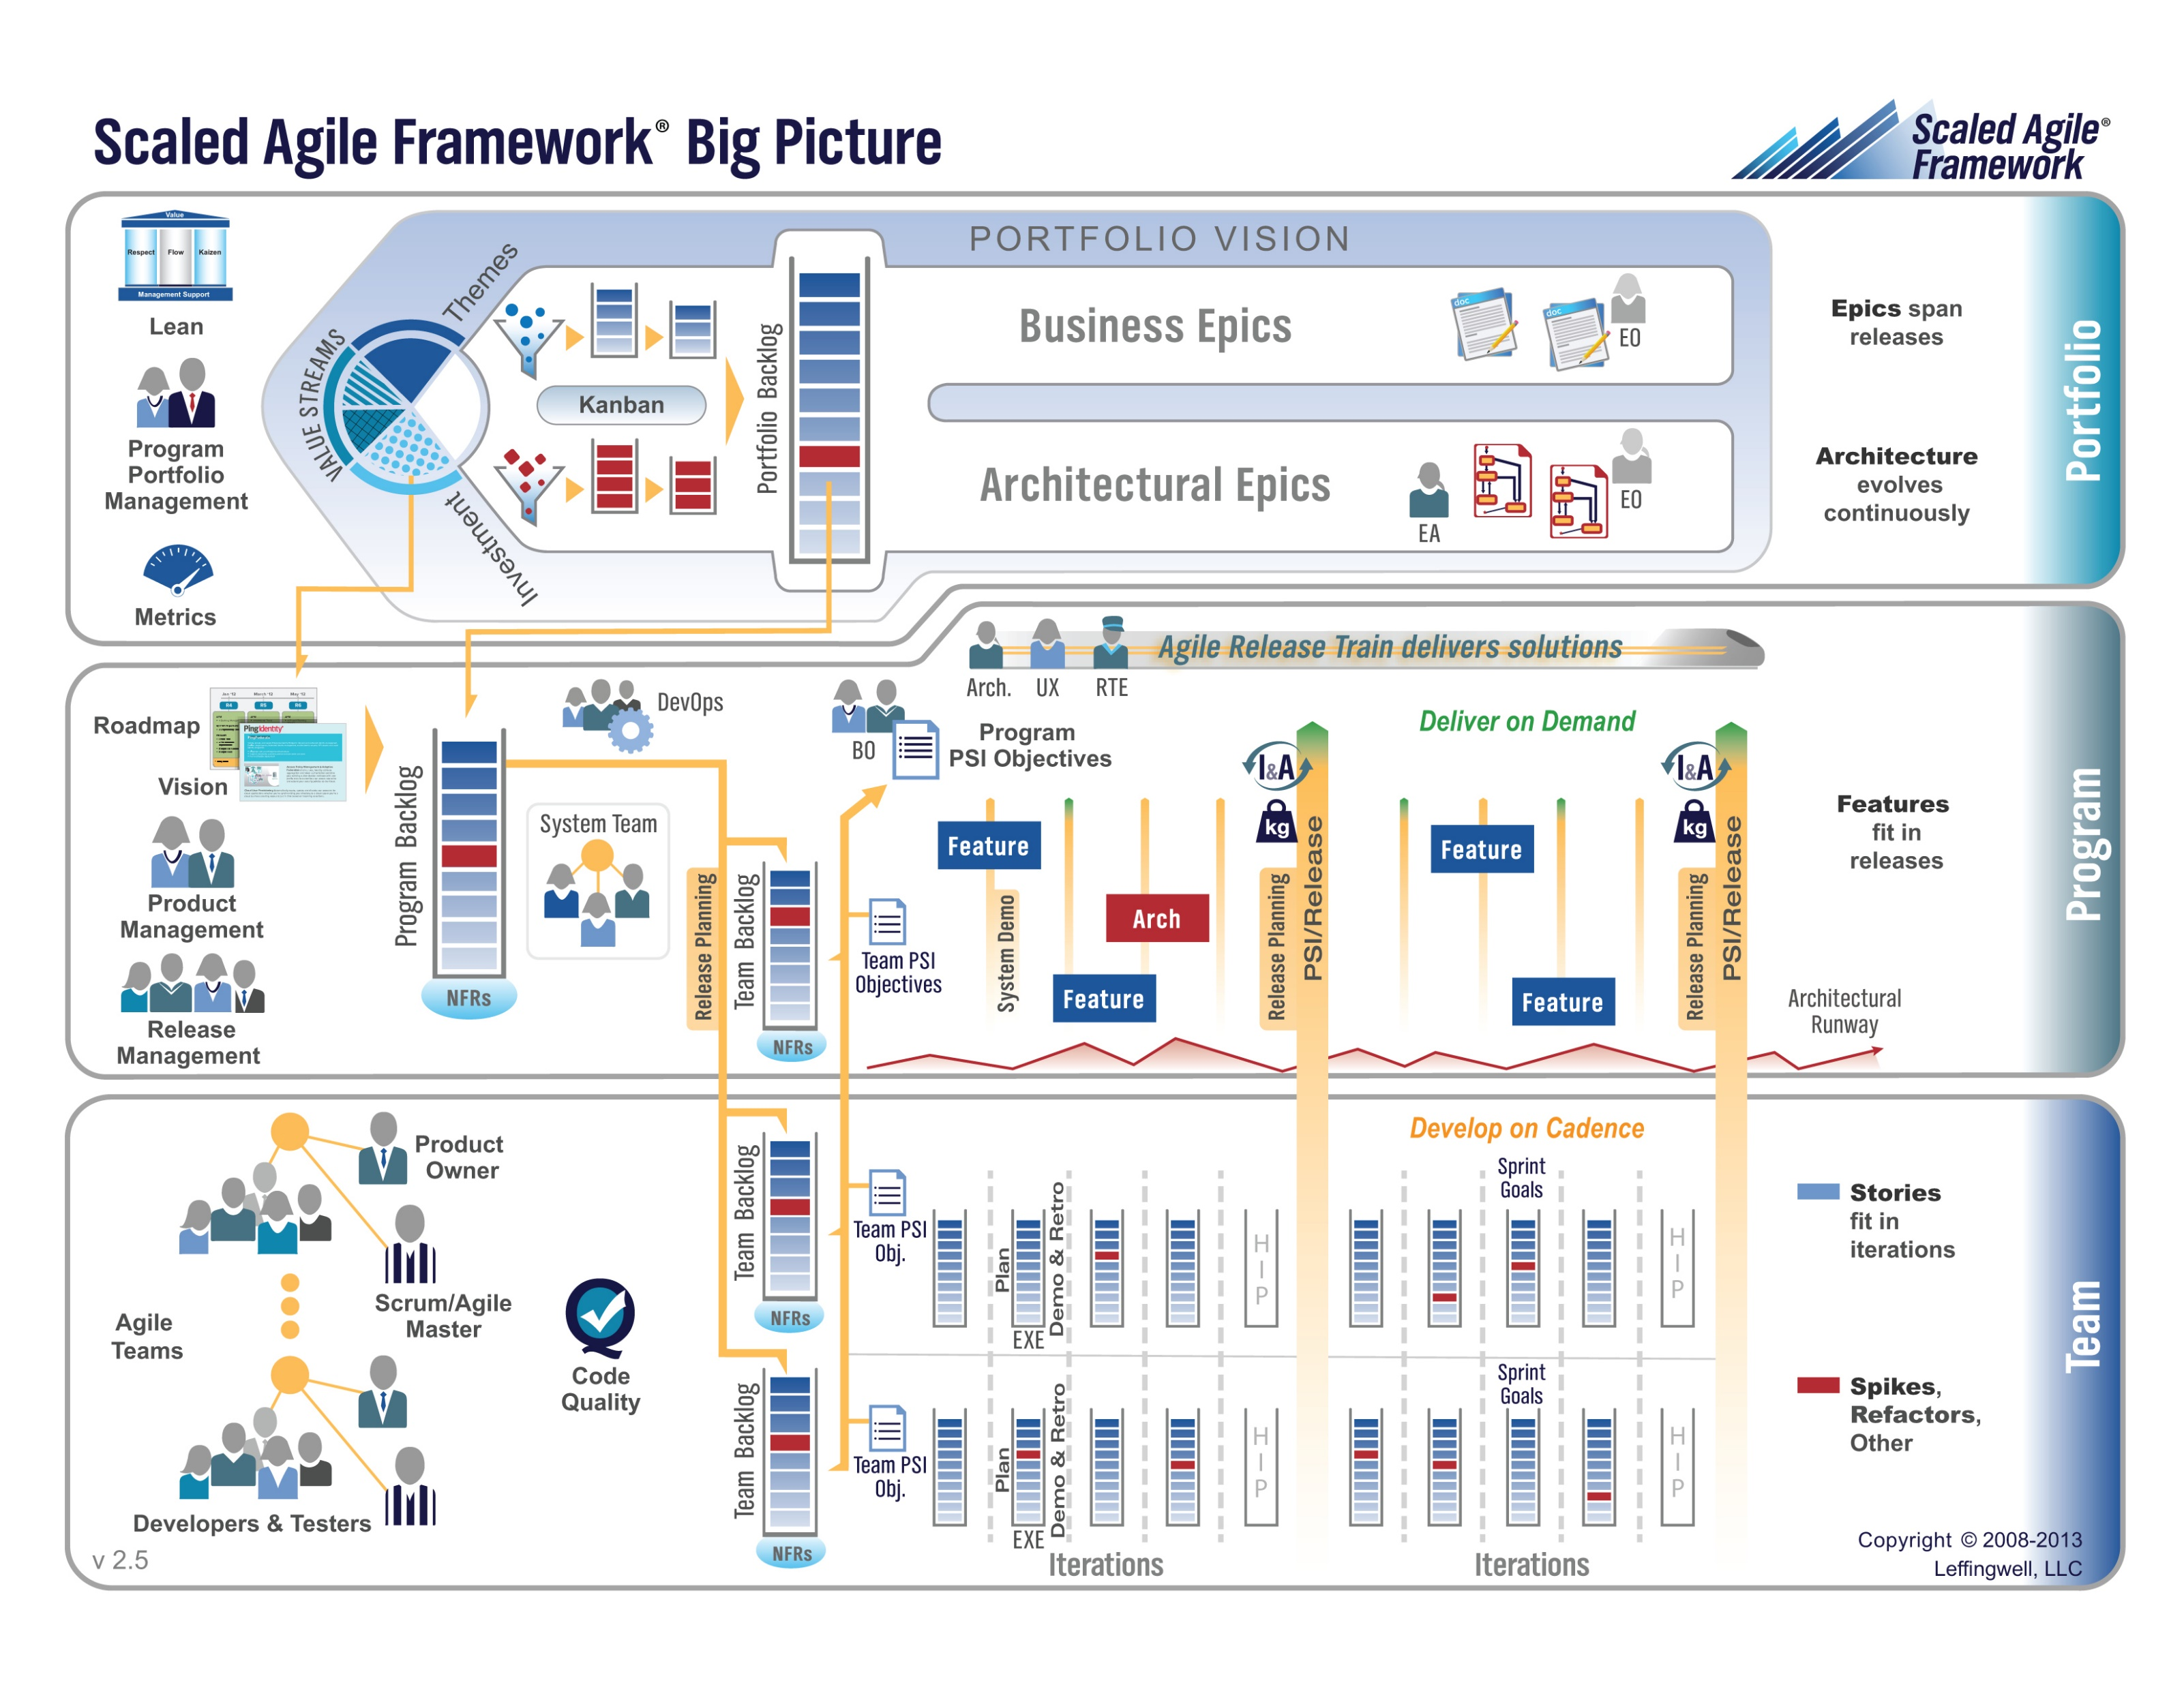

Slide 22
Step 2: Epic Backlog Grooming
Actions & Requirements:
Product Owner to lead the review and/or creation of Epics
There must be one list of Epics managed by the Product Owner
Each Epic must deliver customer functionality and value
Epics should be written in User Story format
Epics must be prioritized and forced ranked
Each product must have at least three Epics
Epic Backlog Grooming report questions (Scrum Master):
What is the number of Epics?
How many are force ranked?

Slide 23
Step 3: Story Backlog Grooming
By Dr ian mitchell - Own work, CC BY-SA 4.0, Link

Slide 24
Step 3: Story Backlog Grooming
Review Done, User Stories, and Story Backlog:
“Done” must be well defined and for us includes at a minimum:
Successfully deployed and integration tested in the production environment
Demoed to the Product Owner
Available to be demoed to the class
User Stories must:
Be written in User Story format from a customer / user perspective
Deliver user (customer) value
Be associated with Epic
Product Product Backlog is:
Managed by to Product Owner
The team’s master list of prioritized (force ranked) User Stories
The team’s master list of all important project work (spikes, continuous improvement, etc.)
Notes:
How will you handle dependancies?

Slide 25
Step 3: Story Backlog Grooming
Requirements:
Product Owner to lead the creation, force ranking, and estimating of User Stories.
Each User Story must have an estimated effort in Story Points
For our purposes assume 1 Story Point is approximately equal to 1 hour of effort
Each User Story must be deliverable in a single sprint

Slide 26
Step 3: Story Backlog Grooming
Requirements & Actions:
Update Product Backlog by:
Relocating “Done” User Stories “Done” list (skip)
Relocating “Pending” User Stories to the “Pending” list
Reviewing remaining User Stories
Creating new User Stories
Prioritize and force rank important stories (anything that might make it to the Sprint Backlog)
Provide Story Point estimates for important stories
Product Backlog report out questions (Product Owner):
How is “Done” defined for your team?
What is the total number of user stories?
What is the total number of story points?
How many stories and story points are force ranked?
Notes:
How will you handle dependancies?

Slide 27
Step 4: Sprint Planning
By Dr ian mitchell - Own work, CC BY-SA 4.0, Link

Slide 28
Do you need to update your story backlog to reflect unexpected results from sprint 5?

Slide 29
Step 4: Team Capacity, Story Assignment, and Cut Line
Activities:
Estimate Scrum Team Capacity for the current sprint by multiplying the number of team members times 8 hours each team member
Each User Story should be requested/assigned to 1 (preferably) or more team members
Review your Product Backlog and draw your “cut line” to create your Sprint Backlog

Slide 30
Step 4: Sprint Planning
Requirements & Activities:
Scrum Master and Product Owner lead effort to create Sprint Backlog
Request volunteers (or make assignments) to move the highest ranked Product Backlog stories to Sprint backlog until capacity is utilized
Comment: Your tools and formats you utilize for managing stories and backlogs are your own, but you need to be comfortable in showing how you choosing to do it.

Slide 31
Step 5: Sprint Backlog Commitment
By Dr ian mitchell - Own work, CC BY-SA 4.0, Link

Slide 32
Step 5: Sprint Backlog Commitment
The team commits to completing (“done”) the stories in the Sprint backlog.
It is required that we:
Be non-ambiguous in our commitments
Commit and deliver as an individual and as a team
Be transparent
Commit to continuous improvement
Product Backlog report out questions (Scrum Master):
What is your team’s capacity and how was it calculate
How many stories and story points did you team commit to delivering in sprint 6
How many stories and story points did each individual commit to delivering
What are your assumptions about “carry-over” (high-risk) sprint 5 stories

Slide 33
Step 6: Celebrate
Recognize your teammates that stepped up. Tell them “Well done!”
Celebrate report out questions (Scrum Master & Product Owner):
How do you feel about your sprint 6 planning?

Slide 34

Review User Story, Spike, and Backlog
User Story
Spike:
A user story that does not deliver functionality to the product user. This in not a generally accepted definition.
User Story Template
Backlog
Backlog Template?

Slide 35
Backlog Grooming
Backlog Grooming includes:
Creating and Deleting
Prioritizing
Estimating
Spitting or Consolidating

Slide 36
More Backlog Grooming
Backlog Grooming includes:
Creating and Deleting
Prioritizing
Estimating
Spitting or Consolidating

Slide 37
Prework For Next Class
Sprint Planning
Your in-person presence in requested Monday. Please contact me if you cannot be there Monday or need to participate remotely.
Looking Farther Ahead:
Friday (Nov 5): Backlog Grooming plus Lab
Monday (Nov 8): Sprint Planning …contact me if you cannot be there Monday or need to be remote

Slide 38
End of Session

