Slide 1

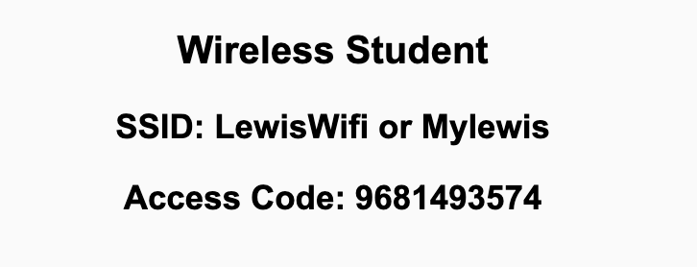
Preflight Check List
Sign into our Zoom meeting through our integrated Blackboard/Zoom link
Make sure that you can hear the conversation, see shared desktops, and view chat topics
Thank you if you choose to leave your camera on to help make our class more interactive
Be prepared to share your computer screen
Be prepared to utilize a headset with a microphone
In person participants also:
Make sure that your microphone and speakers are muted/off so that we don’t get an echo
Sit in a good spot near the classroom ceiling microphones if possible

Slide 2
Recordings
Discuss that recording are:
Opportunistic
Automatically available in Blackboard/Zoom
Sound Check… plus Video, and Desktop Sharing check
Start Recording

Slide 3
Agenda:
Prework and Announcements
Sprint 8 Planning
Scrum Team Planning Review
Prework for Next Class
Discussion & Questions welcome at any time but please be present with no phones or email during our time together

Slide 4
Prework
Everything is Due Sunday!
Be prepared for sprint 8 planning on Monday

Slide 5
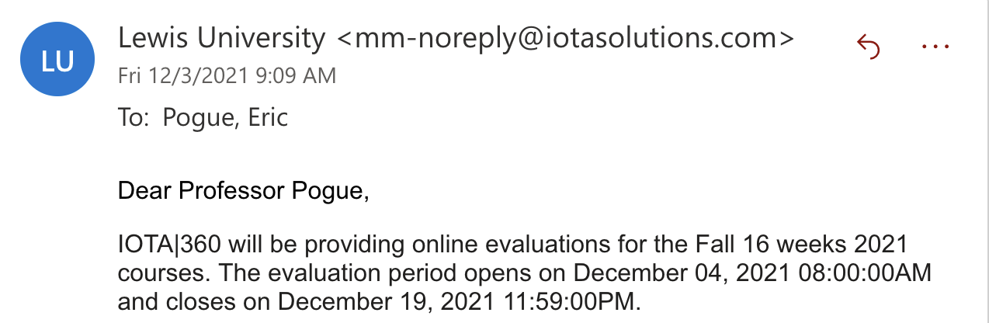
Announcements

Slide 6
Sprint Planning

Slide 7
Sprint 8 Changes
Normal class schedule this week with:
Sprint 8 planning Monday
Sprint 7 Demos, Retrospective, and Chapter discussion on Wednesday
Quiz 8 and Lab on Friday
Final Exams start next week with no regular classes
We will be presenting our Final Project during our scheduled Final Exam time

Slide 8
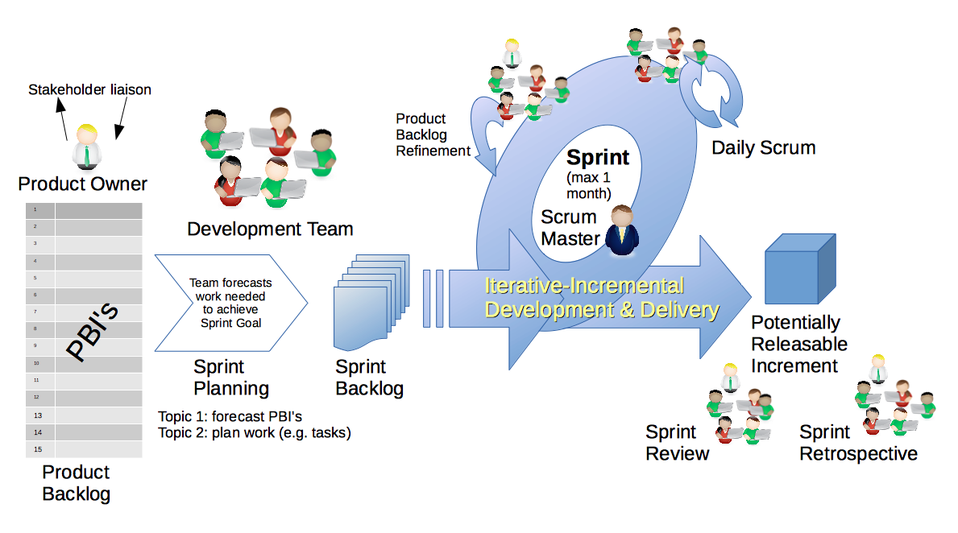
Scrum Process – Sprint Planning
By Dr ian mitchell - Own work, CC BY-SA 4.0, Link

Slide 9
Review Activities List
and Assignments

Slide 10
Prework For Next Class
Complete through activity 5
Those scheduled to demo on Wednesday please be a couple of minutes early to class

Slide 11
Review Wednesday
Demo Schedule

Slide 12
Scrum Team Planning Review
As a scrum team:
Discuss changing scrum masters
Review sprint activities & assignments in detail
Discuss and document questions/concerns
Confirm Final Project presentation Date/Time
Report Out:
Who is the sprint 8 scrum master?
Questions/Concerns?
Confirm Final Project Review Date/Time

Slide 13
End of Session

