Slide 1

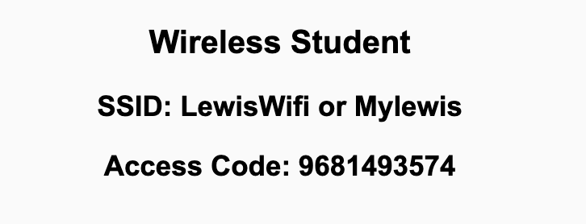
Preflight Check List
Sign into our Zoom meeting through our integrated Blackboard/Zoom link
Make sure that you can hear the conversation, see shared desktops, and view chat topics
Thank you if you choose to leave your camera on to help make our class more interactive
Be prepared to share your computer screen
Be prepared to utilize a headset with a microphone
In person participants also:
Make sure that your microphone and speakers are muted/off so that we don’t get an echo
Sit in a good spot near the classroom ceiling microphones if possible

Slide 2
Recordings
Discuss that recording are:
Opportunistic
Automatically available in Blackboard/Zoom
Sound Check… plus Video, and Desktop Sharing check
Start Recording

Slide 3
Agenda:
Prework & Announcements
Sprint 7 Review & Demos
Sprint 7 Retrospective
Scrum Team Sprint 7 Retrospective with Start, Stop, Continue
Prework for Next Class
Discussion & Questions welcome at any time but please be present with no phones or email during our time together

Slide 4
Prework For Next Class
Complete through activity 6
Each team should be prepared to demo “Best Story” and “Random Story”

Slide 5
Sprint Review & Demos

Slide 6
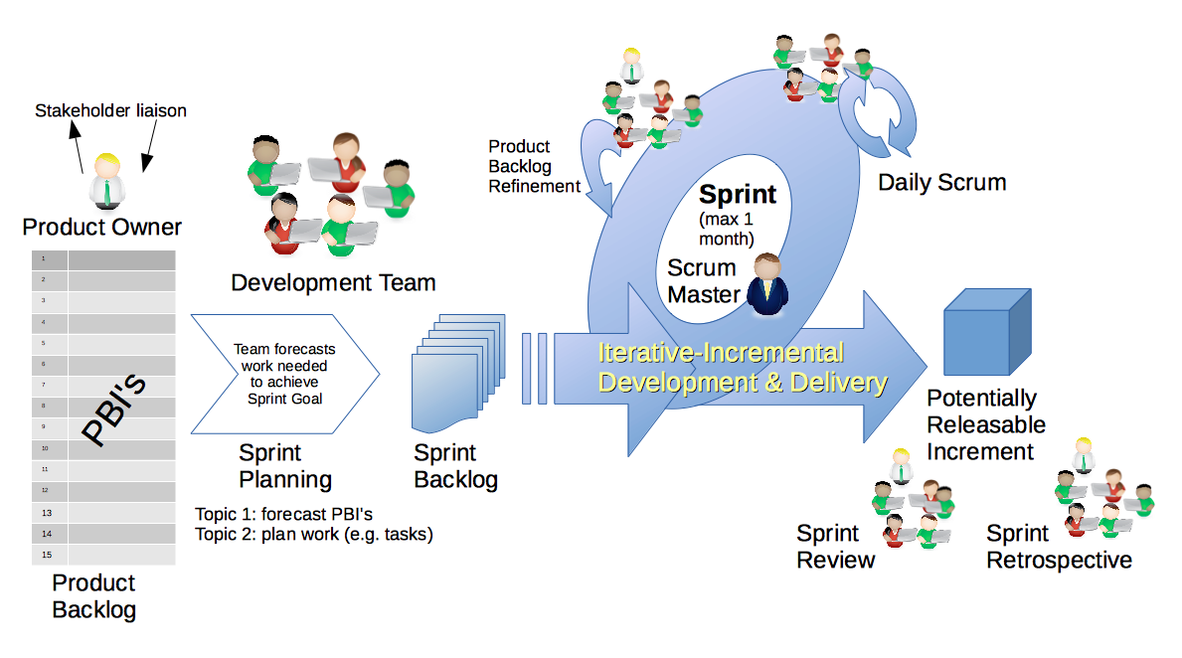
Scrum Process – Sprint Review & Demo
By Dr ian mitchell - Own work, CC BY-SA 4.0, Link

Slide 7

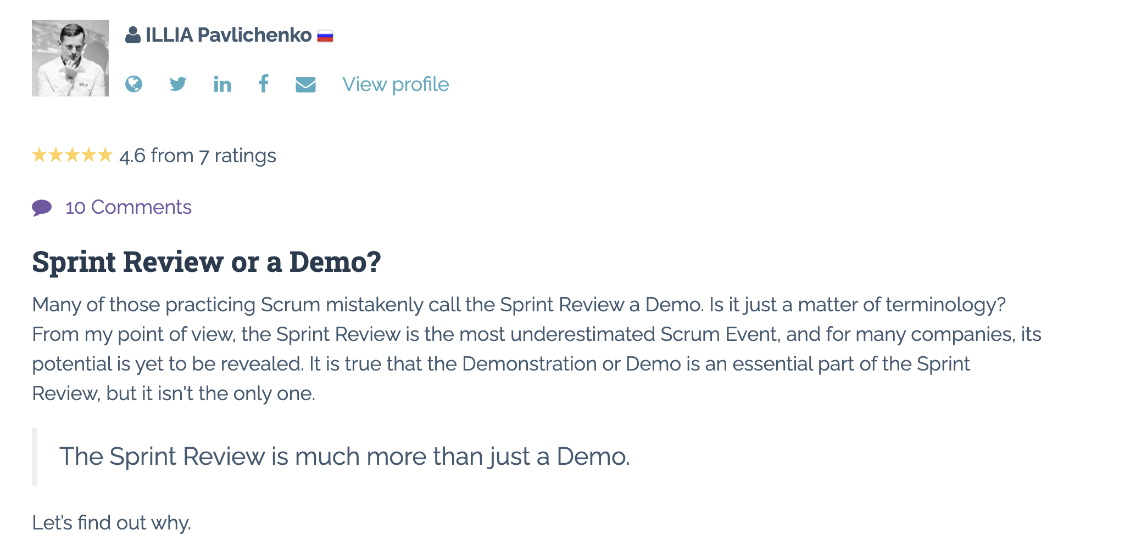
Sprint Review: Much More Than Just A Demo

Slide 8
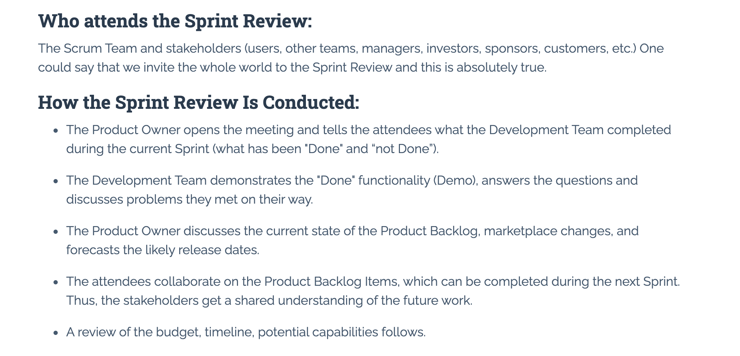
Sprint Review: Much More Than Just A Demo

Slide 9
Demos

Slide 10
Demo Guidelines – Presenter
Everyone will give at least one demo of their work during the semester.
Your demo should be 2 to 5 minutes and can include any or all of the following:
Show your application running
Comment on your implementation
Show the source code
Explain how you organized the code
Talk about any challenges
You should not prepare slides or a presentation
**You will also need to complete the Demo assignment in Blackboard.

Slide 11
Demo Guidelines – Listener
Everyone will be listening to many demos during the semester.
Your listener responsibilities include:
Actively listening and watching what is being demoed
Come up with a meaningful yet easy to answer question
Ask your question if the presenter does not get sufficient questions from other listeners
Do not ask hard question or attempt to review the presenters code
Clap for the presenter at the end of the demo and thank them for presenting
Optionally follow up with the presenter later if you have what could be more difficult questions or if you have suggestions

Slide 12
Sprint Demos – Team
Demo your stories and vote on the Best!

Slide 13
Sprint Demos - Class

Slide 14
Scrum Process – Sprint Retrospective
By Dr ian mitchell - Own work, CC BY-SA 4.0, Link

Slide 15
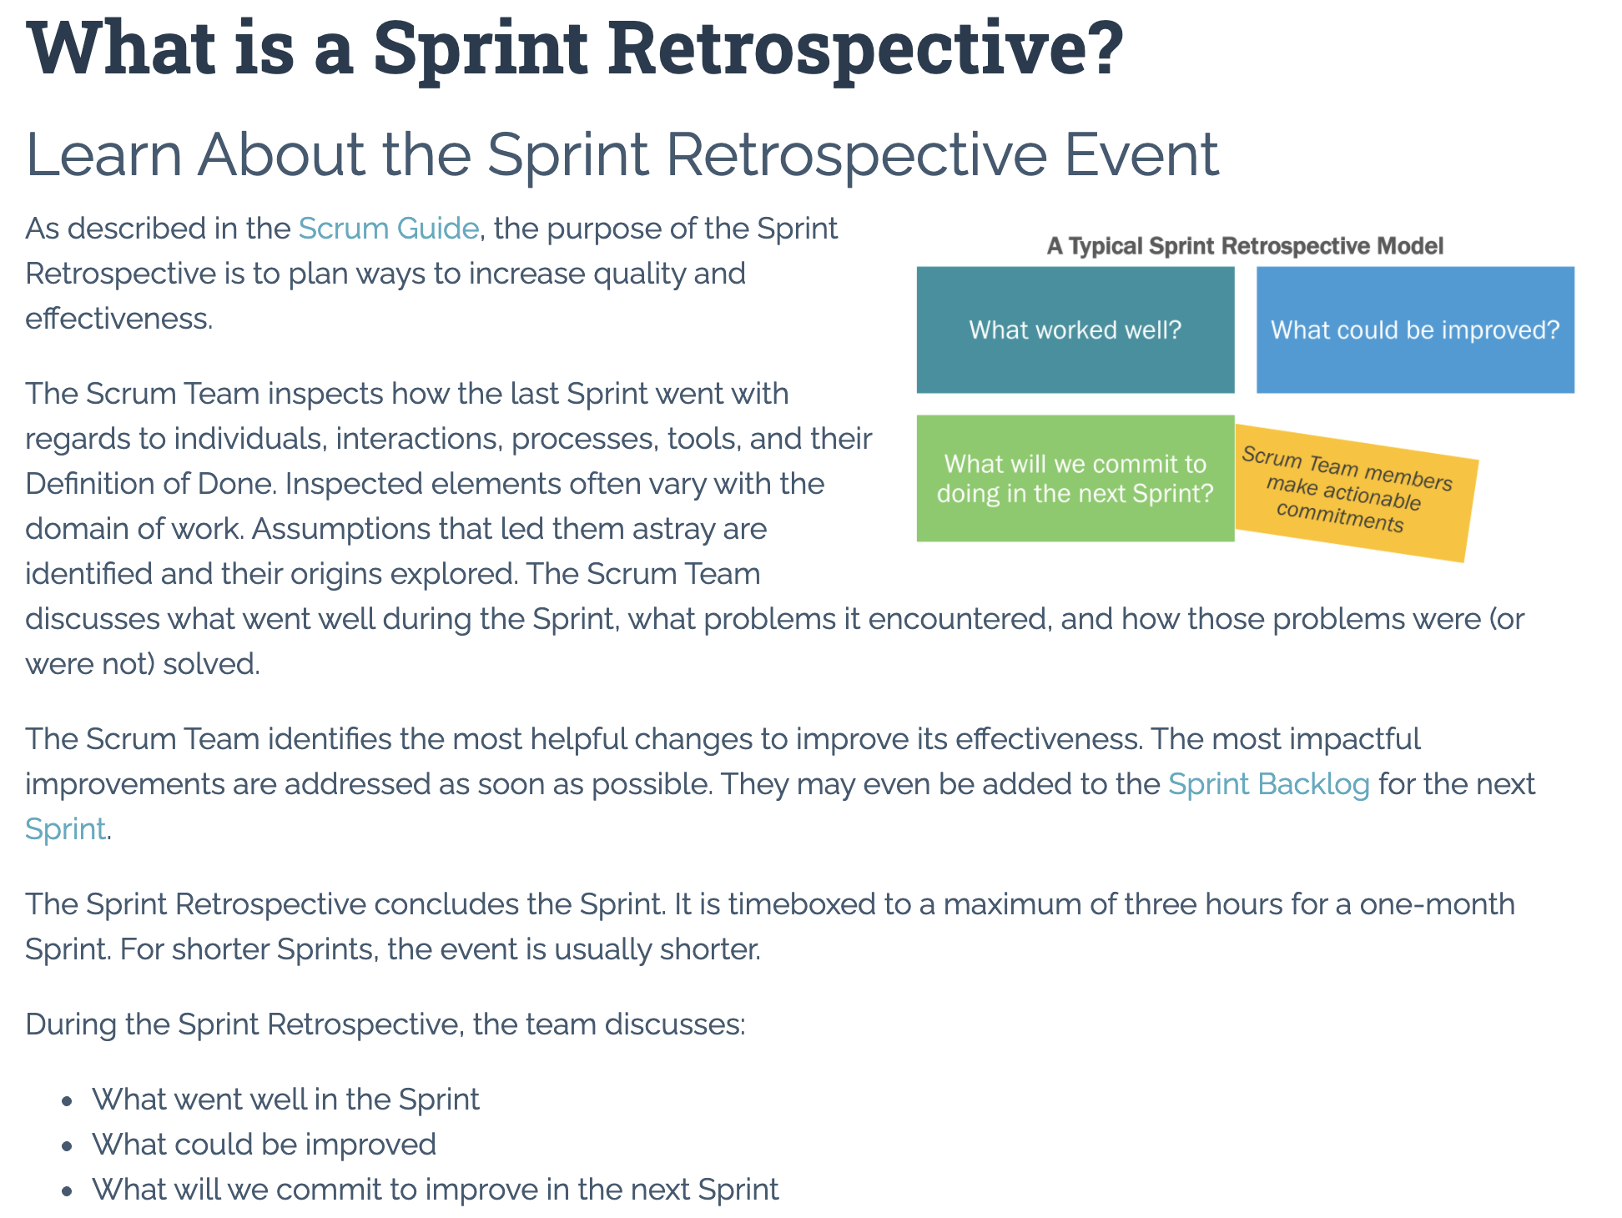

Slide 16
Metrics – Submission Percentage

Slide 17
Class Retrospective
Feedback from Assignments & Reflections:
And there we have it PERFECTION… and Food?!?!?
Great job taking time for yourself and for you families over Thanksgiving!
All assignments are graded and posted
Lot’s of good teaming going on!

Slide 18
Class Retrospective Breakout
Start, Stop, Continue for the class:
Continue: What is something specific that is working? Something that we should make sure that we continue to do.
Start: What is something specific that would be nice to do that we are not doing now? Maybe something that you have seen work well for others.
Stop: What is not working or not adding value? Something to stop doing.
Report out questions (Scrum Master):
What are two or three start, stop, continue items that you would be willing to share?
Are there ways I could better reward participate in class and on scrum teams?
What if we finished all sprints on Thursdays instead of Sundays? Or another day of the week?

Slide 19
Thank you!

Slide 20
Review Schedule

Slide 21
Prework For Next Class
Be ready for Quiz 8 on Friday

Slide 22
End of Session

