Slide 1

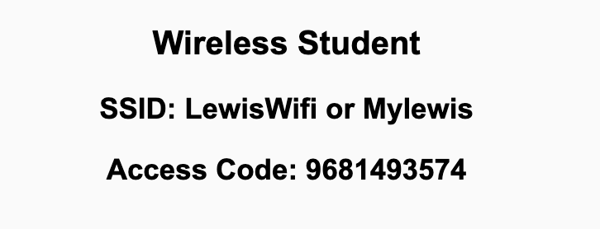
Preflight Checklist
Sign into our Zoom meeting through our integrated Blackboard/Zoom link
Make sure that you can hear the conversation, see shared desktops, and view chat topics
Thank you if you choose to leave your camera on to help make our class more interactive
Be prepared to share your computer screen
Be prepared to utilize a headset with a microphone
In person participants also:
Make sure that your microphone and speakers are muted/off so that we don’t get an echo
Sit in a good spot near the classroom ceiling microphones if possible

Slide 2
Preflight Checklist (continued)
Load Polling
Set Camera, Microphone, and Speakers
Share Desktop
… review that recordings are opportunistic and automatically available in Blackboard/Zoom
Start Recording
Start Recording

Slide 3
Agenda:
Prework and Announcements
Sprint Progress Polling
Sprint 1 Planning (continued)
Prework for Next Class
Team Adjustments? … Goal: 5 teams with at most 5 members each and only 1 remote team.
Breakout: Scrum Team Review, Discord Setup, and Planning Review
Discussion & Questions welcome at any time but please be present with no phones or email during our time together

Slide 4
Prework
Prior to our next class please:
Complete through activity 9 prior to next class
Get your headset with microphone for teaming and programming together activities
Be ready to test your scrum team discussion capabilities with your team Discord server*
Be prepared for your first Scrum Team chapter review which will be on Fox chapter 1 which may require you to use you Discord server to communicate
* You may choose a different communication tool if the team agrees.

Slide 5
Polling – Sprint Progress

Slide 6
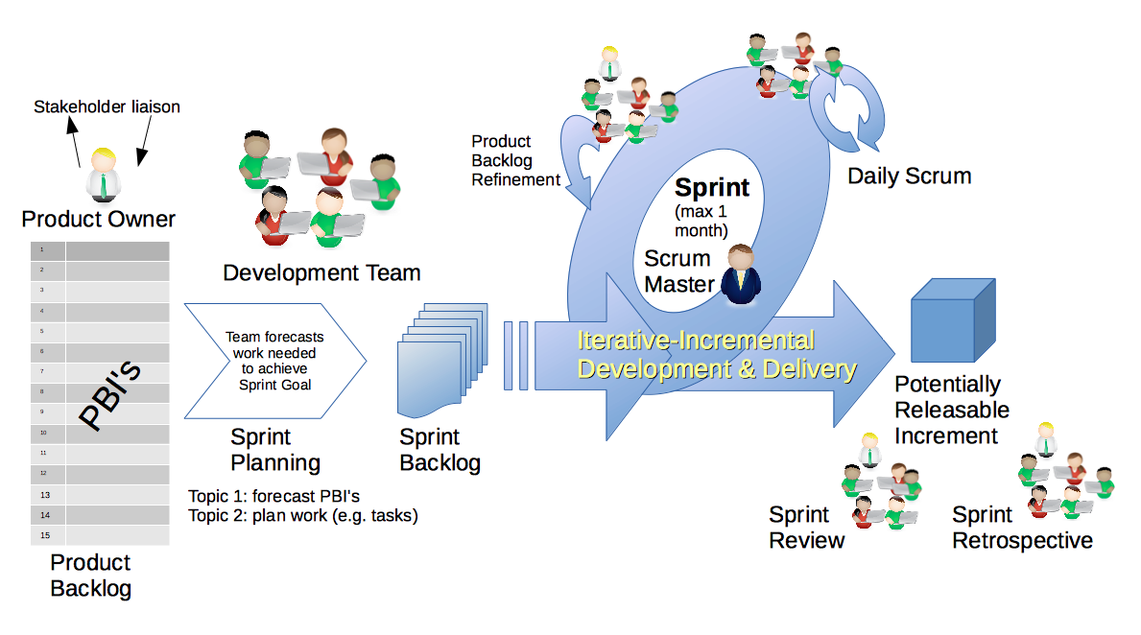
Scrum Process – Sprint Planning
By Dr ian mitchell - Own work, CC BY-SA 4.0, Link

Slide 7
Review Activities List,
Assignments, and Syllabus

Slide 8
Prework For Next Class
Prior to our next class please:
Complete through activity 12 prior to next class
Be prepared for your first Scrum Team chapter review which will be on Fox chapter 2
Be prepared for Quiz 1

Slide 9
Team Adjustments?
Goal: 5 teams with at most 5 members each and only 1 remote team.

Slide 10
Scrum Team Fox Preface & Chapter 1 Discussion
Scrum Master accepts volunteers for (or assigns) Presenter
Team discusses and presenter summarizes the topics below:
Preface
Software Development Processes
Virtuous Triangle
Which Element of the Virtuous Triangle is most important and why?
Which Edge of the triangle is most important and why?
SOA vs. SaaS plus Validation vs. Verification
Hosting costs over time? And how important is it to be able to effectively enhance Legacy Code? Why?
Team sits back, relaxes, and acknowledges the bravery and dedication of the presenter
Team returns to class Zoom session where presenter presents summary

Slide 11
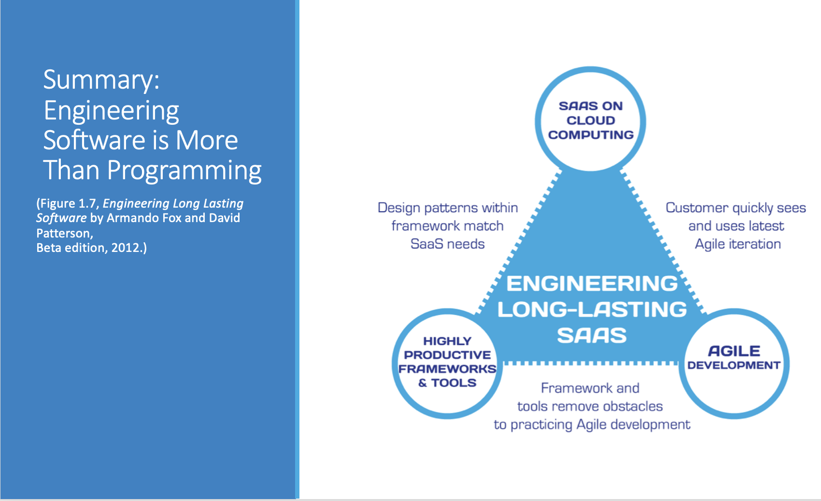
Summary: Engineering Software is More Than Programming
(Figure 1.7, Engineering Long Lasting Software by Armando Fox and David Patterson, Beta edition, 2012.)

Slide 12
History of Website Infrastructure Cost/Time
Year | Acquisition Cost | Annual Cost | Time to Production | Reference
1995 | $500,000 | $100,000 | 6 months | Parsons Technology
2000 | $250,000 | $50,000 | 3 months | John Deere
2005 | $10,000 | $2,000 | 1 week
2010 | $1,000 | $200 | < 1 week | GoDaddy (personal)
2015 | $100 | $20 | < 1 day | GoDaddy (personal)
2018 | ~$0 | ~$0 | < 5 min | Azure (personal)

Slide 13
Development Process Terminology
The industry has focused on slightly updated terminology and categorization to describe Software Development Processes including:
Development Process is often referred to as Software Development Lifecycle (SDLC)
Plan-and-Document and Agile is generally spit into:
Waterfall
Iterative (which includes the Rational Unified Process and Spiral)
Agile
Agile has become so broad that it is generally clarified into subcategories including:
Scrum
XP (formerly Extreme Programming)
Kanban
Test-Driven Development, etc.
Notes:
Agile Team are intended to be co-located… it is hard for team members to work remotely. Easier for full teams to be co-located and have teams separate geographically.

Slide 14
Highly Effective Frameworks
Ruby on Rails, Angular, React,
Spring, Flask, etc., etc., etc

Slide 15
End of Session

