Slide 1

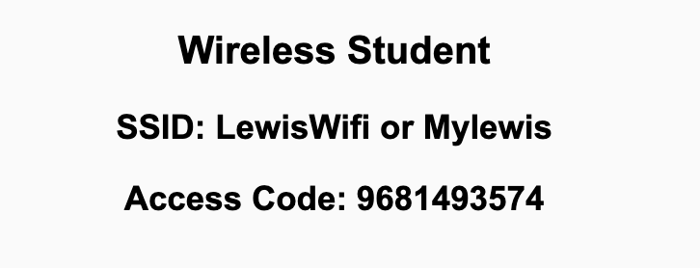
Preflight Checklist
Sign into our Zoom meeting through our integrated Blackboard/Zoom link
Make sure that you can hear the conversation, see shared desktops, and view chat topics
Thank you if you choose to leave your camera on to help make our class more interactive
Be prepared to share your computer screen
Be prepared to utilize a headset with a microphone
In person participants also:
Make sure that your microphone and speakers are muted/off so that we don’t get an echo
Sit in a good spot near the classroom ceiling microphones if possible

Slide 2
Preflight Checklist (continued)
Load Polling
Set Camera, Microphone, and Speakers
Share Desktop
… review that recordings are opportunistic and automatically available in Blackboard/Zoom
Start Recording
Start Recording

Slide 3
Agenda:
Prework for Today
Sprint Progress Polling
Recap Chapter 1 “Introduction to SaaS and Agile Development”
Breakout Session: Chapter 2 “Software as a Service” Architecture and Tools
Prework for Next Class
Quiz 1
Discussion & Questions welcome at any time but please be present with no phones or email during our time together

Slide 4
Prework for Today
Prior to our next class please:
Complete through activity 12 prior to next class
Be prepared for your first Scrum Team chapter review which will be on Fox chapter 2
Be prepared for Quiz 1

Slide 5
Polling – Sprint Progress

Slide 6
Recap Chapter 1
“Introduction to SaaS and Agile Development”
… and the Virtuous Triangle

Slide 7
Scrum Team Fox Preface & Chapter 1 Discussion
Scrum Master accepts volunteers for (or assigns) Presenter
Team discusses and presenter summarizes the topics below:
Preface
Software Development Processes
Virtuous Triangle
Which Element of the Virtuous Triangle is most important and why?
Which Edge of the triangle is most important and why?
SOA vs. SaaS plus Validation vs. Verification
Hosting costs over time? And how important is it to be able to effectively enhance Legacy Code? Why?
Team sits back, relaxes, and acknowledges the bravery and dedication of the presenter
Team returns to class Zoom session where presenter presents summary

Slide 8
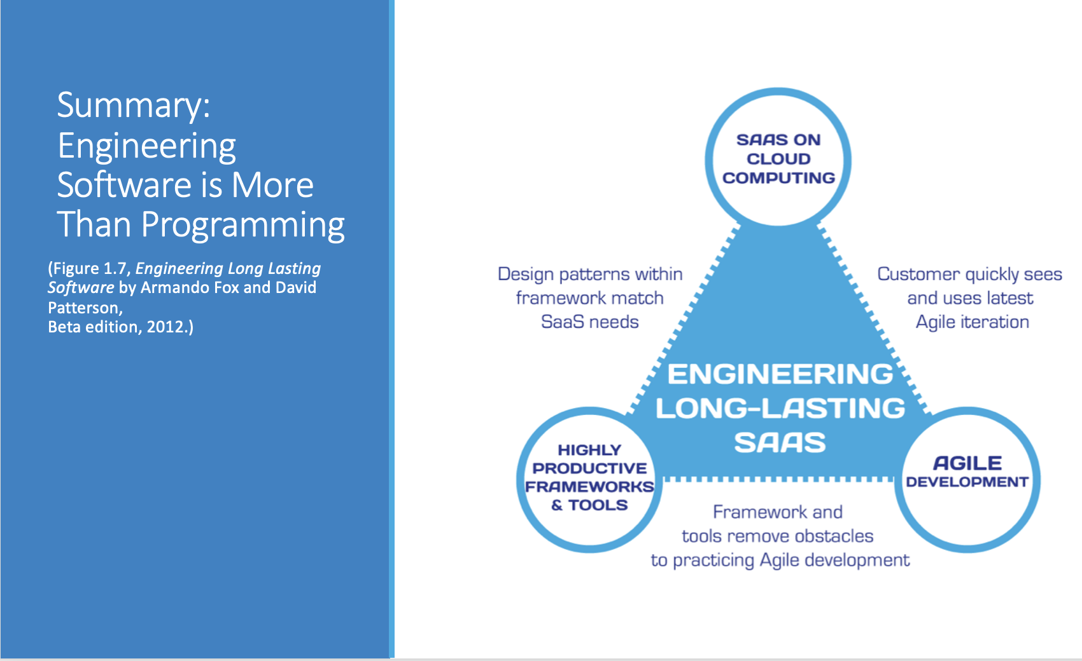
Summary: Engineering Software is More Than Programming
(Figure 1.7, Engineering Long Lasting Software by Armando Fox and David Patterson, Beta edition, 2012.)

Slide 9
History of Website Infrastructure Cost/Time
Year | Acquisition Cost | Annual Cost | Time to Production | Reference
1995 | $500,000 | $100,000 | 6 months | Parsons Technology
2000 | $250,000 | $50,000 | 3 months | John Deere
2005 | $10,000 | $2,000 | 1 week
2010 | $1,000 | $200 | < 1 week | GoDaddy (personal)
2015 | $100 | $20 | < 1 day | GoDaddy (personal)
2018 | ~$0 | ~$0 | < 5 min | Azure (personal)

Slide 10
Summary: Engineering Software is More Than Programming
(Figure 1.7, Engineering Long Lasting Software by Armando Fox and David Patterson, Beta edition, 2012.)

Slide 11
Development Process Terminology
The industry has focused on slightly updated terminology and categorization to describe Software Development Processes including:
Development Process is often referred to as Software Development Lifecycle (SDLC)
Plan-and-Document and Agile is generally spit into:
Waterfall
Iterative (which includes the Rational Unified Process and Spiral)
Agile
Agile has become so broad that it is generally clarified into subcategories including:
Scrum
Kanban
XP (formerly Extreme Programming)
Test-Driven Development, etc.
Notes:
Agile Team are intended to be co-located… it is hard for team members to work remotely. Easier for full teams to be co-located and have teams separate geographically.

Slide 12
Summary: Engineering Software is More Than Programming
(Figure 1.7, Engineering Long Lasting Software by Armando Fox and David Patterson, Beta edition, 2012.)

Slide 13
Highly Effective Frameworks
Ruby on Rails
Angular
React
Spring
Flask
Node and Express
MongoDB
MEAN and MERN
etc., etc., etc.
Notes:
Agile Team are intended to be co-located… it is hard for team members to work remotely. Easier for full teams to be co-located and have teams separate geographically.

Slide 14
Scrum Team Fox Chapter 2 plus Preface Discussion
Scrum Master accepts volunteers for (or assigns) Presenter
Team discusses and presenter summarizes the topics from Chapter 2 including:
SaaS Architecture
The Authors’ SaaS Architecture
Our SaaS Architecture
MERN
What SaaS development environments would historically considered Industrial Strength environments
What Saas development environments would be considered non-Industrial Strength
React, REST, and GraphQL
Team sits back, relaxes, and acknowledges the bravery and dedication of the presenter
Team returns to class Zoom session where presenter presents summary

Slide 15
Architecture and Tool Choices
There are many very good Language / Framework / Server options available including:
Ruby / Rails / Rack
JavaScript / Express / Node.js
Java / Spring / Tomcat
.NET / ASP.NET / IIS (Internet Information Services)
We will be focusing on JavaScript, Express, and Node.js
MongoDB (Atlas) will be the preferred persistence and database solution.
You may optionally include REACT static web sites with serverless functions as an alternative.

Slide 16
Cloud Hosting Choices
There are also many very good cloud hosting services available including:
Amazon AWS
Microsoft Azure
Google App Engine
cloud9
GoDaddy
We will be focusing on the Microsoft Azure… or optionally Google Firebase

Slide 17
Prework For Next Class
Complete through activity 15 prior to next class
Be prepared for working together on Lab 1

Slide 18
Quiz 1
A sincere attempt at quiz 1 is due
before you leave class today.

Slide 19
End of Session

