Slide 1

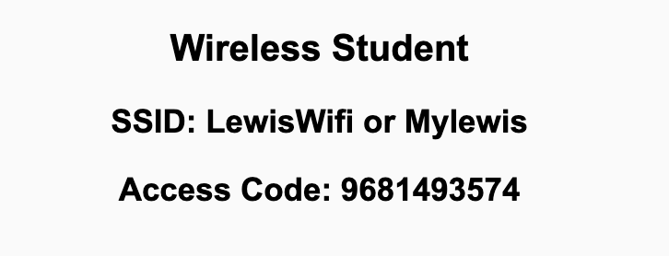
Preflight Checklist
Sign into our Zoom meeting through our integrated Blackboard/Zoom link
Make sure that you can hear the conversation, see shared desktops, and view chat topics
Thank you if you choose to leave your camera on to help make our class more interactive
Be prepared to share your computer screen
Be prepared to utilize a headset with a microphone
In person participants also:
Make sure that your microphone and speakers are muted/off so that we don’t get an echo
Sit in a good spot near the classroom ceiling microphones if possible

Slide 2
Preflight Checklist (continued)
Load Polling
Set Camera, Microphone, and Speakers
Share Desktop
… review that recordings are opportunistic and automatically available in Blackboard/Zoom
Start Recording
Start Recording

Slide 3
Agenda:
Prework and Announcements
Sprint Progress Polling
Breakout Discussion on Object-Oriented Programming Concepts & Practices (continued)
Prework for Next Class
Quiz 1
Discussion & Questions welcome at any time but please be present with no phones or email during our time together

Slide 4
Prework
No class Monday due to the Labor Day holiday. Have a great holiday!
Prior to our Wednesday class please:
Complete through activity 13 prior to next class
Be certain that you have completed “Object-Oriented Programming Concepts & Practices”
Be prepared for continued Breakout Discussion on OOP Concepts & Practices
Attempt to install Microsoft OpenJDK… preferably using a Pack Manger
Be prepared for Quiz 1
Reminder: Your initial Discussion 1 post was due Sunday.

Slide 5
Polling – Sprint Progress

Slide 6
Breakout Discussion (continued)
Object-Oriented Programming Concepts & Practices:
Assign presenter
Team discusses chapter topics while the presenter summarizes the topics below:
Classes and Objects
Properties (member variables) & Methods (member functions)
Encapsulation (information hiding)… Can it protect data from hackers?
Inheritance (abstraction)
Polymorphism
Composition & Aggregation
Team sits back, relaxes, and acknowledges the bravery and dedication of the presenter
Notes:
Object-Oriented Programming is the best way we know to reuse other people’s code.

Slide 7
Quiz Expectations
Quiz Expectations include:
You may use any naturally available documentation including books, notes, and web browser
You may not use quiz specific content like question banks
The quiz is an individual assignment so asking others would be inappropriate**
You are welcome to ask me questions
**General topic conversations are encouraged… plus in class “Phone a Friend” sessions are fine.

Slide 8
Quiz 1
“Phone a Friend”

Slide 9
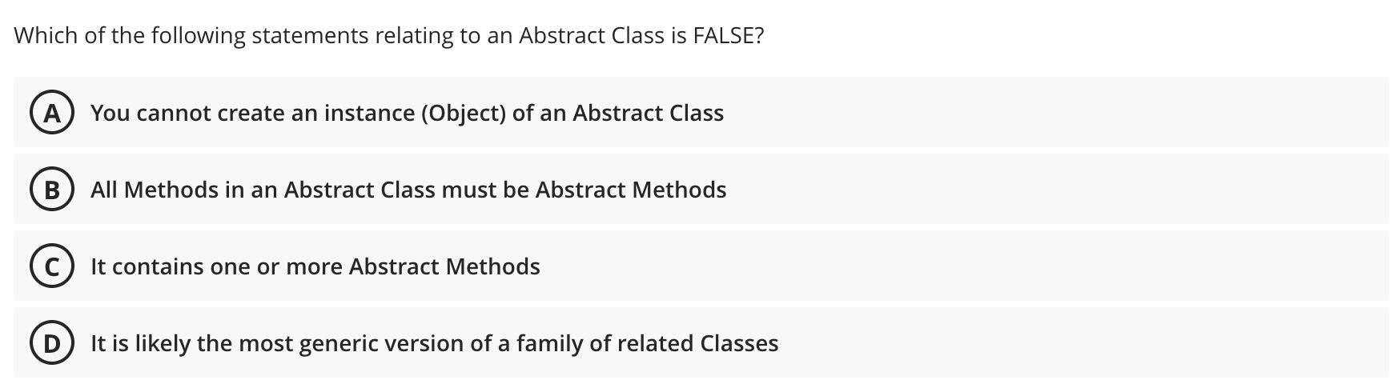

Slide 10
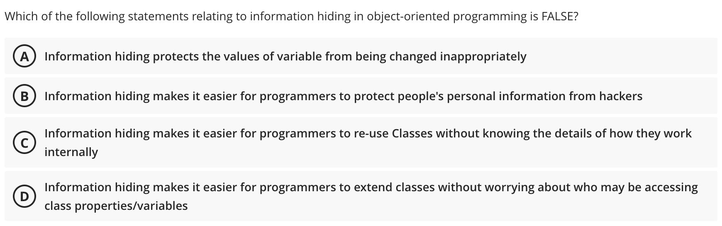

Slide 11
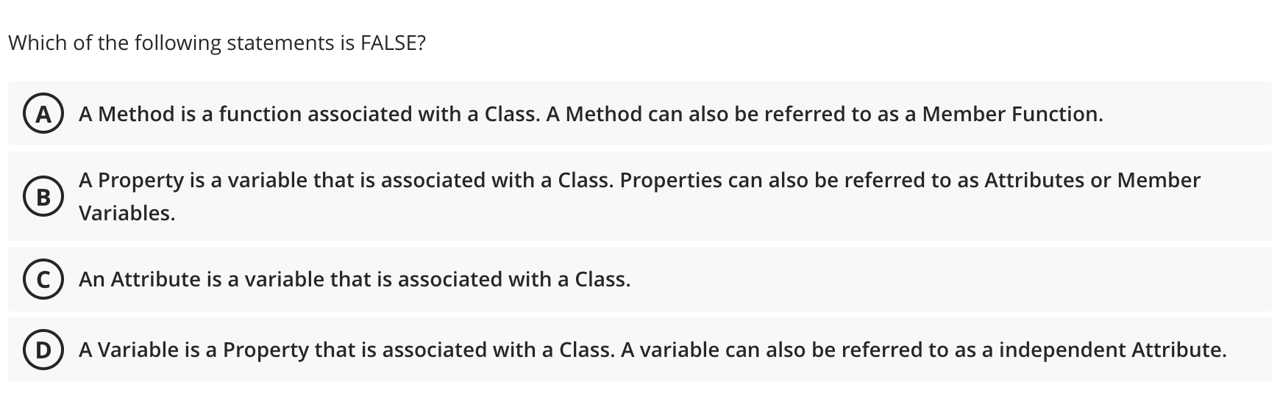

Slide 12
Prework For Next Class
Friday class is all virtual.
Prior to our class please:
Complete through activity 15 prior to next class
Be mostly complete with activity 16
Be prepared for working together on Lab 1 in class
Everything is due Sunday!

Slide 13
Quiz 1
A sincere attempt at quiz 1 is due
before you leave class today.

Slide 14
End of Session

