Slide 1

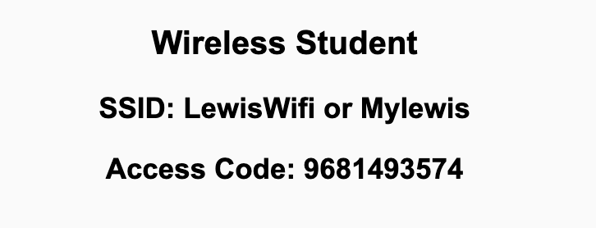
Preflight Checklist
Sign into our Zoom meeting through our integrated Blackboard/Zoom link
Make sure that you can hear the conversation, see shared desktops, and view chat topics
Thank you if you choose to leave your camera on to help make our class more interactive
Be prepared to share your computer screen
Be prepared to utilize a headset with a microphone
In person participants also:
Make sure that your microphone and speakers are muted/off so that we don’t get an echo
Sit in a good spot near the classroom ceiling microphones if possible

Slide 2
Preflight Checklist (continued)
Load Polling
Set Camera, Microphone, and Speakers
Share Desktop
… review that recordings are opportunistic and automatically available in Blackboard/Zoom
Start Recording
Start Recording

Slide 3
Agenda:
Prework and Announcements
Sprint 2 Planning
Prework for Next Class
Scrum Team Sprint 2 Planning Review
Review Demo Schedule for Wednesday
Discussion & Questions welcome at any time but please be present with no phones or email during our time together

Slide 4
Prework For Today
Everything is due Sunday!
Be prepared for Sprint 2 Planning Monday
Be prepared for Sprint 1 Demos, Sprint 1 Retrospective on Wednesday

Slide 5
Sprint Planning

Slide 6
Sprint Planning
Sprint 2 Changes:
Very similar to sprint 1 with sprint 2 including Discussion 2, Quiz 2, Lab 2, and Reflection 2
We will attempt our first Scrum Team Breakout Discussion on Friday
Should be a little easier since we don’t have a holiday during the sprint

Slide 7
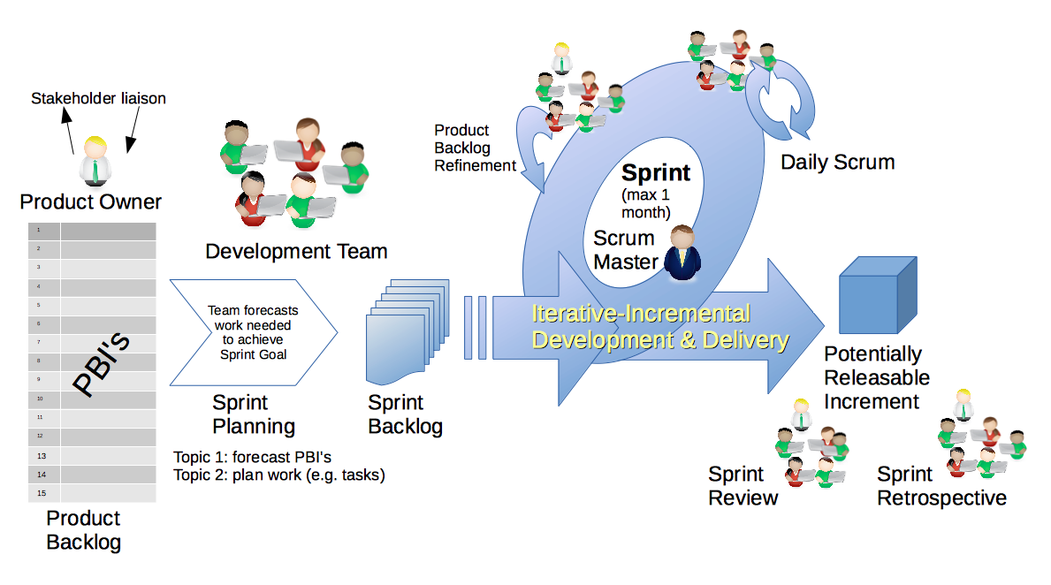
Scrum Process – Sprint Planning
By Dr ian mitchell - Own work, CC BY-SA 4.0, Link

Slide 8
Review Activities List and Assignments

Slide 9
Scrum Team Planning Review
As a scrum team:
Review sprint 2 activities & assignments in detail
Discuss and document questions/concerns
Scrum master share your team’s top 2 questions/concerns during report out

Slide 10
Prework For Next Class
Complete through activity 5 prior to next class
Those scheduled to demo on Wednesday please be a couple of minutes early to class

Slide 11
Review Demo Schedule

Slide 12
End of Session

