Slide 1

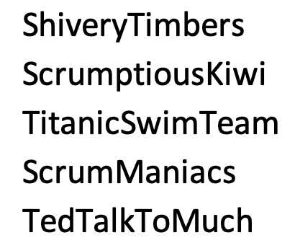
Agenda:
Special Guest: Dr. Howard, Chair of Engineering, Computing and Mathematical Sciences
Prework
The 10 best U.S. jobs according to Glassdoor (Feb 2 2022)
Sprint 3 Planning
Breakout Session for Sprint 3 Planning
Prework for Next Class
Review Demo Schedule for Wednesday
Discussion & Questions welcome at any time but please be present with no phones or email during our time together

Slide 2
Prework For Today
Everything is due Sunday!
Monday will be Sprint 3 planning
Wednesday will Sprint 2 demos and retrospectives

Slide 3


Slide 4
Sprint Planning

Slide 5
Sprint Planning
Sprint 3 Changes:
Very similar to sprint 2 with sprint 3 including Discussion 3, Quiz 3, Lab 3, and Reflection 3
We will continue to do our Scrum Team Breakout Discussion 3 on Friday
The two week sprint pattern should be getting routine

Slide 6
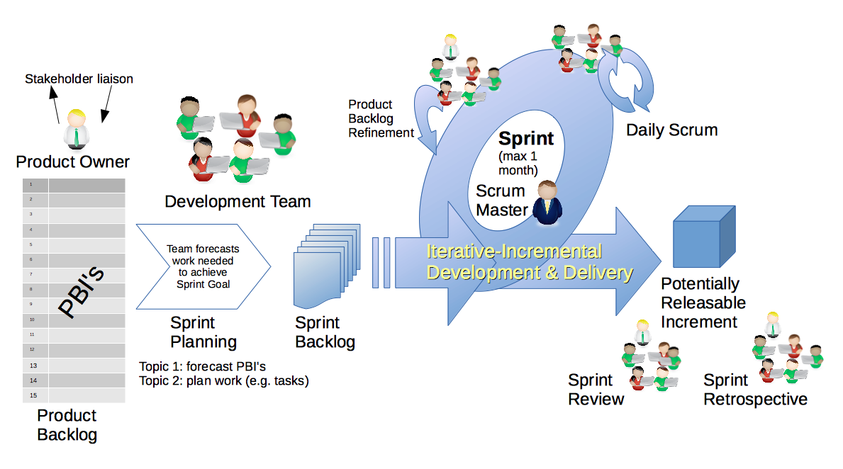
Scrum Process – Sprint Planning
By Dr ian mitchell - Own work, CC BY-SA 4.0, Link

Slide 7
Review Activities List and Assignments

Slide 8
Scrum Team Planning Review
As a scrum team:
Review sprint 3 activities & assignments in detail
Discuss and identify questions/concerns
Scrum master share your team’s top 2 questions/concerns during report out

Slide 9
Prework For Next Class
Complete through activity 5 prior to next class
Those scheduled to demo on Wednesday please be a couple of minutes early to class
Be ready to select a new Scrum Master

Slide 10
Review Demo Schedule

Slide 11
End of Session

