Slide 1

Agenda:
Prework for Today
Breakout: Requirements (Fox chapter 7)
Models, Processes (SDLCs), and Requirements
Prework for Next Class
Breakout: Discussion 3 on Node.js and Azure
Discussion & Questions welcome at any time but please be present with no phones or email during our time together

Slide 2
Prework For Next Class
Complete through activity 5 and start on activity 6 prior to next class
Be prepared for a chapter 7 Breakout
Be prepared for Discussion 3

Slide 3
Review Requirements (Fox chapter 7)
Assign presenter
Team discusses topics while the presenter summarizes the topics below:
Requirements, Behavior-Driven Design, Gemba, Use Cases, and User Stories
Points, velocity, SMART, and MVP
Story Points, Use Case Points, Function Points, and measuring productivity across teams
User Experience / User Interface Design, Interface Sketches, and Storyboards
Requirements Gathering Waterfall (Requirements) vs. Iterative (Use Cases) vs. Agile (Stories)
Team sits back, relaxes, and acknowledges the bravery and dedication of the presenter

Slide 4

Gemba
Genba (現場, also romanized as gemba) is a Japanese term meaning "the actual place". Japanese detectives call the crime scene genba, and Japanese TV reporters may refer to themselves as reporting from genba. In business, genba refers to the place where value is created; in manufacturing the genba is the factory floor. It can be any "site" such as a construction site, sales floor or where the service provider interacts directly with the customer.^{[1]}
In lean manufacturing, the idea of genba is that the problems are visible, and the best improvement ideas will come from going to the genba. The gemba walk, much like Management By Walking Around (MBWA), is an activity that takes management to the front lines to look for waste and opportunities to practice genba kaizen, or practical shop floor improvement.
In quality management, genba means the manufacturing floor and the idea is that if a problem occurs, the engineers must go there to understand the full impact of the problem, gathering data from all sources. Unlike focus groups and surveys, genba visits are not scripted or bound by what one wants to ask.
From Wikipedia, the free encyclopedia
Notes:
What is the term that Jeremy used for doing it in the place?

Slide 5
Models, Processes, and Requirements
Notes:
Critical Path… Light Weight long-term planning

Slide 6
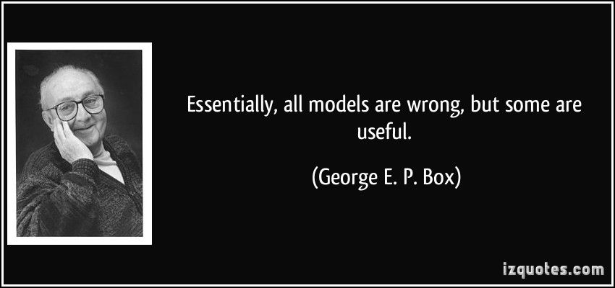
Models

Slide 7
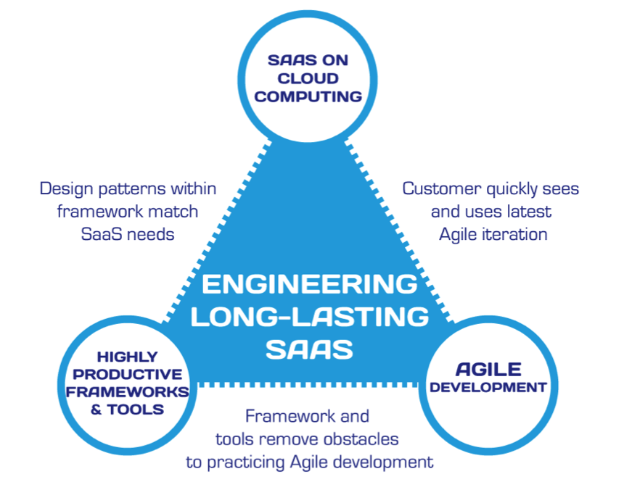
Hosting Technology: Cloud & Software as a Service (SaaS)…
People: Organizations, Domain Knowledge, Customers, Business Process…
The
Virtuous Triangle
Process: Agile, Requirements, Project Management, Prioritization, Portfolio Management, Metrics…
Productivity Technology: Configuration Management, Source Code Management, Automated Testing…

Slide 8
The Righteous Triangle of Software Development
People & Organizations
Technology & Tools
Process & Roles

Slide 9
Processes and Requirements
Notes:
Critical Path… Light Weight long-term planning

Slide 10
Waterfall vs Iterative vs Agile Requirements
 | Waterfall | Iterative | Agile
References | United States Department of Defense: DOD-STD-2167A (1985) | Rational Unified Process (RUP) Open Unified Process | Scrum Kanban Scaled Agile Framework (SAFe)
Priorities | Planning and predictability | Architecture, modeling, and efficiency through early detection & fixing of issues (verification) | Responsiveness to feedback, efficiency through engineering practices, early detection & fixing of issues, and validation
Principles | Execute phases sequentially: Requirements Analysis Design Coding Testing and Operations Define and commit to Scope, Cost, and Timeline “early” Implement strict Change Control | Manage requirements Develop and test iteratively Use components Model visually Verify quality Control changes | Capture lightweight near term requirements Allow requirements to evolve but maintain fixed timelines Develop, test, deploy, and release iteratively Empower teams Apply engineering practices and systems thinking Integrate early user feedback into remaining plan Maintain a collaborative approach between all stakeholders
Notes:
The views on testing and change management have changed dramatically as organizations have moved from Waterfall to Iterative to Agile development lifecycles.
Successful Agile (and Iterative) Development REQUIRES better application design, development techniques, and testing practices.
Testing and lack of defects are not the end goal. A higher quality more usable more cost-effective product is the goal.
Requirements:
Waterfall:
Full project requirements upfront
Inconsistent industry capture techniques
Tend to be verbose requirements with formal signoff
Change requests needed
Estimation bottom up detailed estimates sometimes function points
Iterative:
Mostly upfront

Slide 11
Requirements – Waterfall
When working in a Waterfall SDLC Requirements are generally:
Captured up front (before any design or development)
Documented in a variety of formats
Verbose
Estimated in detail using bottom-up estimating techniques (sometime Function Points)
Risk Analysis & Mitigation
Signed off on
Managed with change requests
Notes:
Grace period until Monday morning a 6am CT

Slide 12
Requirements – Iterative (RUP)
When working in an Iterative (RUP) SDLC Requirements are generally:
Captured primarily up front but updated during design
Documented in Use Cases
Moderately verbose
Estimated using Use Case points
Signed off on with an understanding that minor changes are likely
Managed with change requests
Notes:
Grace period until Monday morning a 6am CT

Slide 13
Recall Scaled Agile Framework is an Agile Model
Notes:
Critical Path… Light Weight long-term planning

Slide 14
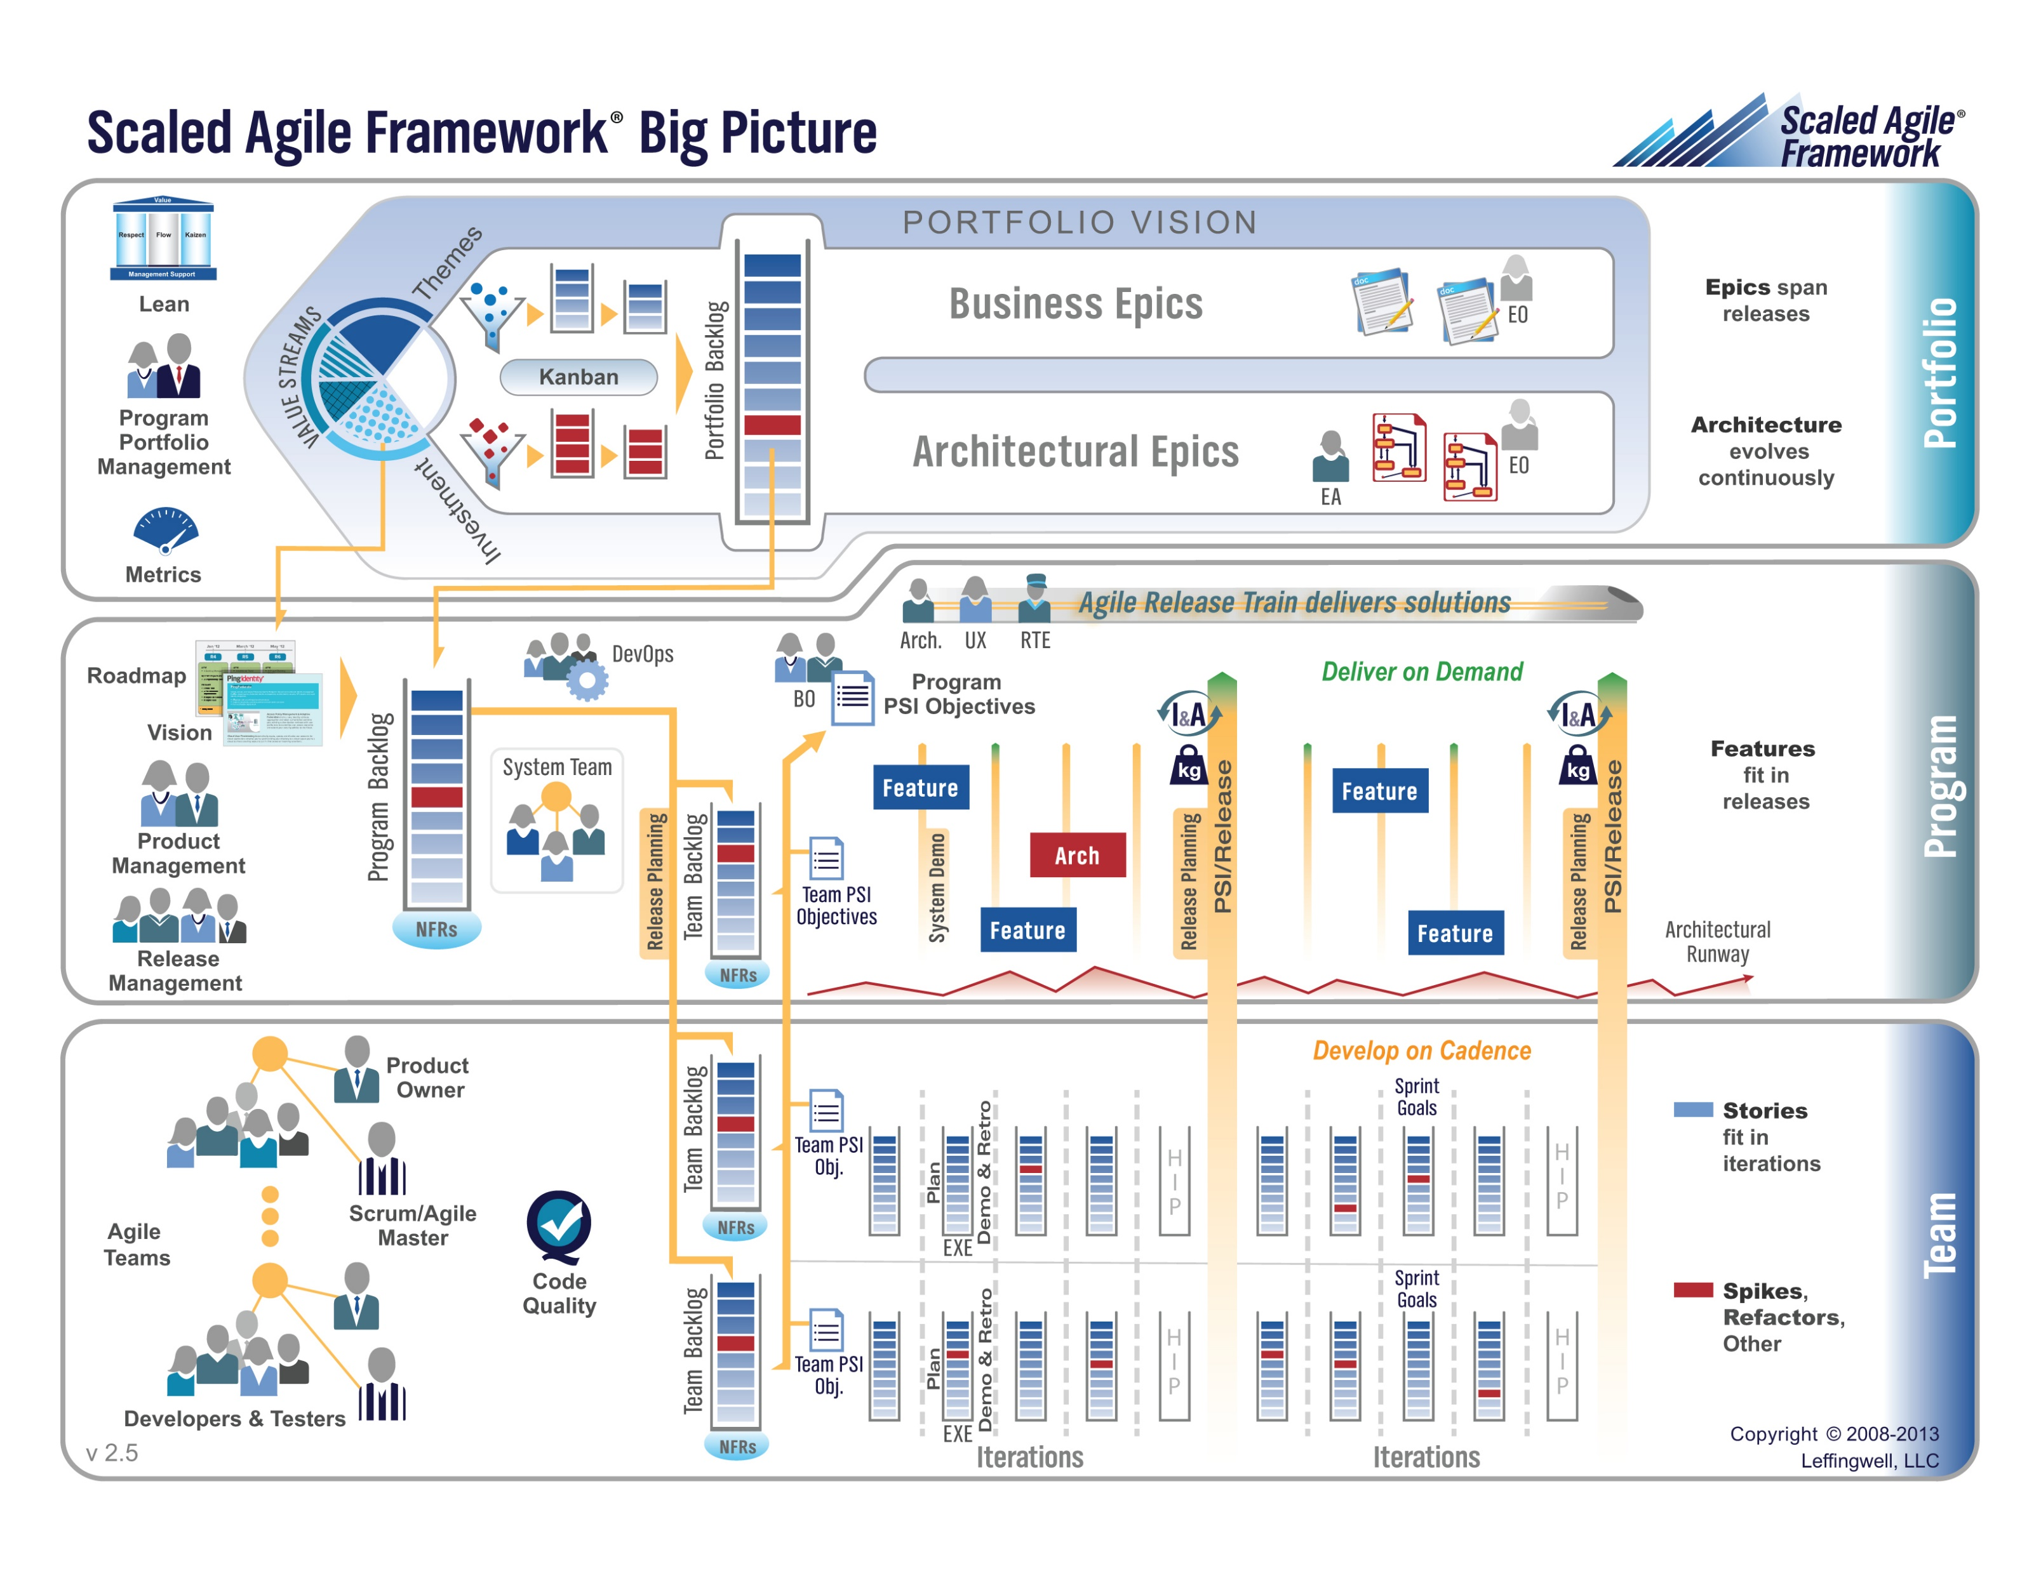

Slide 15
Requirements – Agile (Scrum)
When working in an Agile (Scrum) SDLC Requirements are generally:
Captured before each sprint
Documented using Stories (light weight)… always from a user perspective
In Scaled Agile Epics & Features are also used
Only detailed as needed
Estimated using Story Points (very light weight)
Immutable for current sprint
Change is encouraged for future sprints
Notes:
Final Topics:
SMART: Specific, Measurable, Achievable, Relevant, and Time-boxed
Be very careful attempting to measure productivity across teams
Story Points vs Use Case Points vs Function Points

Slide 16
Multi-Domain Integration & Complex Dependencies
Notes:
Critical Path… Light Weight long-term planning

Slide 17
Multi-Domain Examples
Most Agile system development is part of a larger initiative that includes multiple domains. Many of these larger initiatives are unable or unwilling to fully adopt Agile methodologies.
Examples include:
Implementing a new aircraft model
Building a new car factory
Updating a new car model or a new model of agricultural harvester
Executing portfolio management and annual budgeting within an organization
Migrating to a new purchased accounting system (buy vs build)
Agile initiatives need to be able to effectively integrate which often requires adopting some Plan & Document Project Management practices.

Slide 18
Complex Dependencies
Agile processes intentionally do not look for long term dependencies. There are times when intentionally managing and monitoring at least a subset of these dependencies is necessary.
Examples:
Implementing user preferences is dependent on securely creating a website in the Google cloud
Securely creating a web page in the Google cloud is dependent on custom authentication
Custom authentication is dependent on Microsoft Office user authentication
Microsoft Office authentication likely requires hosting a web service in Azure
Pure Agile may not allow us to understand that we need to start on item 4 four sprints before we expect to have item 1 implemented.

Slide 19
Prework for Next Class
Complete through activity 10 and started on 11
Be prepared for Quiz 3

Slide 20
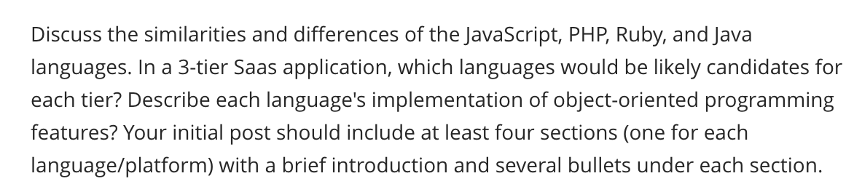
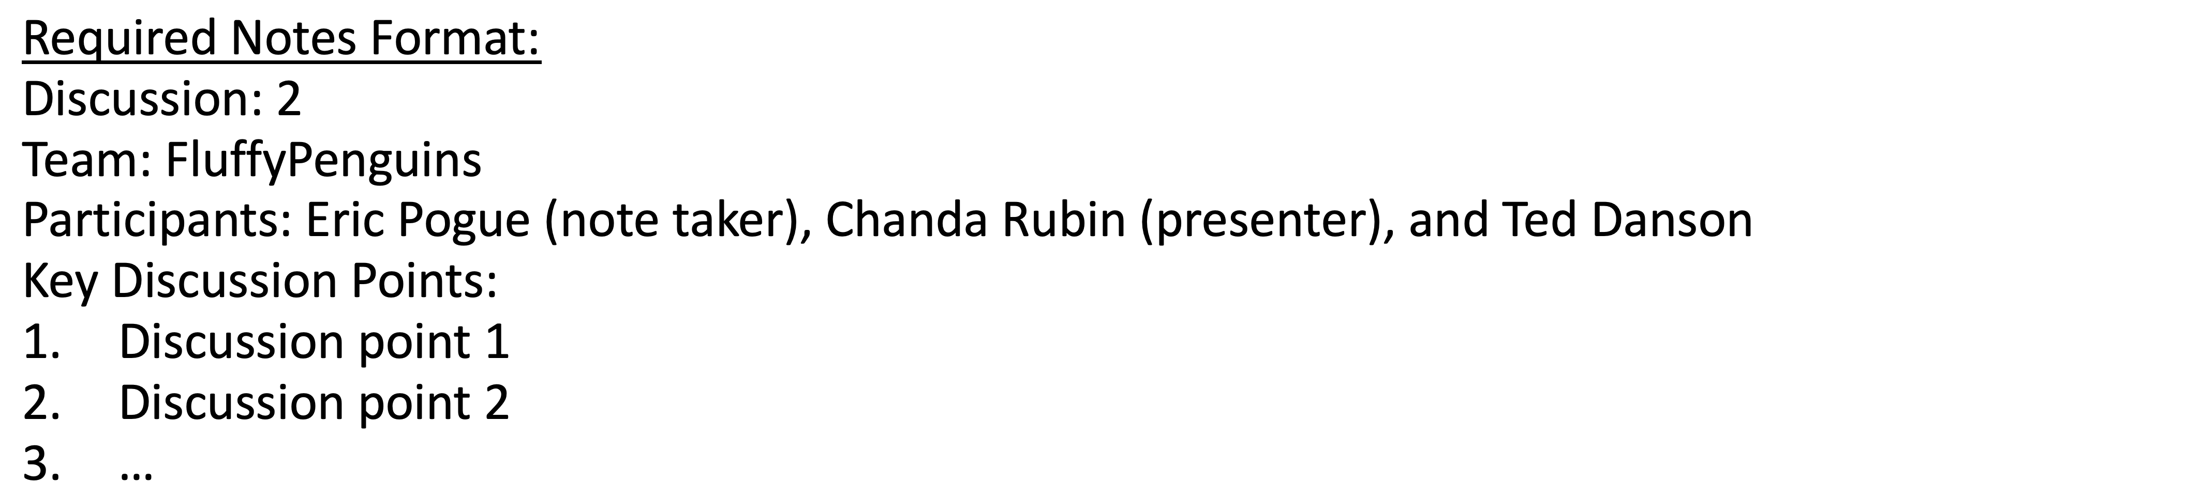
Scrum Team Discussion
Assign note taker and presenter roles to team members
Review and discuss topic
Note taker takes notes and presenter prepares a report out
Note taker share notes with all participating team members
Each team member pastes and submits an exact copy of the notes into their discussion board
Team sits back, relaxes, and tells the note taker and presenter what I wonderful job the did
Notes:
Seating chart and attendance tracker (virtual and in person)

Slide 21
End of Session

Slide 22
Gemba
Genba (現場, also romanized as gemba) is a Japanese term meaning "the actual place". Japanese detectives call the crime scene genba, and Japanese TV reporters may refer to themselves as reporting from genba. In business, genba refers to the place where value is created; in manufacturing the genba is the factory floor. It can be any "site" such as a construction site, sales floor or where the service provider interacts directly with the customer.^{[1]}
In lean manufacturing, the idea of genba is that the problems are visible, and the best improvement ideas will come from going to the genba. The gemba walk, much like Management By Walking Around (MBWA), is an activity that takes management to the front lines to look for waste and opportunities to practice genba kaizen, or practical shop floor improvement.
In quality management, genba means the manufacturing floor and the idea is that if a problem occurs, the engineers must go there to understand the full impact of the problem, gathering data from all sources. Unlike focus groups and surveys, genba visits are not scripted or bound by what one wants to ask.
From Wikipedia, the free encyclopedia
Notes:
What is the term that Jeremy used for doing it in the place?

Slide 23
Models, Processes, and Requirements
Notes:
Critical Path… Light Weight long-term planning

Slide 24
Models

Slide 25
Hosting Technology: Cloud & Software as a Service (SaaS)…
People: Organizations, Domain Knowledge, Customers, Business Process…
The
Virtuous Triangle
Process: Agile, Requirements, Project Management, Prioritization, Portfolio Management, Metrics…
Productivity Technology: Configuration Management, Source Code Management, Automated Testing…

Slide 26
The Righteous Triangle of Software Development
People & Organizations
Technology & Tools
Process & Roles

Slide 27
Processes and Requirements
Notes:
Critical Path… Light Weight long-term planning

Slide 28
Waterfall vs Iterative vs Agile Requirements
 | Waterfall | Iterative | Agile
References | United States Department of Defense: DOD-STD-2167A (1985) | Rational Unified Process (RUP) Open Unified Process | Scrum Kanban Scaled Agile Framework (SAFe)
Priorities | Planning and predictability | Architecture, modeling, and efficiency through early detection & fixing of issues (verification) | Responsiveness to feedback, efficiency through engineering practices, early detection & fixing of issues, and validation
Principles | Execute phases sequentially: Requirements Analysis Design Coding Testing and Operations Define and commit to Scope, Cost, and Timeline “early” Implement strict Change Control | Manage requirements Develop and test iteratively Use components Model visually Verify quality Control changes | Capture lightweight near term requirements Allow requirements to evolve but maintain fixed timelines Develop, test, deploy, and release iteratively Empower teams Apply engineering practices and systems thinking Integrate early user feedback into remaining plan Maintain a collaborative approach between all stakeholders
Notes:
The views on testing and change management have changed dramatically as organizations have moved from Waterfall to Iterative to Agile development lifecycles.
Successful Agile (and Iterative) Development REQUIRES better application design, development techniques, and testing practices.
Testing and lack of defects are not the end goal. A higher quality more usable more cost-effective product is the goal.
Requirements:
Waterfall:
Full project requirements upfront
Inconsistent industry capture techniques
Tend to be verbose requirements with formal signoff
Change requests needed
Estimation bottom up detailed estimates sometimes function points
Iterative:
Mostly upfront

Slide 29
Requirements – Waterfall
When working in a Waterfall SDLC Requirements are generally:
Captured up front (before any design or development)
Documented in a variety of formats
Verbose
Estimated in detail using bottom-up estimating techniques (sometime Function Points)
Risk Analysis & Mitigation
Signed off on
Managed with change requests
Notes:
Grace period until Monday morning a 6am CT

Slide 30
Requirements – Iterative (RUP)
When working in an Iterative (RUP) SDLC Requirements are generally:
Captured primarily up front but updated during design
Documented in Use Cases
Moderately verbose
Estimated using Use Case points
Signed off on with an understanding that minor changes are likely
Managed with change requests
Notes:
Grace period until Monday morning a 6am CT

Slide 31
Recall Scaled Agile Framework is an Agile Model
Notes:
Critical Path… Light Weight long-term planning

Slide 33
Requirements – Agile (Scrum)
When working in an Agile (Scrum) SDLC Requirements are generally:
Captured before each sprint
Documented using Stories (light weight)… always from a user perspective
In Scaled Agile Epics & Features are also used
Only detailed as needed
Estimated using Story Points (very light weight)
Immutable for current sprint
Change is encouraged for future sprints
Notes:
Final Topics:
SMART: Specific, Measurable, Achievable, Relevant, and Time-boxed
Be very careful attempting to measure productivity across teams
Story Points vs Use Case Points vs Function Points

Slide 34
Multi-Domain Integration & Complex Dependencies
Notes:
Critical Path… Light Weight long-term planning

Slide 35
Multi-Domain Examples
Most Agile system development is part of a larger initiative that includes multiple domains. Many of these larger initiatives are unable or unwilling to fully adopt Agile methodologies.
Examples include:
Implementing a new aircraft model
Building a new car factory
Updating a new car model or a new model of agricultural harvester
Executing portfolio management and annual budgeting within an organization
Migrating to a new purchased accounting system (buy vs build)
Agile initiatives need to be able to effectively integrate which often requires adopting some Plan & Document Project Management practices.

Slide 36
Complex Dependencies
Agile processes intentionally do not look for long term dependencies. There are times when intentionally managing and monitoring at least a subset of these dependencies is necessary.
Examples:
Implementing user preferences is dependent on securely creating a website in the Google cloud
Securely creating a web page in the Google cloud is dependent on custom authentication
Custom authentication is dependent on Microsoft Office user authentication
Microsoft Office authentication likely requires hosting a web service in Azure
Pure Agile may not allow us to understand that we need to start on item 4 four sprints before we expect to have item 1 implemented.

Slide 37
Lab
Azure Static Web Sites and Custom Domains

