Slide 1

Agenda:
Prework for Today
Sprint 2 Demos
Sprint 2 Retrospective
Prework for Next Class
Breakout Session: Sprint 2 Retrospective
Discussion & Questions welcome at any time but please be present with no phones or email during our time together

Slide 2
Prework For Next Class
Complete through activity 5 prior to next class
Those scheduled to demo on Wednesday please be a couple of minutes early to class
Be ready to select a new Scrum Master

Slide 3
Sprint Demos

Slide 4
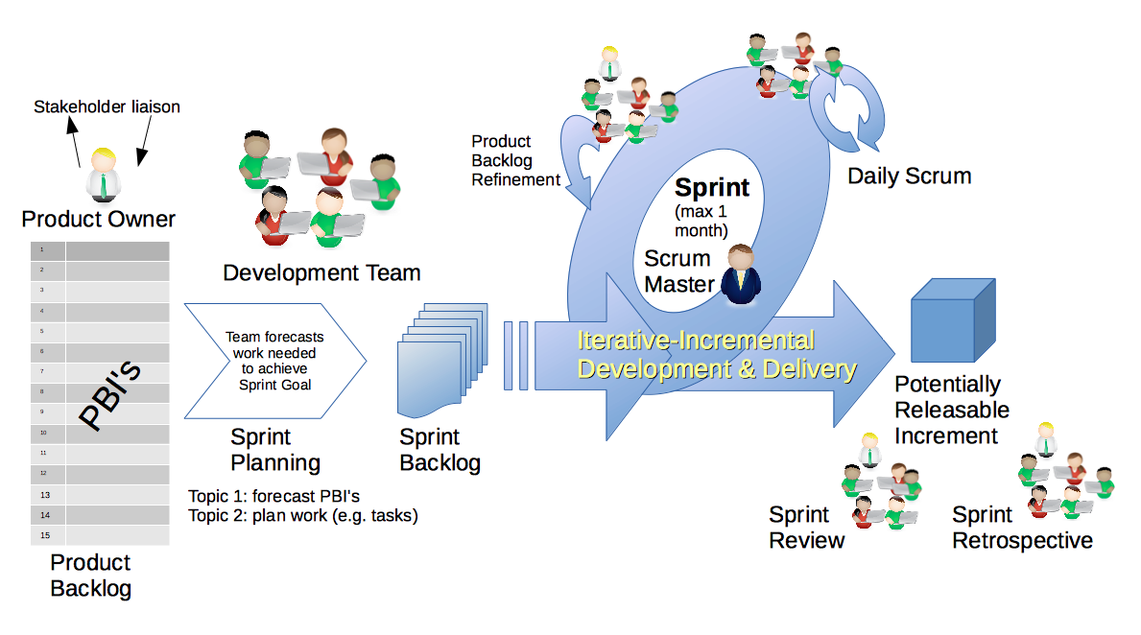
Scrum Process – Sprint Review & Demo
By Dr ian mitchell - Own work, CC BY-SA 4.0, Link

Slide 5
Demo Guidelines – Presenter
Everyone will give at least one demo of their work during the semester.
Your demo should be 2 to 5 minutes and can include any or all of the following:
Show your application running
Comment on your implementation
Show the source code
Explain how you organized the code
Talk about any challenges
You should not prepare slides or a presentation
**You will also need to complete the Demo assignment in Blackboard.

Slide 6
Demo Guidelines – Listener
Everyone will be listening to many demos during the semester.
Your listener responsibilities include:
Actively listening and watching what is being demoed
Come up with a meaningful yet easy to answer question
Ask your question if the presenter does not get sufficient questions from other listeners
Do not ask hard question or attempt to review the presenters code
Clap for the presenter at the end of the demo and thank them for presenting
Optionally follow up with the presenter later if you have what could be more difficult questions or if you have suggestions

Slide 7
Sprint Demos

Slide 8
Complete Sprint Demo Assignment

Slide 9
Scrum Process – Sprint Retrospective
By Dr ian mitchell - Own work, CC BY-SA 4.0, Link

Slide 10
Metrics (Rule #9)
“Anything that is measured and watched, improves.” – Bob Parsons

Slide 11
Submission Percentage

Slide 12
Class Retrospective
Feedback from Assignments & Reflections:
Very good submission percentage. Well done.
Assignments are graded and you should have access to grades and quiz answers
More nice comments about the helpfulness of scrum team members
Let’s make sure that we know how to use the HTML validator
Centering the picture was that most challenging
I agree that we need to look at creating README and LICENSE files
From a class perspective what can I/we do to improve in sprint 2?
What can we do to keep up the energy
Can we solve that LICENSE problem today?

Slide 13
Software Licensing
Primary software license types include:
Public Domain
Permissive including MIT and BSD
Copy Left including GPL and LGPL
Proprietary including all rights reserved
5 types of software licenses you need to understand [link]
What are you afraid of [link]

Slide 14
Software Licensing
How do we get a license in our project?

Slide 15
Prework & Announcements
Complete through activity 8 prior to next class
Be prepared for Breakout Session on The Information Layer
Be prepared for team Discussion 2

Slide 16
Breakout Session: Sprint 2 Retrospective
As a scrum team consider:
What license does your team prefer? Why?
How does your team feel about sprint 2 now that it is over?
What improvements should we make as a class, team, or individual in sprint 2?

Slide 17
End of Session

