Slide 1

Agenda:
Prework for Today
Treats
Easiest way to get a LICENSE and README.md
How much for a 1,000,000,000 (billion) Gates
Breakout Session: Gates and Circuits
Prework for Next Class
Discussion & Questions welcome at any time but please be present with no phones or email during our time together

Slide 2
Prework for Next Class
Complete through activity 11 prior to next class
Complete Azure Website Tutorial
Be prepared for Breakout Session: Gates and Circuits

Slide 3
Thanks again for your patience on Friday!

Slide 4


Thank You for Turning in Assignments!

Slide 5
Easiest way to get a LICENSE and README.md
GitHub:
New Repository with LICENSE and README.md
Clone Repository
Edit README.md
Add, Commit, Push

Slide 6
Gates & Circuits
How much would it cost to buy a billion gates?

Slide 7
Scrum Team Review of Gates & Circuits

Slide 8
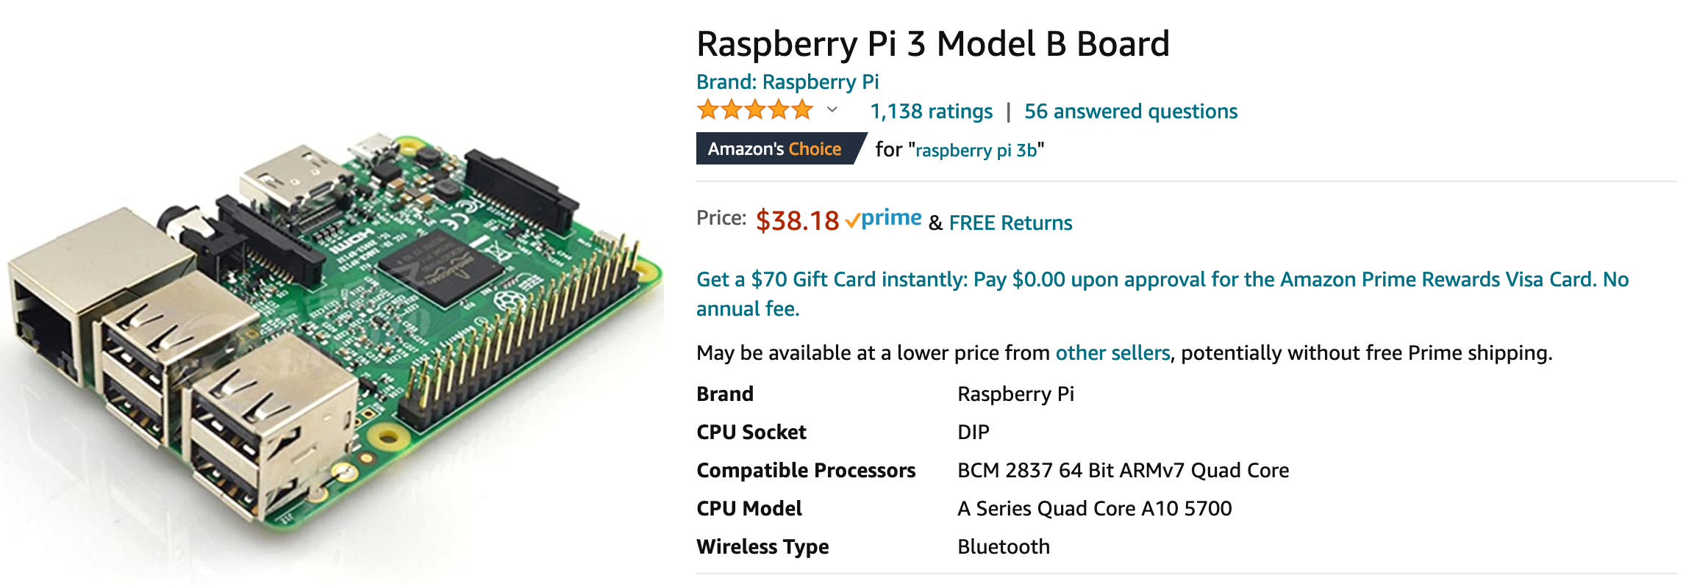
Gates & Circuits
How much would it cost to buy a billion gates?

Slide 9
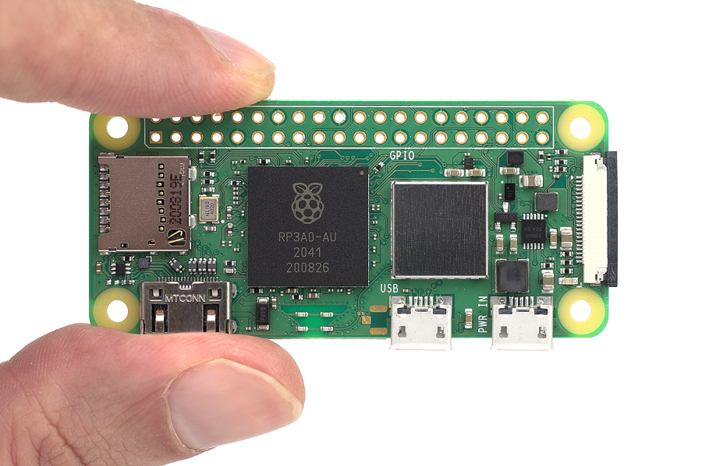
Gates & Circuits
How much would it cost to buy a billion gates?

Slide 10
End of Session

