Slide 1

Agenda:
Prework and Announcements
Breakout Discussion on Computer Languages, Popularity, and Language Focus
Prework for Next Class
Quiz 3
Discussion & Questions welcome at any time but please be present with no phones or email during our time together

Slide 2
Prework for Next Class
Complete through activity 8
Be prepared to discuss Computer Languages, Popularity, and Language Focus
Be prepared for Quiz 3

Slide 3
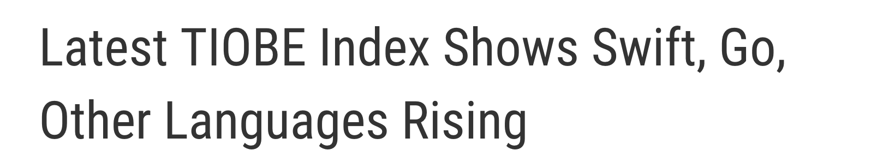

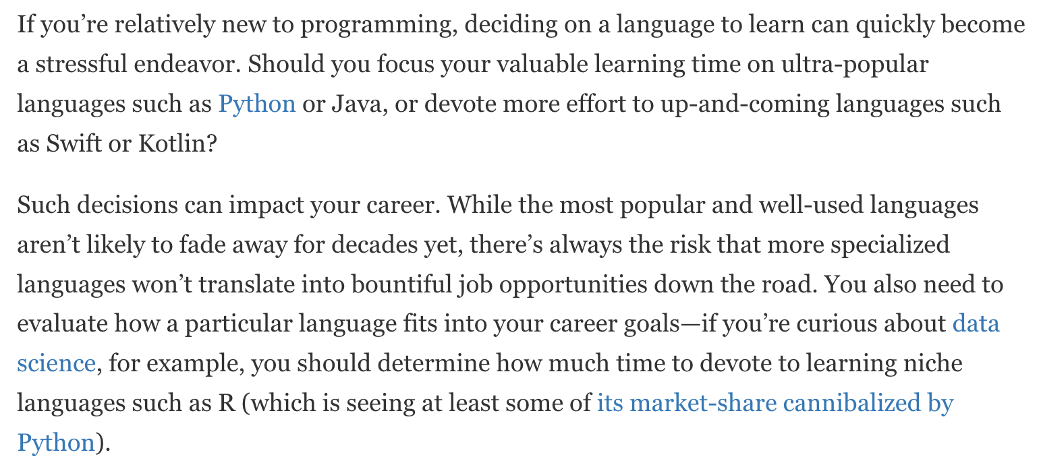

Slide 4
Computer Languages, Popularity, and Language Focus
Assign presenter
Team discusses topics while the presenter summarizes the most important topics including the representation of:
Pick two languages out of the current top 20
Explain current and trending popularity
What is the focus of the language
Compare and contrast the language’s Object-Oriented Programming-ness
On a scale of 1-5 rate you interest investing time to learning the language and explain why
Team sits back, relaxes, and acknowledges the bravery and dedication of the presenter

Slide 5
Quiz Expectations
Quiz Expectations include:
You may use any naturally available documentation including books, notes, and web browser
You may not use quiz specific content like question banks
The quiz is an individual assignment so asking others would be inappropriate**
You are welcome to ask me questions
**General topic conversations are encouraged… plus in class “Phone a Friend” sessions are fine.

Slide 6
Prework for Next Class
Complete through activity 9 and be actively working on 10
Be prepared for lab
Everything is due Sunday!

Slide 7
Quiz 3
A sincere attempt at quiz 3 is due
before you leave class today.

Slide 8
End of Session

