Slide 1

Agenda:
Prework for Today
Sprint 3 Demos
Sprint 3 Retrospective
Breakout Session: Sprint 3 Retrospective
Prework for Next Class
Discussion & Questions welcome at any time but please be present with no phones or email during our time together

Slide 2
Prework
Complete through activity 4 and start on activity 5 prior to next class
Those scheduled to demo on Wednesday please be a couple of minutes early to class

Slide 3
Sprint Demos

Slide 4
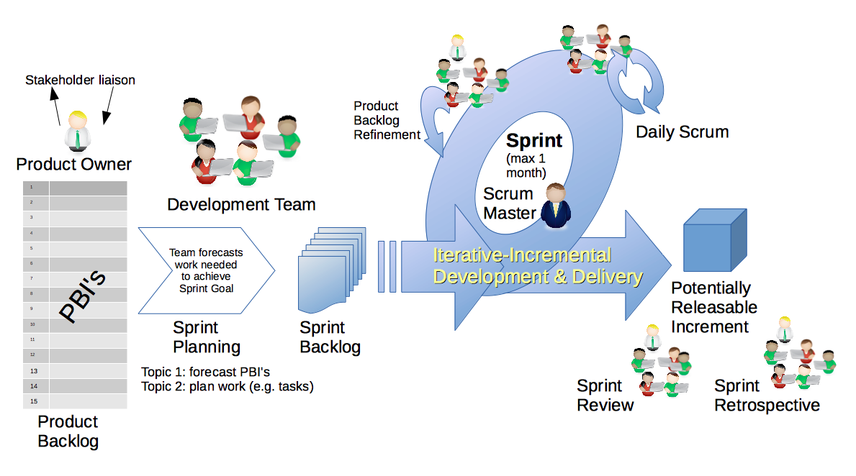
Scrum Process – Sprint Review & Demo
By Dr ian mitchell - Own work, CC BY-SA 4.0, Link

Slide 5
Demo Guidelines – Presenter
Everyone will give at least one demo of their work during the semester.
Your demo should be 2 to 5 minutes and can include any or all of the following:
Show your application running
Comment on your implementation
Show the source code
Explain how you organized the code
Talk about any challenges
You should not prepare slides or a presentation
**You will also need to complete the Demo assignment in Blackboard.

Slide 6
Demo Guidelines – Listener
Everyone will be listening to many demos during the semester.
Your listener responsibilities include:
Actively listening and watching what is being demoed
Come up with a meaningful yet easy to answer question
Ask your question if the presenter does not get sufficient questions from other listeners
Do not ask hard question or attempt to review the presenters code
Clap for the presenter at the end of the demo and thank them for presenting
Optionally follow up with the presenter later if you have what could be more difficult questions or if you have suggestions

Slide 7
Sprint Demos

Slide 8
Complete Sprint Demo Assignment

Slide 9
Scrum Process – Sprint Retrospective
By Dr ian mitchell - Own work, CC BY-SA 4.0, Link

Slide 10
Submission Percentage

Slide 11
Class Retrospective
Feedback from Assignments & Reflections:
Excellent submission percentage. Very well done.
Assignments are graded and you should have access to grades and quiz answers
Wow! Very nice job getting your sites hosted on Azure!
Interesting observation about web applications… what happens if your Azure hosted web application “late”?
Please do NOT paste large volumes of text in your Reflection… it seems to lock up Blackboard making it very difficult for me to grade Reflections

Slide 12
Class Retrospective
What can I/we do to improve in sprint 4?
Stay focused and stay optimistic
Keep up the energy

Slide 13
Breakout Session: Sprint 3 Retrospective
As a scrum team consider:
How does your team feel about sprint 3 now that it is over?
What could could be done for future classes to make sprint 3 more manageable?
What improvements should we make as a class, team, or individual in sprint 4?

Slide 14
Prework for Next Class
Complete through activity 7 prior to next class
Be prepared for team Discussion 4
Be prepared for Lab

Slide 15
Agenda:
Prework
Sprint 4 Planning
Breakout Session for Sprint 4 Planning
Review Demo Schedule for Wednesday
Prework for Next Class
Discussion & Questions welcome at any time but please be present with no phones or email during our time together

Slide 16
Prework For Today
Everything is due Sunday!
Monday will be Sprint 4 planning
Wednesday will Sprint 3 demos and retrospectives

Slide 17
Sprint Planning

Slide 18
Sprint Planning
Sprint 4 Changes:
Very similar to previous sprints with sprint 4 including Discussion 4, Quiz 4, Lab 4, and Reflection 4
We will continue to do our Scrum Team Breakout Discussion 4 on Friday
Spring Break will be at the end of the sprint which might make things challenging

Slide 19
Scrum Process – Sprint Planning
By Dr ian mitchell - Own work, CC BY-SA 4.0, Link

Slide 20
Review Activities List and Assignments

Slide 21
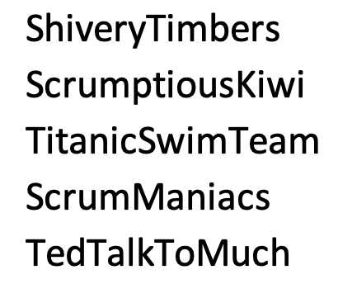
Scrum Team Planning Review
As a scrum team:
Review sprint 4 activities & assignments in detail
Discuss and identify questions/concerns
Scrum master share your team’s top 2 questions/concerns during report out
Anybody team members willing to make a team trade just to spice things up?

Slide 22
Review Demo Schedule

Slide 23
Prework For Next Class
Complete through activity 4 and start on activity 5 prior to next class
Those scheduled to demo on Wednesday please be a couple of minutes early to class

Slide 24
End of Session

