Slide 1
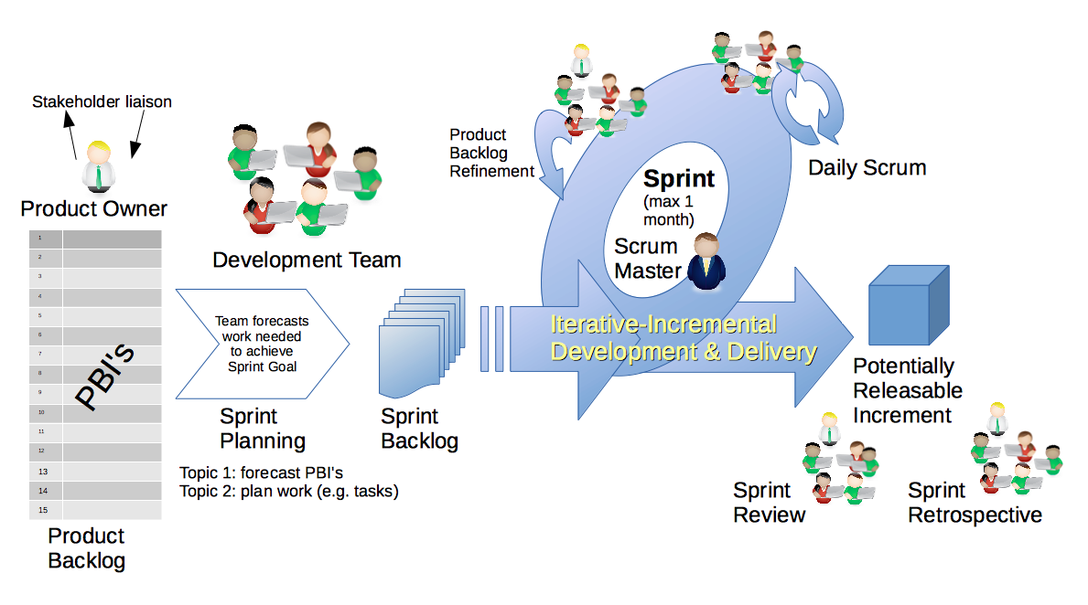
Scrum Process – Sprint Planning
By Dr ian mitchell - Own work, CC BY-SA 4.0, Link

Slide 2
Review Activities List and Assignments

Slide 3
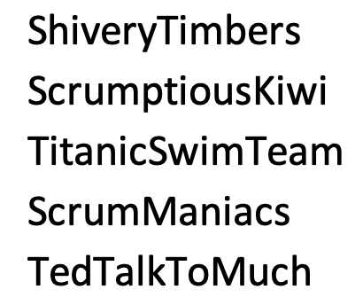
Scrum Team Planning Review
As a scrum team:
Review sprint 5 activities & assignments in detail
Discuss and identify questions/concerns
Scrum master share your team’s top 2 questions/concerns during report out

Slide 4
Review Demo Schedule

Slide 5
Prework For Next Class
Complete through activity 4 prior to next class
Those scheduled to demo on Wednesday please be a couple of minutes early to class

Slide 6
End of Session

