Slide 1
Object-Oriented Programming
Concepts – powerful features that are indispensable to modern software development
Practices – everyday activities that software developers perform in order to delivery quality products utilizing key Concepts
Patterns – tried-and-true templates for forging powerful relationships between classes
Principles – guidelines that help you determine what classes are needed and how they should work together
Concepts & Practices: Many times a day
Patterns: A few times a month
Principles: Aspirational months, years, maybe never achieved
Notes:
Concepts/Patterns/Principles… Hours/Days/Months

Slide 2

Recall Design Patterns

Slide 3
Breakout: Design Patterns
Assign presenter
Team discusses topics while the presenter summarizes the topics below:
Who wrote “the book”, what is GOF, and which Pattern is the most important
Singleton
Factory
Delegation
Model-View-Controller
Team sits back, relaxes, and acknowledges the bravery and dedication of the presenter

Slide 4
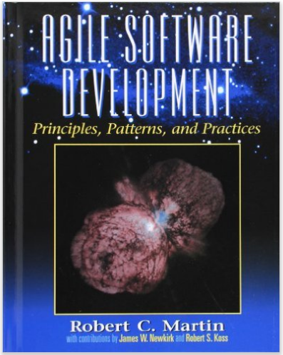
Principles & Agile

Slide 5

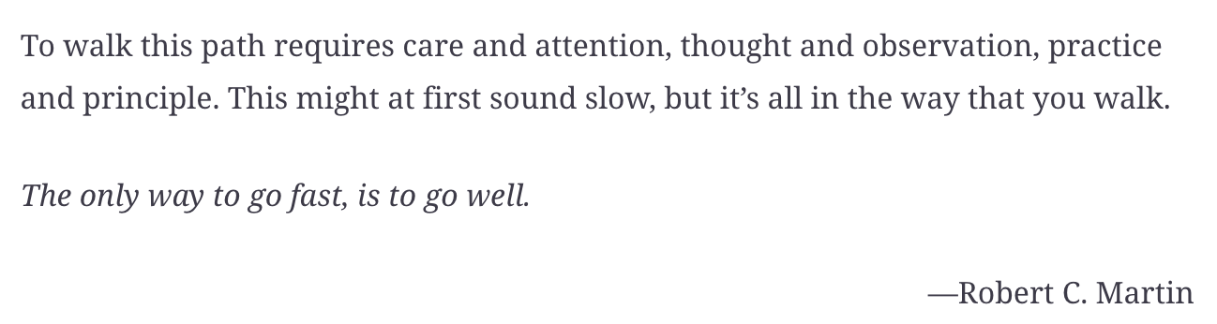
Principles & Architecture

Slide 6
Breakout Session: Object-Oriented Programming Principles Agile Software Devlepment Principles Design Principles

