Slide 1

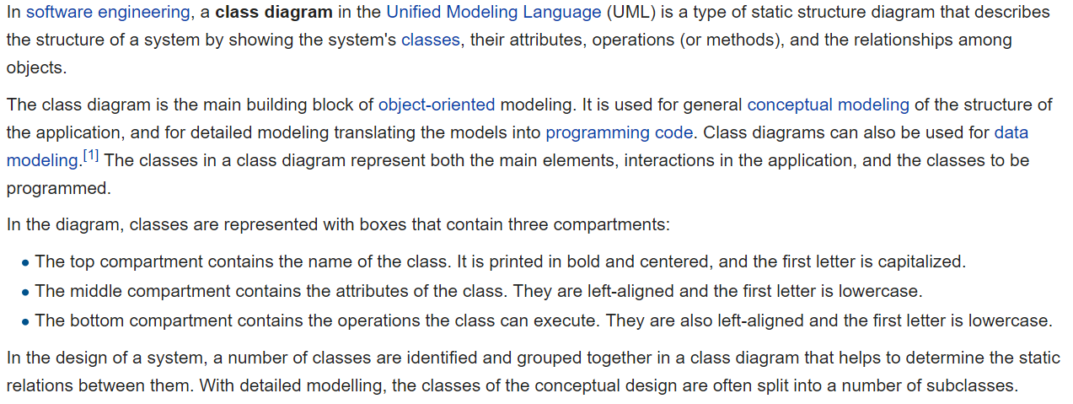
UML Class Diagram [link]

Slide 2
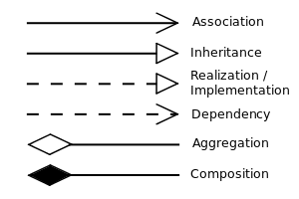


UML Class Diagram (continued) [link]

Slide 3
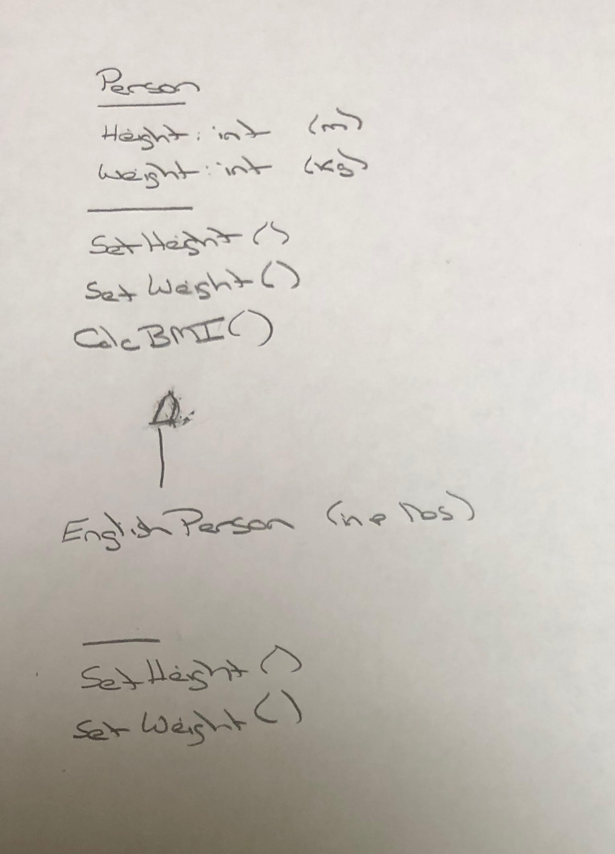
UML – BMI Calculator Plus

Slide 4
Is Object-Oriented Always Best?
Class Design vs
Relational Database Design

Slide 5
Concepts, Patterns, and Principles
Concepts – powerful features that are indispensable to modern software development
Practices – everyday activities that software developers perform in order to delivery quality products utilizing key Concepts
Patterns – tried-and-true templates for forging powerful relationships between classes
Principles – guidelines that help you determine what classes are needed and how they should work together

Slide 6
Scrum Team Chapter Review
Assign presenter
Team discusses topics while the presenter summarizes the topics below:
Who wrote “the book”
Rigidity, fragility, and immobility
Single-Responsibility Principle (team 1)
Open-Closed Principle (team 2)
Liskov's Substitution Principle (team 3)
Dependency-Inversion Principle (team 4)
Interface-Segregation Principle (team 5)
SOLID?
Which of these can be applied to non-object-oriented programs and/or non-agile environments?
Team sits back, relaxes, and acknowledges the bravery and dedication of the presenter
Object-Oriented Principles

