Slide 1
YouTube, Eric’s Trip to Google, The Social Dilemma, and Technology Business Models

Slide 2
The Question
“Professor Pogue, Why don’t you put your videos on YouTube? It works great.”
- students from Lewis University
The Response:
It makes me uncomfortable that Google and YouTube (and Facebook and Amazon) are all focused on getting more of your attention while I am trying to enable you to focus more on the content. I don’t like this because I would enable it by posting my content on YouTube.
On the other hand, I would like the potential feedback I would receive from a larger, more diverse audience.

Slide 3
Story Time with
Eric’s Trip to Google

Slide 4
Quotes from “The Social Dilemma”
“We’re the product. Our attention is the product being sold to advertisers.” - Justin Rosenstein, former engineer Facebook and Google, co-founder of Asana
“It’s the gradual, slight, imperceptible change in your own behavior and perception that is the product.” - Jaron Lainer, founding father of Virtual Reality Computer Scientist

Slide 5
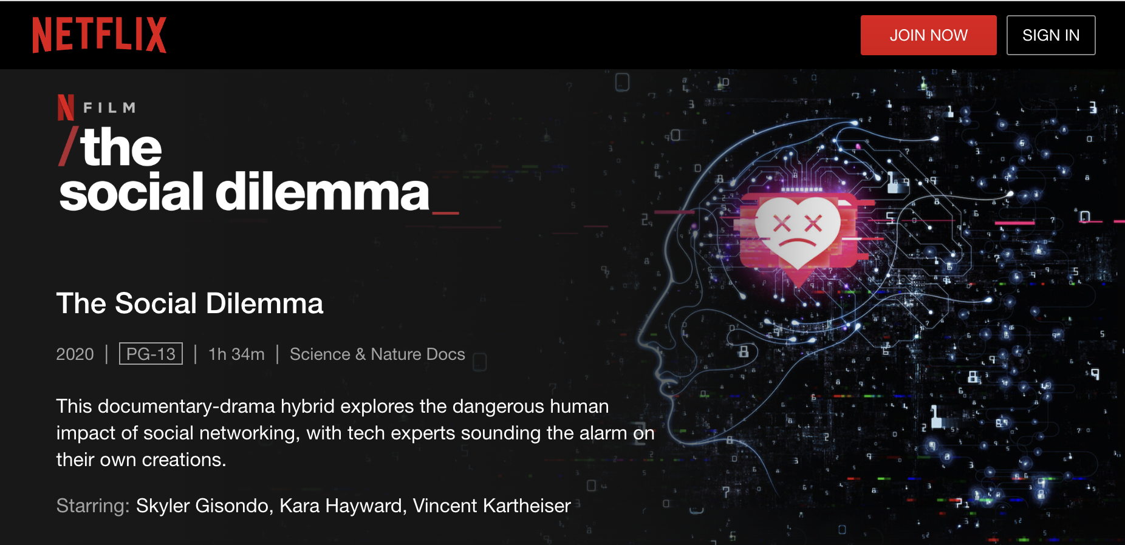
“The Social Dilemma” Documentary

Slide 6
Quotes from “The Social Dilemma”
“We’ve created a world in which online connection has become primary. Especially for younger generations. And yet, in that world, anytime two people connect, the only way it’s financed is through a sneaky third person whose paying to manipulate those two people. So we’ve created an entire global generation of people who were raised within a context with the very meaning of communication, the very meaning of culture, is manipulation.” - Jaron Lainer, founding father of Virtual Reality Computer Scientist

Slide 7
Quotes from “The Social Dilemma”
“If something is a tool, it genuinely is just sitting there, waiting patiently. If something is not a tool it's demanding things from you. It's seducing you, it’s manipulating you, it wants things from you. We've moved away from a tools based technology environment, to an addiction and manipulation used technology environment. Social media isn't a tool waiting to be used. It has its own goals, and it has its own means of pursuing them by using your psychology against you.” - Tristan Harris, former design ethicist at Google and co-founder of Centre for Humane Technologies‍

Slide 8
Quotes from “The Social Dilemma”
“We’re training and conditioning a whole new generation of people that when we are uncomfortable or lonely or uncertain or afraid, we have a digital pacifier for ourselves. That is kind of atrophying our own ability to deal with that.” - Tristan Harris, former design ethicist at Google and co-founder of Centre for Humane Technologies

Slide 9
Eric’s Opinion and Editorial Comments
We are polarizing viewpoints by providing individualized feeds that reinforce already held views and opinions. This reinforcement and polarization is a byproduct of the desire to gain a few more seconds of attention (or another click).

Slide 10
The Original Question
“Professor Pogue, Why don’t you put your videos on YouTube? It works great.”
-- students from Lewis University
The Response:
It makes me uncomfortable that Google and YouTube (and Facebook and Amazon) are all focused on getting more of your attention and I am enabling that by putting my content on YouTube.

Slide 11
Update - October, 2021
"The result has been more division, more harm, more lies, more threats and more combat. In some cases, this dangerous online talk has led to actual violence that harms and even kills people,"
-- Former Facebook data scientist Frances Haugen
Also considerable conversation around the “addictive” nature of social media and impact to children and young adults.

Slide 12
Recommendation
Take a few minutes to to contemplate the Google, YouTube, Facebook, WhatsApp, and TicTok style business model. Also consider the Apple and Microsoft business model.
Be aware. Decide what’s right for you.

