Slide 1

Agenda:
Prework & Announcements
Sprint 7 Review & Demos
Sprint 7 Retrospective
Scrum Team Sprint 7 Retrospective with Start, Stop, Continue
Prework for Next Class
Discussion & Questions welcome at any time but please be present with no phones or email during our time together

Slide 2
Prework For Next Class
Complete through activity 6
Each team should be prepared to demo “Best Story” and “Random Story”

Slide 3
Sprint Review & Demos

Slide 4
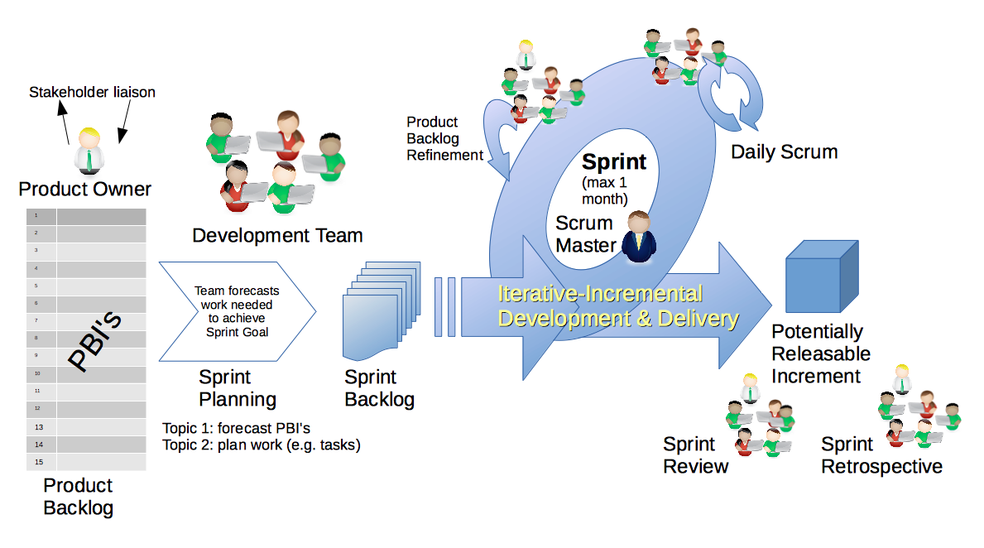
Scrum Process – Sprint Review & Demo
By Dr ian mitchell - Own work, CC BY-SA 4.0, Link

Slide 5

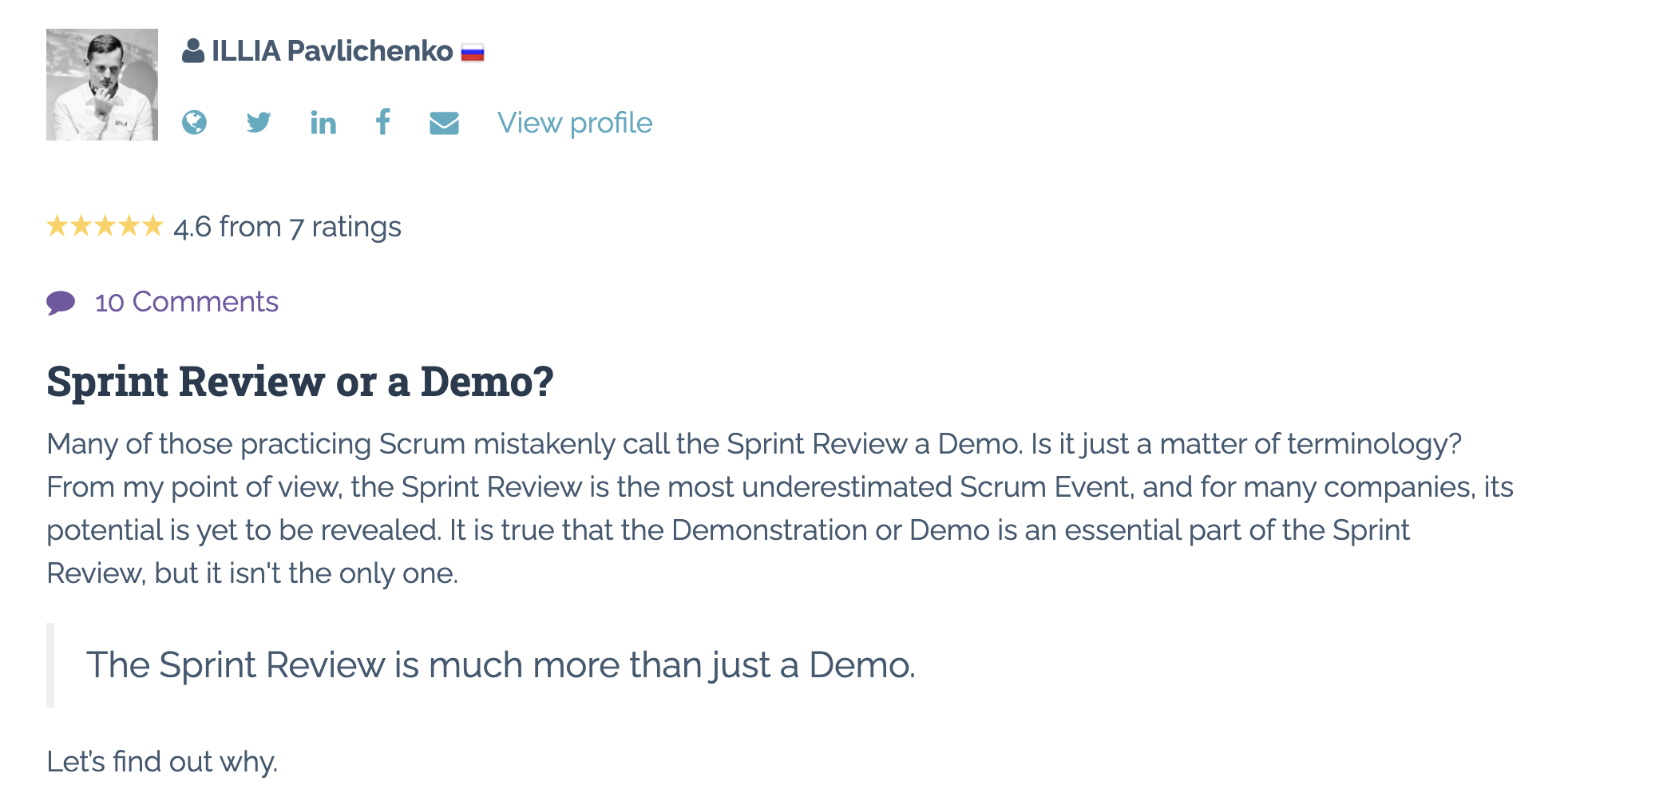
Sprint Review: Much More Than Just A Demo

Slide 6
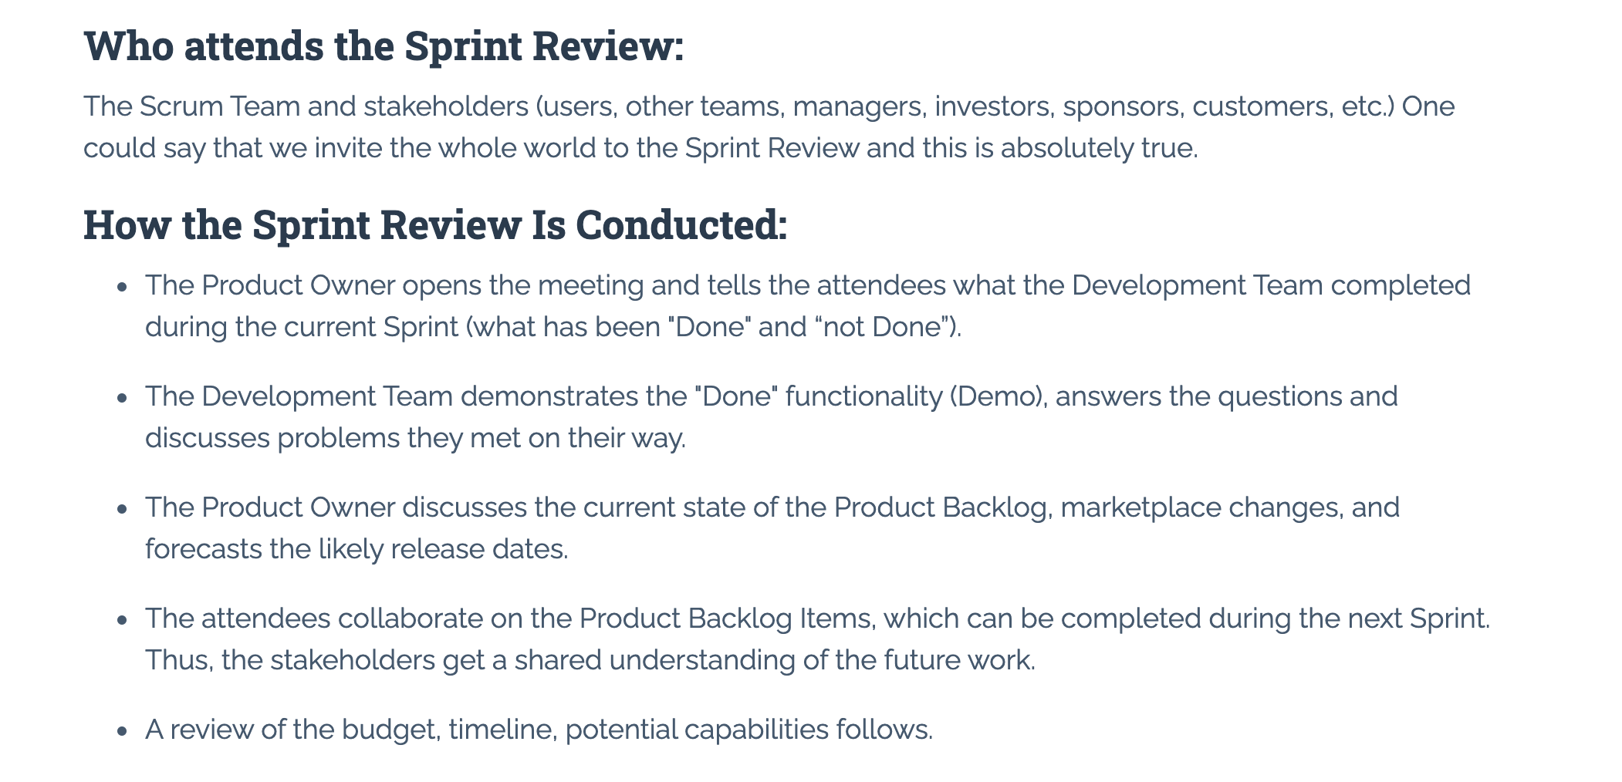
Sprint Review: Much More Than Just A Demo

Slide 7
Demos

Slide 8
Demo Guidelines – Presenter
Everyone will give at least one demo of their work during the semester.
Your demo should be 2 to 5 minutes and can include any or all of the following:
Show your application running
Comment on your implementation
Show the source code
Explain how you organized the code
Talk about any challenges
You should not prepare slides or a presentation
**You will also need to complete the Demo assignment in Blackboard.

Slide 9
Demo Guidelines – Listener
Everyone will be listening to many demos during the semester.
Your listener responsibilities include:
Actively listening and watching what is being demoed
Come up with a meaningful yet easy to answer question
Ask your question if the presenter does not get sufficient questions from other listeners
Do not ask hard question or attempt to review the presenters code
Clap for the presenter at the end of the demo and thank them for presenting
Optionally follow up with the presenter later if you have what could be more difficult questions or if you have suggestions

Slide 10
Sprint Demos – Team
Demo your stories and vote on the Best!

Slide 11
Sprint Demos - Class

Slide 12
Scrum Process – Sprint Retrospective
By Dr ian mitchell - Own work, CC BY-SA 4.0, Link

Slide 13
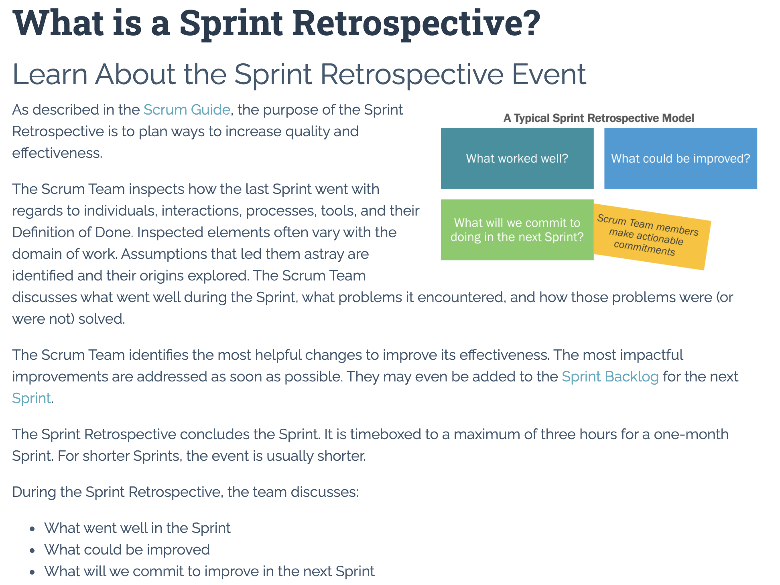

Slide 14
Metrics – Submission Percentage

Slide 15
Class Retrospective
Feedback from Assignments & Reflections:
And there we have it PERFECTION… and Food?!?!?
Great job taking time for yourself and for you families over Thanksgiving!
All assignments are graded and posted
Lot’s of good teaming going on!

Slide 16
Class Retrospective Breakout
Start, Stop, Continue for the class:
Continue: What is something specific that is working? Something that we should make sure that we continue to do.
Start: What is something specific that would be nice to do that we are not doing now? Maybe something that you have seen work well for others.
Stop: What is not working or not adding value? Something to stop doing.
Report out questions (Scrum Master):
What are two or three start, stop, continue items that you would be willing to share?
Are there ways I could better reward participate in class and on scrum teams?
What if we finished all sprints on Thursdays instead of Sundays? Or another day of the week?

Slide 17
Thank you!

Slide 18
Review Schedule

Slide 19
Prework For Next Class
Be ready for Quiz 8 on Friday

