Slide 1
Sprint Planning

Slide 2
This is Your Scrum Process

Slide 3
INVEST to Write Good User Stories
Independent: Self contained, not dependent on other user stories
Negotiable: Leave space for discussion, discovery and invention
Valuable: Has immediate value to stakeholder.
Estimable: Constrained in size and scope, just enough information
Small: Ideally 1-2 days work with larger efforts being decomposed
Testable: Acceptance criteria makes clear when work is done

Slide 4
Sprint Planning Goal
Goal: By the end of sprint planning the team (and each team member) will have committed to meaningful User Stories (stories that add value to the user) that have story point estimates approximately equal to capacity.
Steps:
Create or update the definition of “Done”… at a minimum make sure that it includes that stories must be deployed to production and available to demo in order to be “Done”
Come into Sprint Planning with a Groomed Backlog of sufficient “ready” stories to meet capacity
Team members request stories, stories are assigned, and team members commit to delivering stories (making them “done”) by end of sprint
The team is responsible for defining Done and having a fully Groomed Product Backlog.
The Product Owner maintains and updates the Product and Sprint Backlogs.
Each team member is responsible for requesting and committing to stories. Stories must be deliverable within the sprint. Make it a priority to assign a story to a single team member.

Slide 5
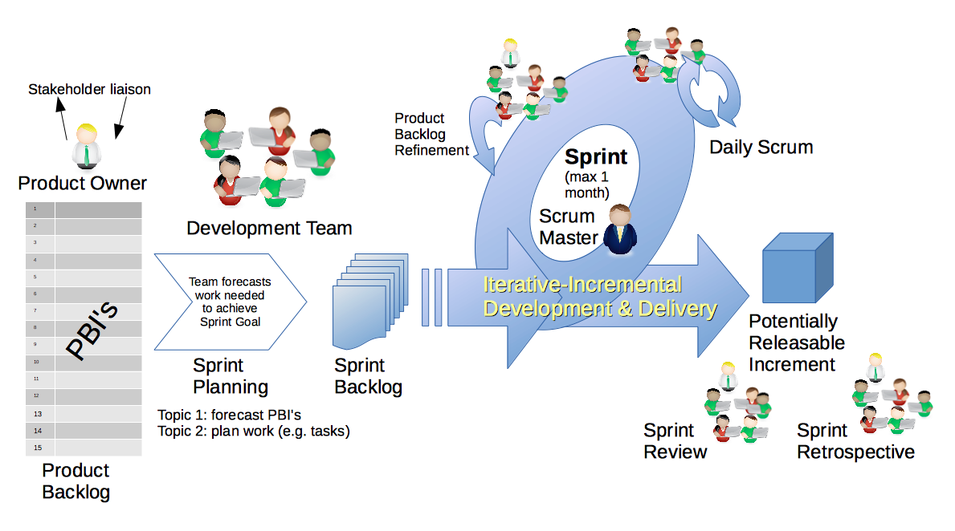
Scrum Process
By Dr ian mitchell - Own work, CC BY-SA 4.0, Link

Slide 6
Backlogs
By Dr ian mitchell - Own work, CC BY-SA 4.0, Link

Slide 7
Backlog Grooming and Sprint Planning
Steps:
Priorities & Roles Assignment
Epic Backlog Grooming
Story Backlog Grooming
Sprint Planning
Sprint Backlog Commitment
Celebrate!

Slide 8
Step 1: Review Priorities & Roles
Agile Priorities (associated scrum role):
Customer (Product Owner)
Technology (Architect)
Process (Scrum Master)
Review Organization Sprint Priorities
Notes:
Agile Glossary [link]
One person can play multiple roles
Quite different/difficult for us because we are playing the role of the customer as well as the delivery team

Slide 9
Step 2: Epic Backlog Grooming
User Stories, Epics and Backlogs
Agile Glossary [link]… review User Story format

Slide 10
Step 2: Epic Backlog Grooming
Actions & Requirements:
Product Owner to lead the review and/or creation of Epics
There must be one list of Epics managed by the Product Owner
Each Epic must deliver customer functionality and value
Epics should be written in User Story format
Epics must be prioritized and forced ranked
Each product must have at least three Epics
Epic Backlog Grooming report questions (Scrum Master):
What is the number of Epics? Should be at least 2 Epics
How many are force ranked?

Slide 11
Step 3: Story Backlog Grooming
By Dr ian mitchell - Own work, CC BY-SA 4.0, Link

Slide 12
Step 3: Story Backlog Grooming
Review Done, User Stories, and Story Backlog:
“Done” must be well defined and for us includes at a minimum:
Successfully deployed and integration tested in the production environment
Demoed to the Product Owner
Available to be demoed to the class
User Stories must:
Be written in User Story format from a customer / user perspective
Deliver user (customer) value
Be associated with Epic
Product Product Backlog is:
Managed by to Product Owner
The team’s master list of prioritized (force ranked) User Stories
The team’s master list of all important project work (spikes, continuous improvement, etc.)
Notes:
How will you handle dependancies?

Slide 13
Step 3: Story Backlog Grooming
Requirements:
Product Owner to lead the creation, force ranking, and estimating of User Stories.
Each User Story must have an estimated effort in Story Points
For our purposes assume 1 Story Point is approximately equal to 1 hour of effort (controversial)
Each User Story must be deliverable in a single sprint

Slide 14
Step 3: Story Backlog Grooming
Requirements & Actions:
Update Product Backlog by:
Relocating “Done” User Stories “Done” list
Reviewing and creating User Stories
Prioritize and force rank important stories (anything that might make it to the Sprint Backlog)
Provide Story Point estimates for important stories
Product Backlog report out questions (Product Owner):
Who is the Scrum Master and Product Owner?
How many Sprint 7 backlog stories/story points are done/not done?
What is your team’s capacity in sprint 8… given that each team member is expected complete 10 story points worth of User Stories in sprint 8
Number of force ranked estimated User Stories in valid User Story Format
Number of force ranked User Story points
Number of forced ranked Epic (should be at least 2)
Notes:
How will you handle dependancies?

Slide 15
Update your product backlog to reflect unexpected results from previous sprint?
Copy (don’t move) any sprint 7 backlog stories that are not “done” into the product backlog.

Slide 16
Step 3: Story Backlog Grooming
Requirements & Actions:
Update Product Backlog by:
Relocating “Done” User Stories “Done” list
Reviewing and creating User Stories
Prioritize and force rank important stories (anything that might make it to the Sprint Backlog)
Provide Story Point estimates for important stories
Product Backlog report out questions (Product Owner):
Who is the Scrum Master and Product Owner?
What is your team’s capacity in sprint 6… given that each team member is expected complete 8 story points worth of User Stories in sprint 6
Number of force ranked estimated User Stories in valid User Story Format
Number of force ranked User Story points
Number of forced ranked Epic (should be at least 1)
How many sprint 7 backlog stories and story points are not “done” and had to be copied back into the Product Backlog
Notes:
How will you handle dependancies?

Slide 17
Step 4: Sprint Planning
By Dr ian mitchell - Own work, CC BY-SA 4.0, Link

Slide 18
Step 4: Team Capacity, Story Assignment, and Cut Line
Activities:
Review Scrum Team Capacity for the current sprint
Each User Story should be requested/assigned to 1 (preferably) or more team members
Move your committed stories to your Sprint Backlog… assignments, story point estimates, and story descriptions need to be immutable and non-ambiguous
You may choose to track actual effort but that does not impact your story point estimates

Slide 19
Step 4: Sprint Planning
Requirements & Activities:
Scrum Master and Product Owner lead effort to create Sprint Backlog
Request volunteers (or make assignments) to move the highest ranked Product Backlog stories to Sprint backlog until capacity is utilized
Comment: Your tools and formats you utilize for managing stories and backlogs are your own, but you need to be comfortable in showing how you choosing to do it.

Slide 20
Step 5: Sprint Backlog Commitment
By Dr ian mitchell - Own work, CC BY-SA 4.0, Link

Slide 21
Step 5: Sprint Backlog Commitment
The team commits to completing (“done”) the stories in the Sprint backlog.
It is required that we:
Be unambiguous in our commitments
Be transparent in our commitments and progress
Maintain an immutable sprint backlog
Commit and deliver as a team and as an individual
Commit to continuous improvement
Product Backlog report out questions (Scrum Master):
What is your team’s capacity and how was it calculate
How many stories and story points did you team commit to delivering in this sprint
How many stories and story points did each individual commit to delivering

Slide 22
Step 6: Celebrate
Recognize your teammates that stepped up. Tell them “Well done!”
Celebrate report out questions (Scrum Master & Product Owner):
How do you feel about your sprint planning?

