Slide 1
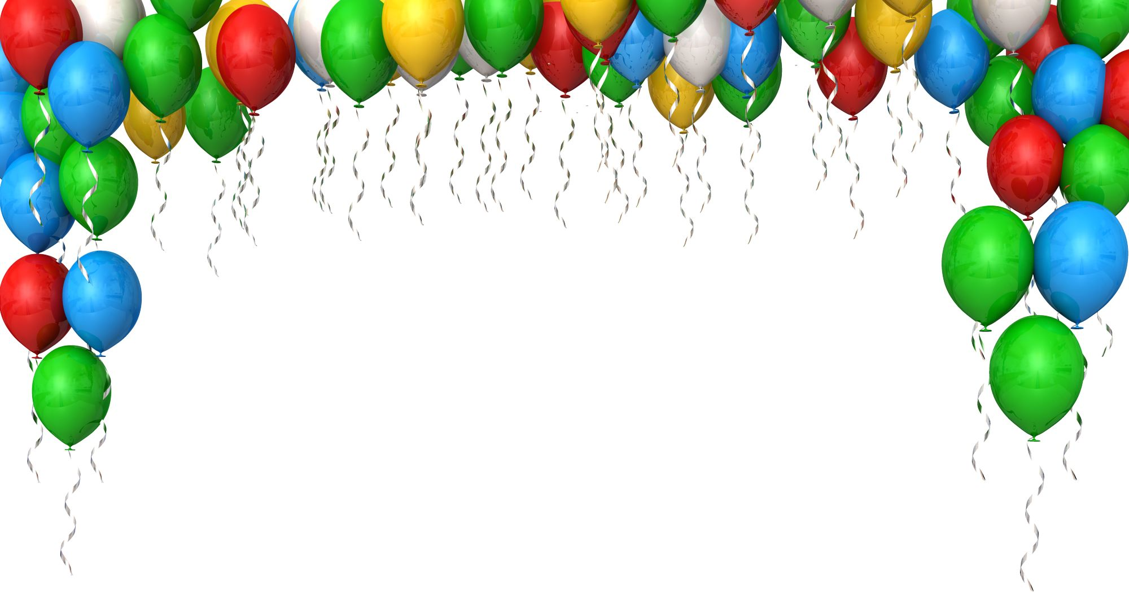
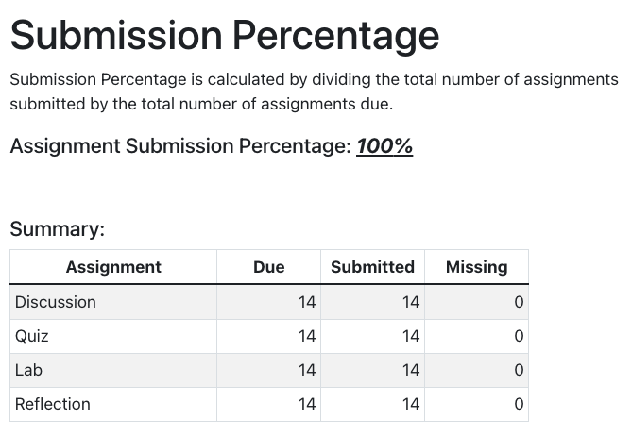
Treats Today: Thank You for Submitting All Assignments On Time!

