Slide 1
UML and UML Class Diagrams

Slide 2

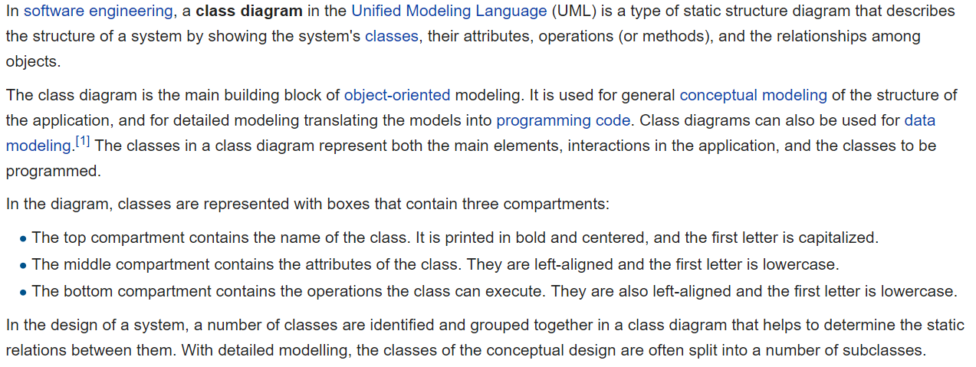
UML Class Diagram [link]

Slide 3
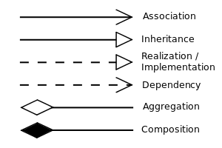


UML Class Diagram (continued) [link]

Slide 4
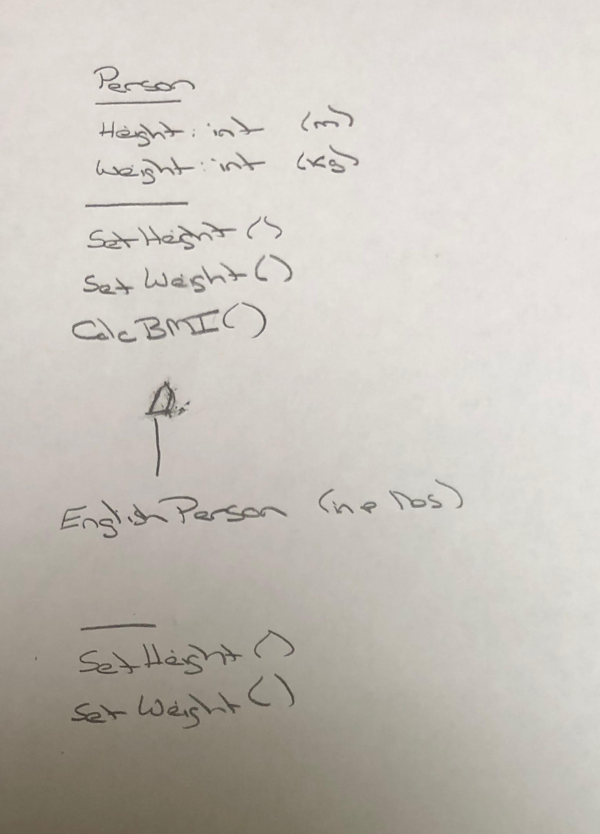
UML – BMI Calculator Plus

Slide 5
Is Object-Oriented Always Best?
Class Design vs
Relational Database Design

