Slide 1

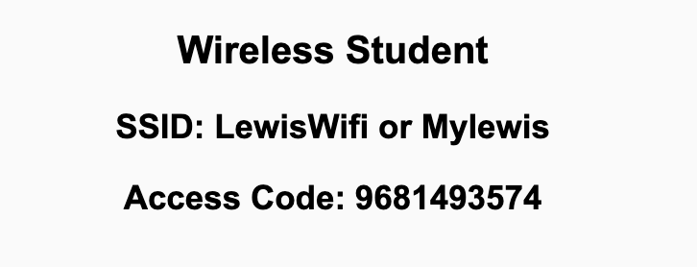
Preflight Check List
Sign into our Zoom meeting through our integrated Blackboard/Zoom link
Make sure that you can hear the conversation, see shared desktops, and view chat topics
Thank you if you choose to leave your camera on to help make our class more interactive
Be prepared to share your computer screen
Be prepared to utilize a headset with a microphone
In person participants also:
Make sure that your microphone and speakers are muted/off so that we don’t get an echo
Sit in a good spot near the classroom ceiling microphones if possible

Slide 2
Recordings
Discuss that recording are:
Opportunistic
Automatically available in Blackboard/Zoom
Start Recording

Slide 3
Agenda:
Friendly Conversation Topic: Who is Team 7?
Prework and Announcements
Sprint Progress Polling
Scrum Team Fox Preface & Chapter 1 Discussion
Prework for Next Class
Lab (as time allows)
Discussion & Questions welcome at any time but please be present with no phones or email during our time together

Slide 4
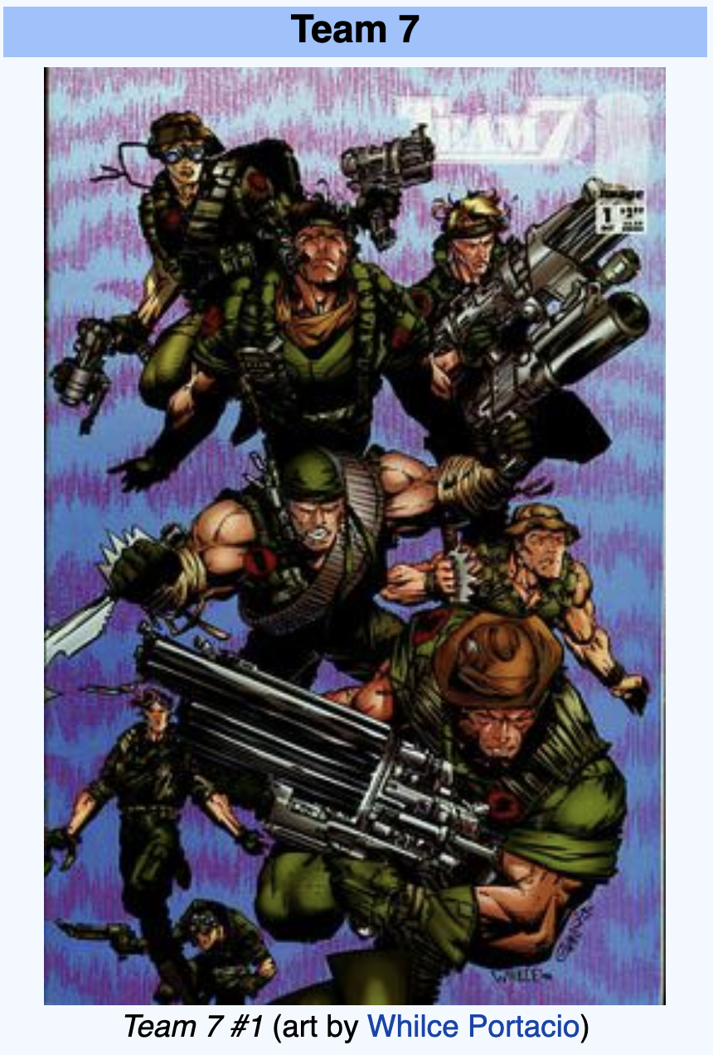
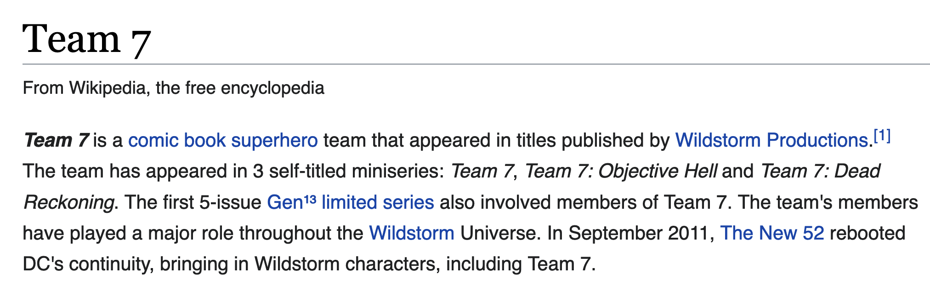
Who Is Team 7?

Slide 5
Prework & Announcements
Before class today we were anticipating that we would be able to:
Complete through activity 10 prior to next class
Be prepared for your Scrum Team review and report out of “Engineering Software as a Service” Preface and Chapter 1

Slide 6
Polling – Sprint Progress and CLIs

Slide 7
Scrum Team Fox Preface & Chapter 1 Discussion
Scrum Master accepts volunteers for (or assigns) Presenter
Team discusses and presenter summarizes the topics below:
Preface
Software Development Processes
Virtuous Triangle
Which Element of the Virtuous Triangle is most important and why?
Which Edge of the triangle is most important and why?
SOA vs. SaaS plus Validation vs. Verification
Hosting costs over time? And important is it to be able to effectively enhance Legacy Code? Why?
Team sits back, relaxes, and acknowledges the bravery and dedication of the presenter
Team returns to class Zoom session where presenter presents summary

Slide 8
Prework For Next Class
No class Monday due to the Labor Day holiday.
Prior to our Wednesday class please:
Complete through activity 13 prior to next class
Be prepared for your Scrum Team review and report out of “Engineering Software as a Service” Chapter 2
Be prepared to take Quiz 1 in class on Wednesday

Slide 9
Lab (as time allows)

Slide 10
End of Session

