Slide 1

Hi, everyone.
Just a reminder that Witron is coming tomorrow at 2pm in AS106 and online at https://lewisu-edu.zoom.us/j/6217684130.
If you or a student or students of yours are interested in working on a database-related project involving Witron's warehouse automation software, please attend or have them attend.
Eric - I know your class runs at the same time as the meeting. So, if you have students who have some skills and are interested in working on this project and can spare some classtime, please invite them to attend.
Thanks.
Ray
---
Dr. Ray Klump
Associate Dean, CoAST
Professor & Director of Computer Science
Lewis University
815-836-5528

Slide 2

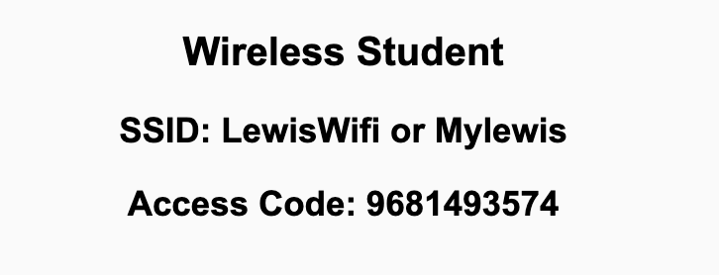
Preflight Check List
Sign into our Zoom meeting through our integrated Blackboard/Zoom link
Make sure that you can hear the conversation, see shared desktops, and view chat topics
Thank you if you choose to leave your camera on to help make our class more interactive
Be prepared to share your computer screen
Be prepared to utilize a headset with a microphone
In person participants also:
Make sure that your microphone and speakers are muted/off so that we don’t get an echo
Sit in a good spot near the classroom ceiling microphones if possible

Slide 3
Recordings
Discuss that recording are:
Opportunistic
Automatically available in Blackboard/Zoom
Start Recording

Slide 4
Agenda:
Prework
Sprint 1 Review & Demos
Sprint 1 Retrospective
Scrum Team Retrospectives
Prework for Next Class
Lab (as time allows)
Discussion & Questions welcome at any time but please be present with no phones or email during our time together

Slide 5
Prework
Complete through activity 6 prior to next class
Those scheduled to demo on Wednesday please be a couple of minutes early to class

Slide 6
Sprint Review & Demos

Slide 7
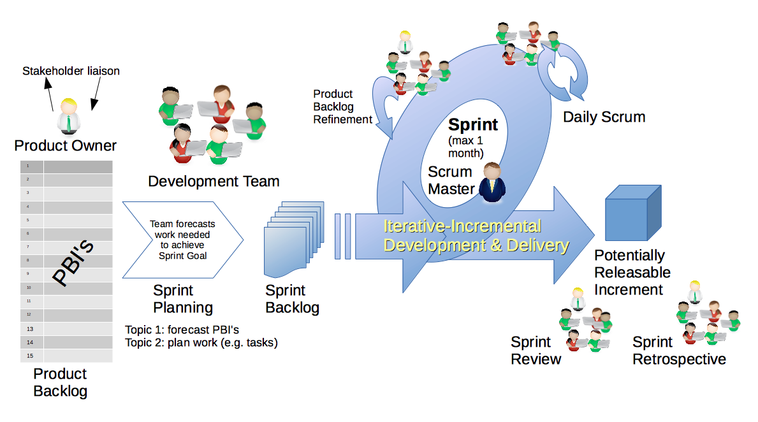
Scrum Process – Sprint Review & Demo
By Dr ian mitchell - Own work, CC BY-SA 4.0, Link

Slide 8

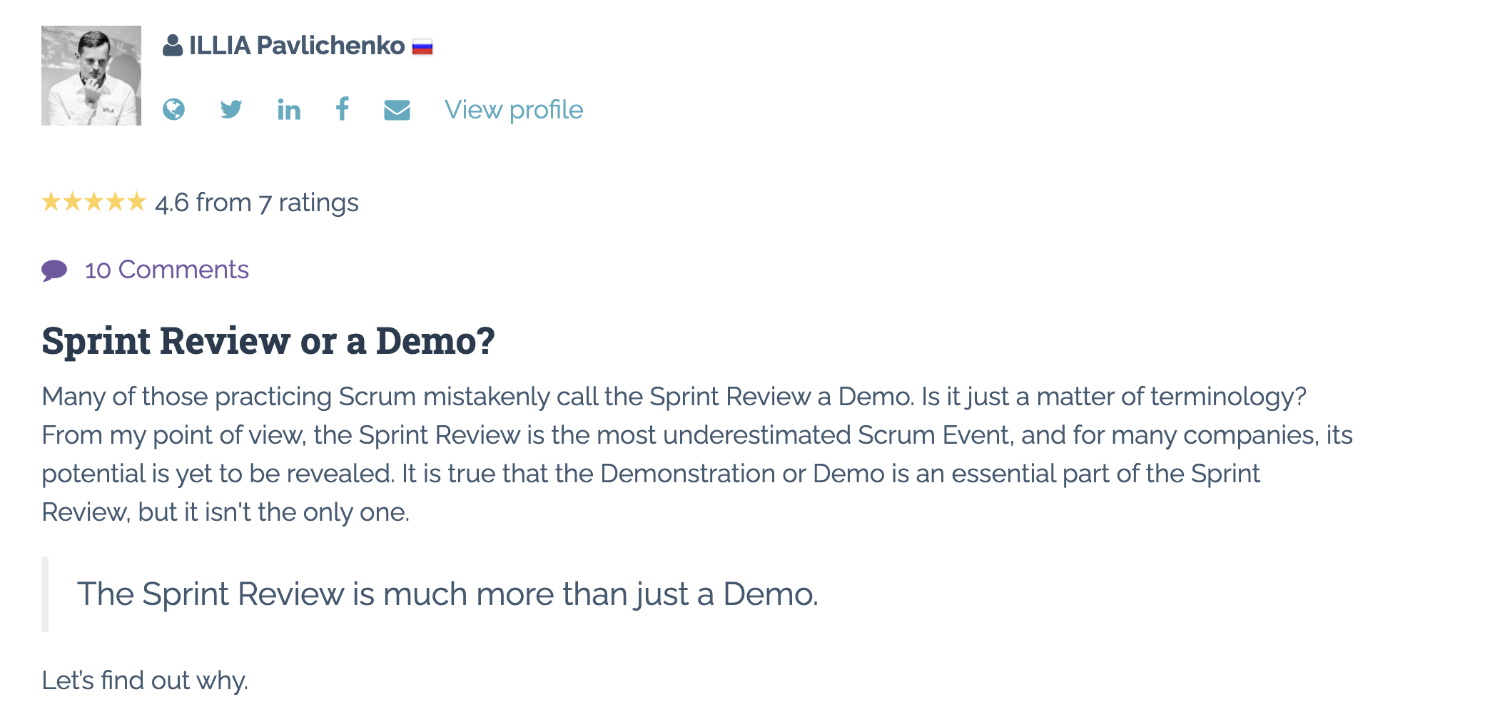
Sprint Review: Much More Than Just A Demo

Slide 9
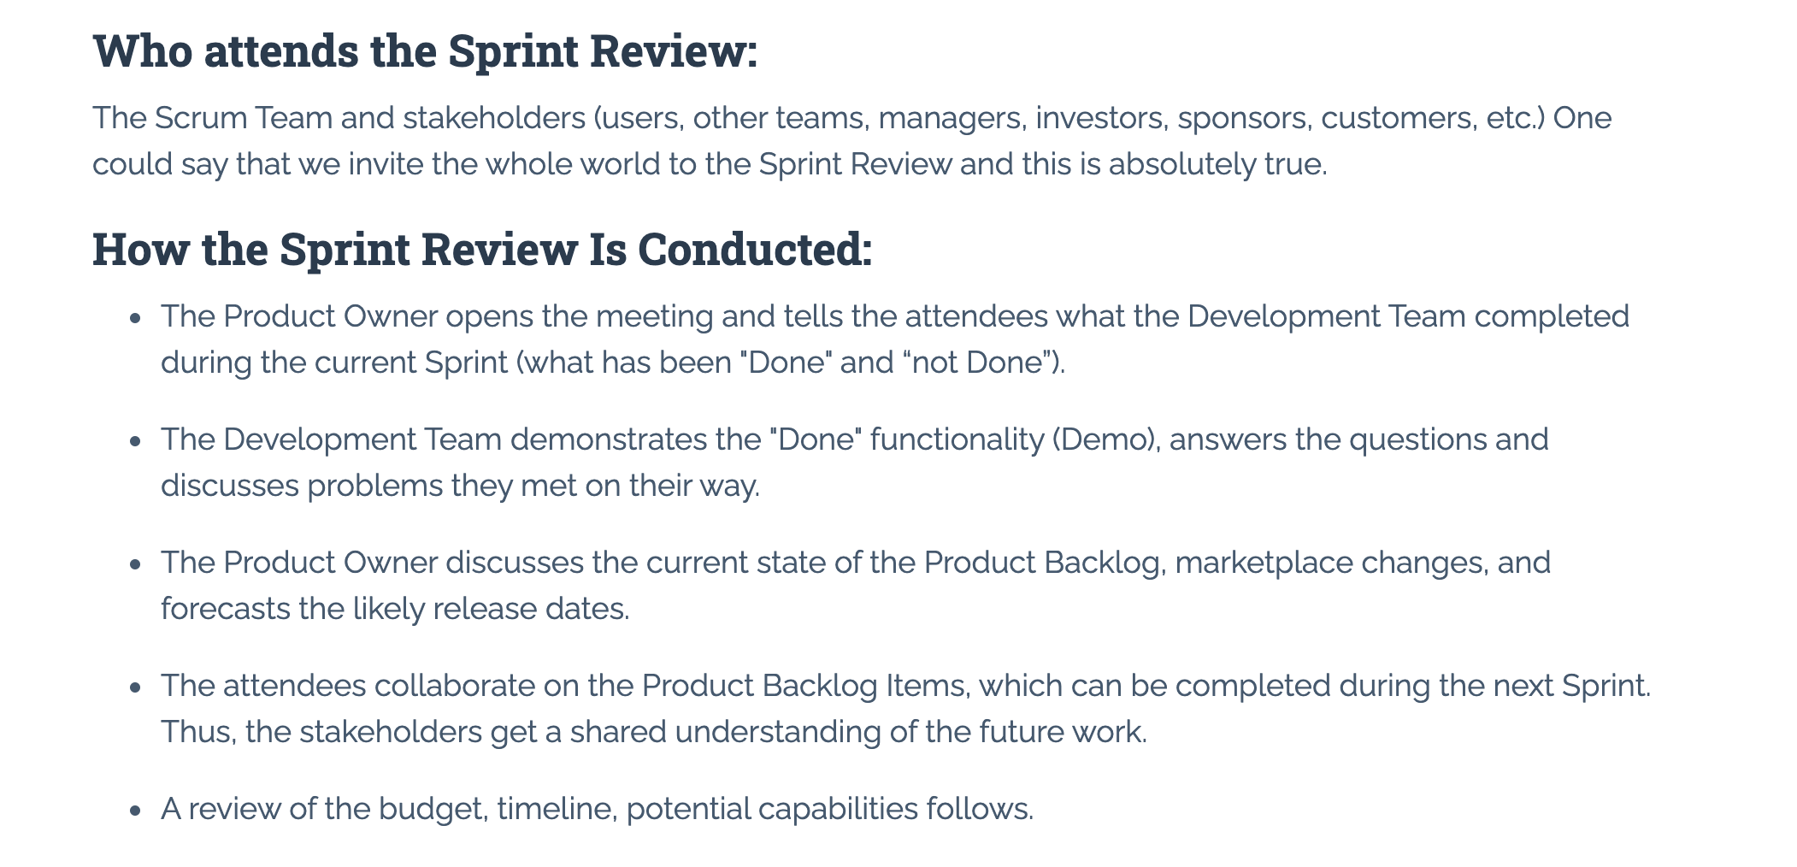
Sprint Review: Much More Than Just A Demo

Slide 10
Demos

Slide 11
Demo Guidelines – Presenter
Everyone will give at least one demo of their work during the semester.
Your demo should be 2 to 5 minutes and can include any or all of the following:
Show your application running
Comment on your implementation
Show the source code
Explain how you organized the code
Talk about any challenges
You should not prepare slides or a presentation
**You will also need to complete the Demo assignment in Blackboard.

Slide 12
Demo Guidelines – Listener
Everyone will be listening to many demos during the semester.
Your listener responsibilities include:
Actively listening and watching what is being demoed
Come up with a meaningful yet easy to answer question
Ask your question if the presenter does not get sufficient questions from other listeners
Do not ask hard question or attempt to review the presenters code
Clap for the presenter at the end of the demo and thank them for presenting
Optionally follow up with the presenter later if you have what could be more difficult questions or if you have suggestions

Slide 13
Sprint Demos

Slide 14
Complete Sprint Demo Assignment

Slide 15
Scrum Process – Sprint Retrospective
By Dr ian mitchell - Own work, CC BY-SA 4.0, Link

Slide 16
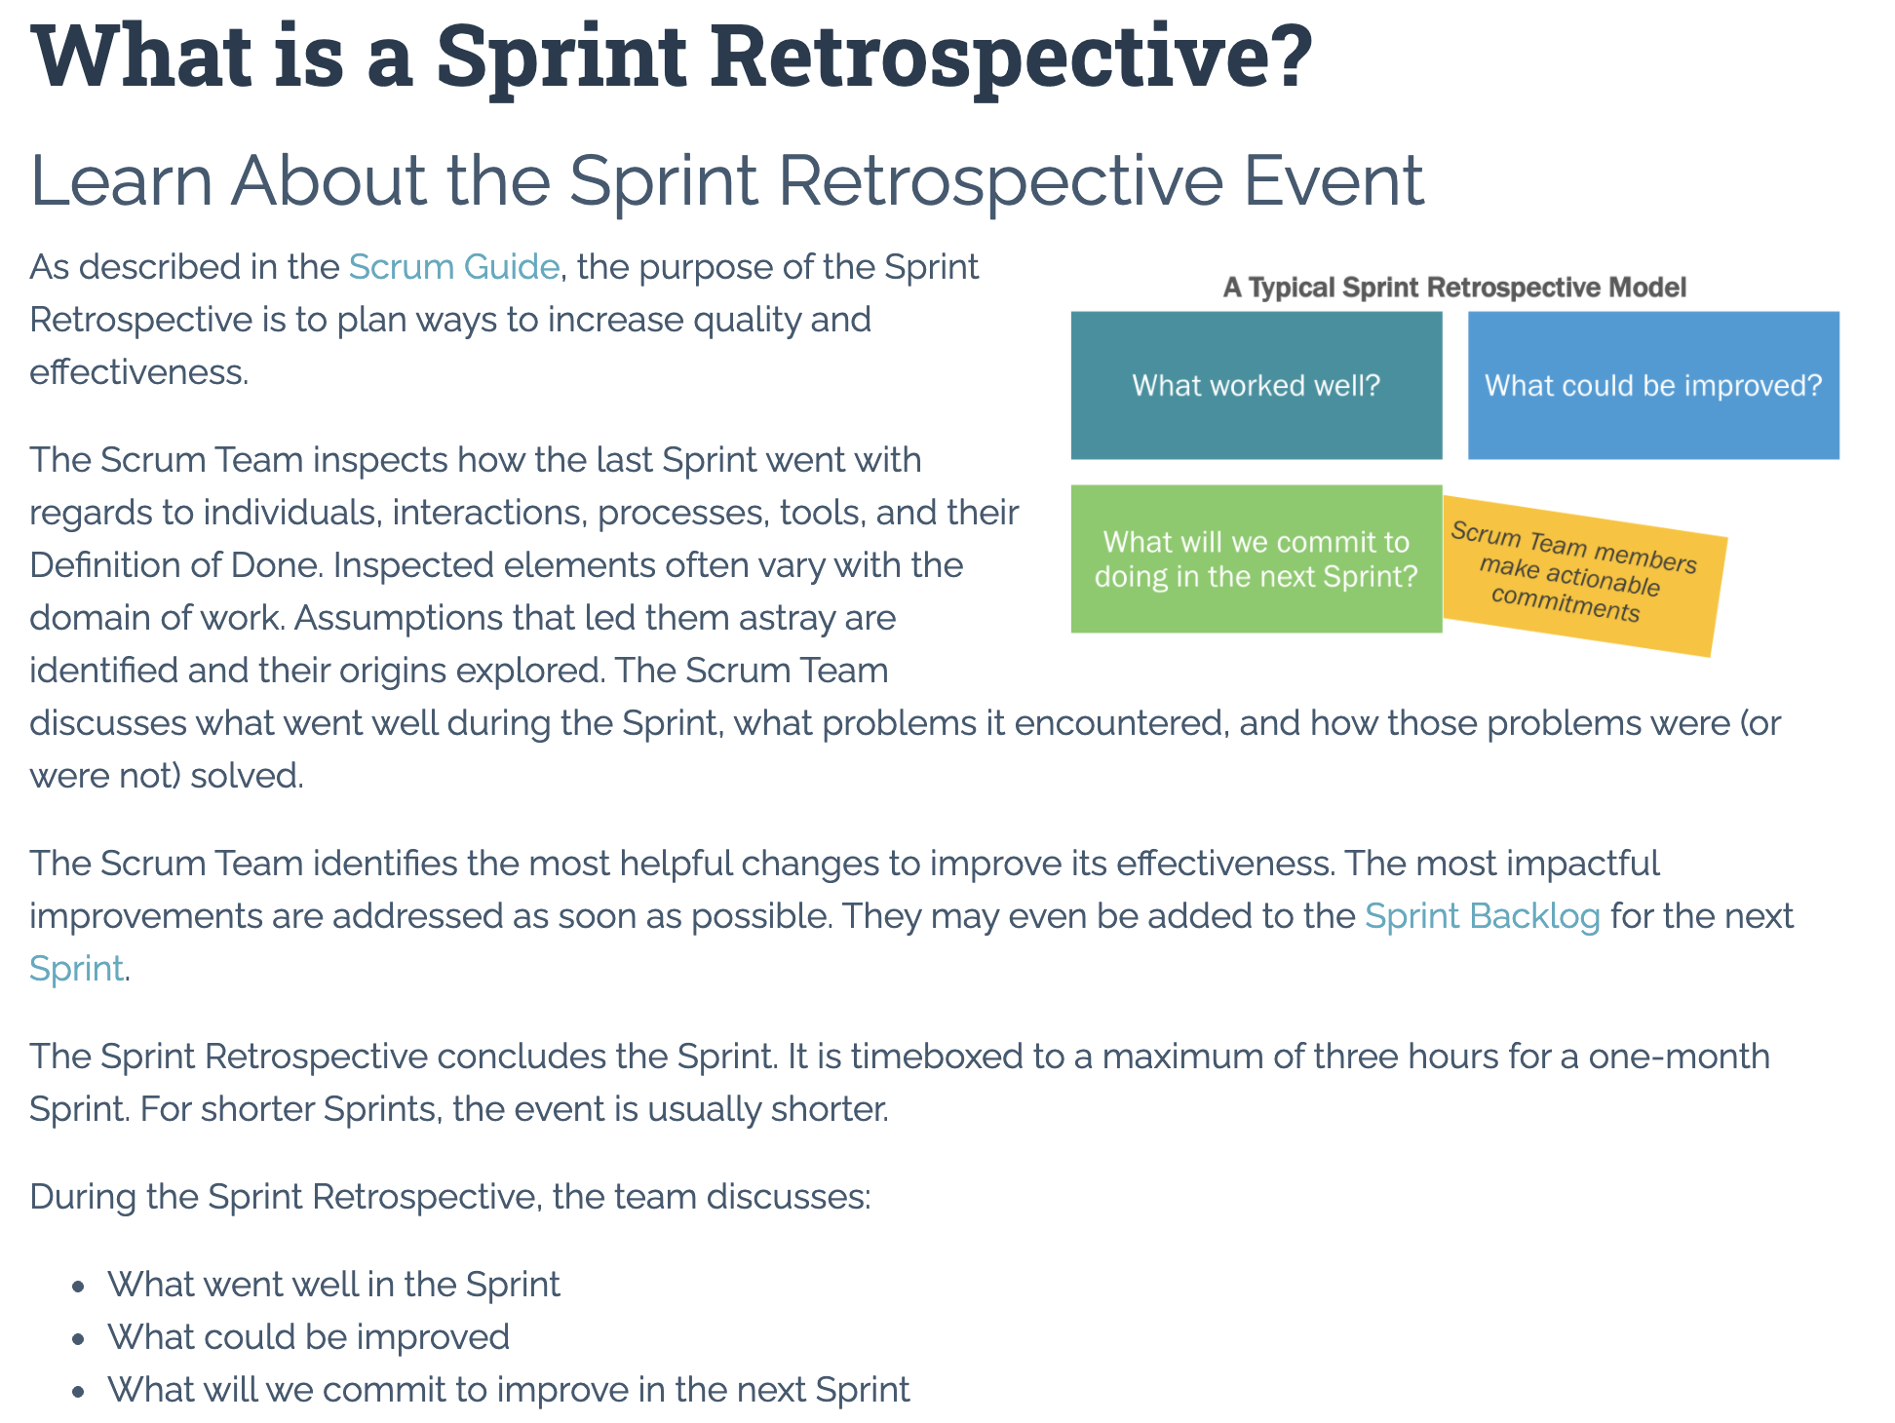

Slide 17
Submission Percentage

Slide 18
Class Retrospective
Feedback from Assignments & Reflections:
Great job turning in assignments on time!
** Know that your teammates appreciate you :-) **
What can I/we do to improve in sprint 2?
Scrum team discussion boards starting Friday

Slide 19
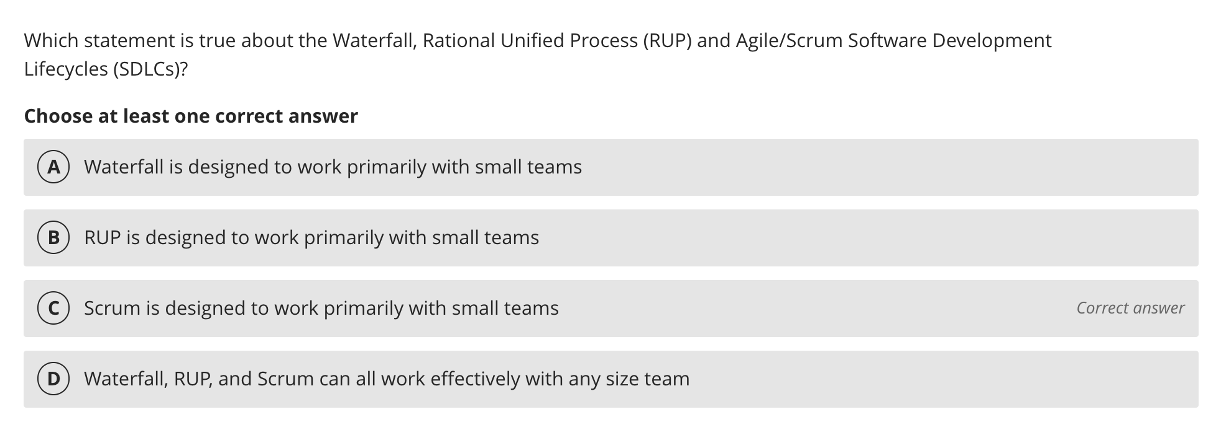
Class Retrospective

Slide 20
Scrum Team Retrospective
What’s working and what’s not working (team/class)?
What is one continuous improvement activity (team/class)?
Were you able to see the quiz answers?
Were you able to see my reflection responses?
Report-out

Slide 21
Prework For Next Class
Complete through activity 9 and actively working on activity 10 prior to next class
Be prepared for Scrum Team Review of FOX chapter 6 Saas Client Framework
Be prepared for Scrum Team Discussion 2

Slide 22
End of Session

Slide 23
Scrum Team Chapter Review
Assign presenter
Team discusses topics while the presenter summarizes the 5 topics below:
JavaScript
AJAX
XML/JSON
Single-Page Web Applications
Angular, React, other single-page web application environments
Where does Jamstack fit?
Team sits back, relaxes, and acknowledges the bravery and dedication of the presenter
Fox Chapter 6 Saas Client Framework

Slide 24
Scrum Team Chapter Discussion
Assign presenter
Team discussing chapter topics while the presenter summarizes the 5 topics below:
The importance of Branching is VCS systems (which VCS focused on branching)
Where should pared programming fit into the development process
The priority of specialization vs generalization in Agile vs Waterfall/Iterative
The relative importance of PMs in Agile vs Waterfall/Iterative
The two most important book on managing people and conflict (according to the author)
Team sits back, relaxes, and acknowledges the bravery and dedication of the presenter
Fox Chapter 10 on Project Management, Scrum, Pairs, and Version Control Systems

