Slide 1

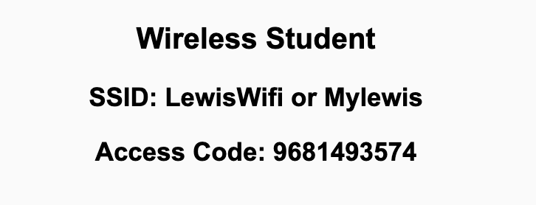
Preflight Check List
Sign into our Zoom meeting through our integrated Blackboard/Zoom link
Make sure that you can hear the conversation, see shared desktops, and view chat topics
Thank you if you choose to leave your camera on to help make our class more interactive
Be prepared to share your computer screen
Be prepared to utilize a headset with a microphone
In person participants also:
Make sure that your microphone and speakers are muted/off so that we don’t get an echo
Sit in a good spot near the classroom ceiling microphones if possible

Slide 2
Recordings
Discuss that recording are:
Opportunistic
Automatically available in Blackboard/Zoom
Start Recording

Slide 3
Agenda:
Prework
Sprint 1 Review & Demos
Sprint 1 Retrospective
Scrum Team Retrospectives
Prework for Next Class
Lab (as time allows)
Discussion & Questions welcome at any time but please be present with no phones or email during our time together

Slide 4
Prework For Next Class
Complete through activity 7 prior to next class
Those scheduled to demo on Wednesday please be a couple of minutes early to class

Slide 5
Sprint Review & Demos

Slide 6
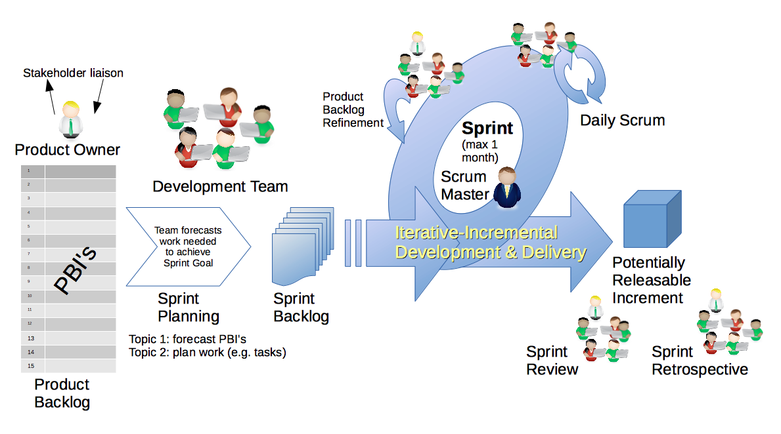
Scrum Process – Sprint Review & Demo
By Dr ian mitchell - Own work, CC BY-SA 4.0, Link

Slide 7
Demos

Slide 8
Demo Guidelines – Presenter
Everyone will give at least one demo of their work during the semester.
Your demo should be 2 to 5 minutes and can include any or all of the following:
Show your application running
Comment on your implementation
Show the source code
Explain how you organized the code
Talk about any challenges
You should not prepare slides or a presentation
**You will also need to complete the Demo assignment in Blackboard.

Slide 9
Demo Guidelines – Listener
Everyone will be listening to many demos during the semester.
Your listener responsibilities include:
Actively listening and watching what is being demoed
Come up with a meaningful yet easy to answer question
Ask your question if the presenter does not get sufficient questions from other listeners
Do not ask hard question or attempt to review the presenters code
Clap for the presenter at the end of the demo and thank them for presenting
Optionally follow up with the presenter later if you have what could be more difficult questions or if you have suggestions

Slide 10
Sprint Demos

Slide 11
Complete Sprint Demo Assignment

Slide 12
Scrum Process – Sprint Retrospective
By Dr ian mitchell - Own work, CC BY-SA 4.0, Link

Slide 13
Submission Percentage

Slide 14
Class Retrospective
Feedback from Assignments & Reflections:
Great job turning in assignments on time!
** Know that your teammates appreciate you :-) **
What can I/we do to improve in sprint 2?
Scrum team discussion boards starting Friday

Slide 15
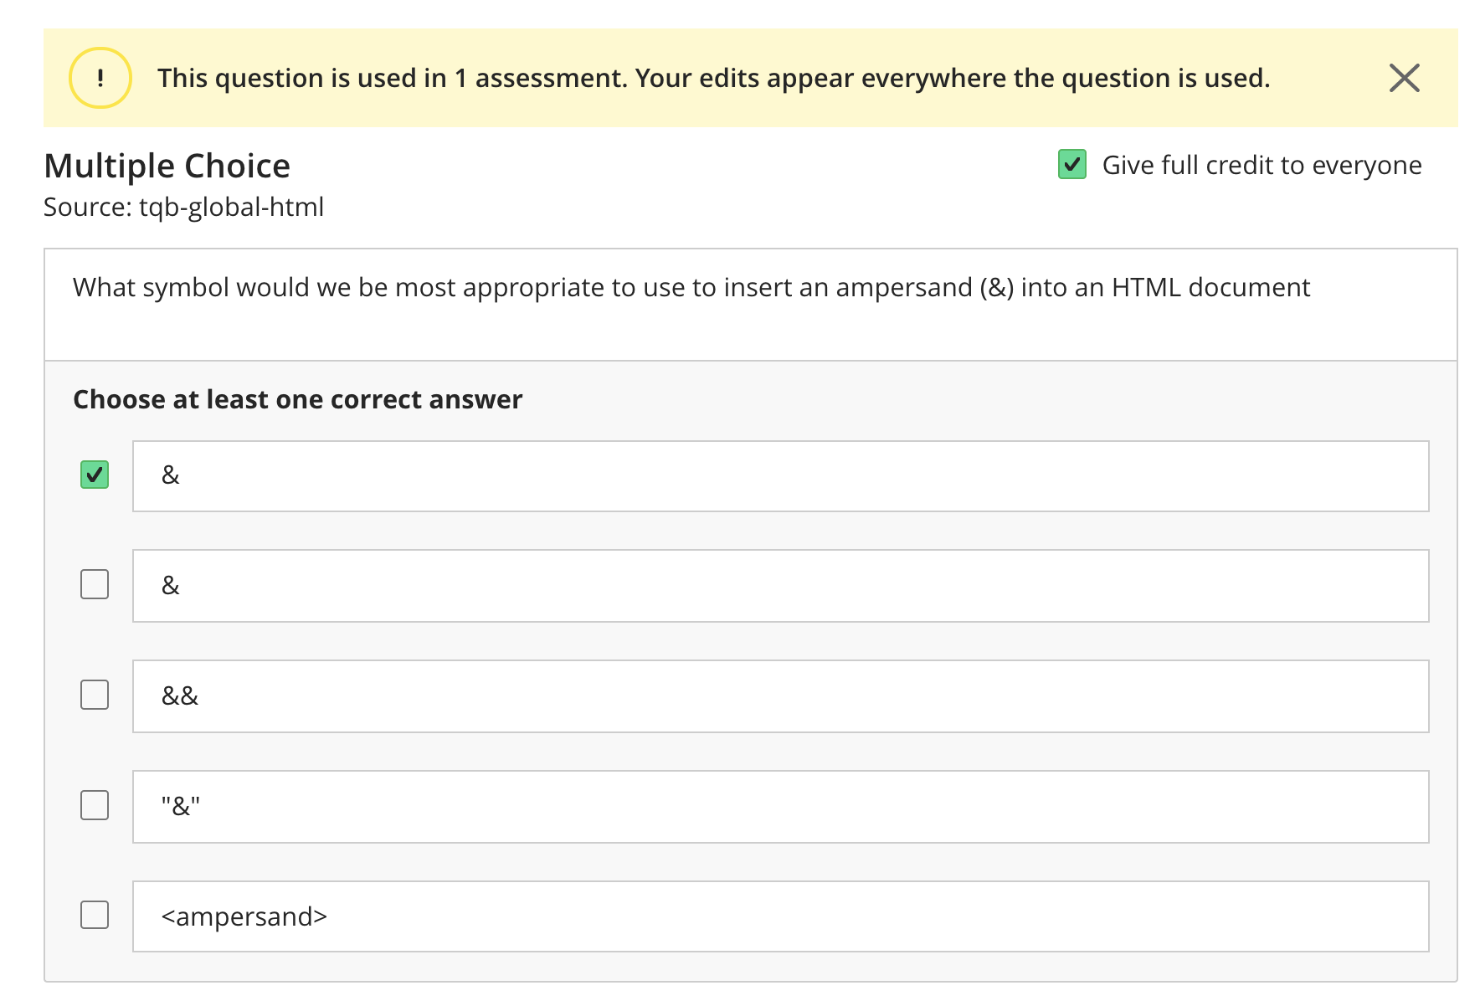
Class Retrospective (&Amp;)

Slide 16
Scrum Team Retrospective
What’s working and what’s not working (team/class)?
What is one continuous improvement activity (team/class)?
Were you able to see the quiz answers?
Were you able to see my reflection responses?
Report-out

Slide 17
Prework For Next Class
Complete through activity 9 and actively working on activity 10 prior to next class
Be prepared for Scrum Team Review
Be prepared for Scrum Team Discussion 2

Slide 18
End of Session

