Slide 1

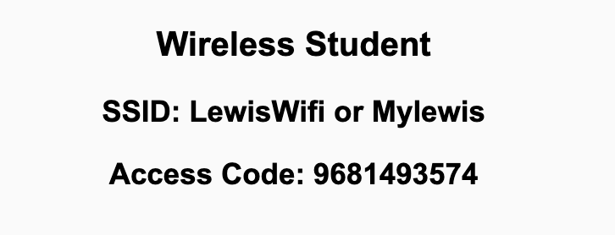
Preflight Check List
Sign into our Zoom meeting through our integrated Blackboard/Zoom link
Make sure that you can hear the conversation, see shared desktops, and view chat topics
Thank you if you choose to leave your camera on to help make our class more interactive
Be prepared to share your computer screen
Be prepared to utilize a headset with a microphone
In person participants also:
Make sure that your microphone and speakers are muted/off so that we don’t get an echo
Sit in a good spot near the classroom ceiling microphones if possible

Slide 2
Recordings
Discuss that recording are:
Opportunistic
Automatically available in Blackboard/Zoom
Start Recording

Slide 3
Agenda:
Prework
Tutoring Options
Remaining Demos?
Review Binary Values and Numbering Systems
Discussion 2
Prework for Next Class
Lab (as time allows)
Discussion & Questions welcome at any time but please be present with no phones or email during our time together

Slide 4
Prework
Complete through activity 8 and actively working on activity 9 prior to next class
Be prepared for Scrum Team Review
Be prepared for Scrum Team Discussion 2

Slide 5

Tutoring Options

Slide 6
Remaining Sprint 1 Demos?

Slide 7
Review Binary Values and Numbering Systems
Assign presenter
Team discusses topics while the presenter summarizes the topics below:
Numbers and Computing
Positional Notation
Binary, Octal, and Hexadecimal
Why Hex?
How does this relate to files?
Team sits back, relaxes, and acknowledges the bravery and dedication of the presenter

Slide 8
Is it okay to use
conversion calculators?

Slide 9
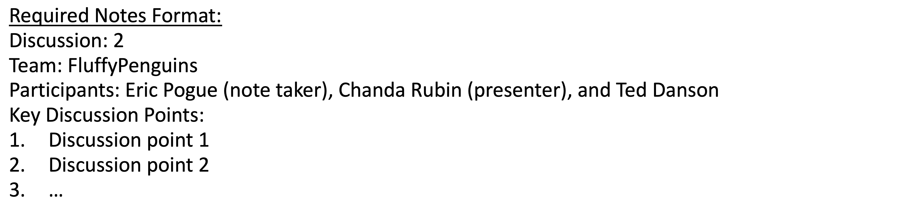
Discussion
Assign note taker and presenter roles
Review and discuss the discussion topic for this sprint for approximately 10 minutes
Note taker takes notes and presenter prepares a summary report out
Note taker share notes with all participating team members and each team member pastes and submits exact copy of the notes into their individual discussion board
Presenter Report Out

Slide 10
Prework For Next Class
Complete through activity 11
Be prepared for Review of Dale Data Representation

Slide 11
Lab (as time allows)
Review programming together tutorials

Slide 12
End of Session

