Slide 1

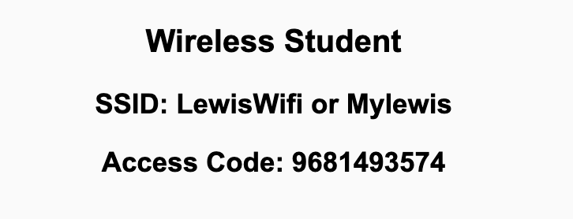
Preflight Check List
Sign into our Zoom meeting through our integrated Blackboard/Zoom link
Make sure that you can hear the conversation, see shared desktops, and view chat topics
Thank you if you choose to leave your camera on to help make our class more interactive
Be prepared to share your computer screen
Be prepared to utilize a headset with a microphone
In person participants also:
Make sure that your microphone and speakers are muted/off so that we don’t get an echo
Sit in a good spot near the classroom ceiling microphones if possible

Slide 2
Recordings
Discuss that recording are:
Opportunistic
Automatically available in Blackboard/Zoom
Start Recording

Slide 3
Agenda:
PUMA STEM – Samuel Boateng
Prework
Review Data Representation
Prework for Next Class
Lab with Getting to Know Each Other
Discussion & Questions welcome at any time but please be present with no phones or email during our time together

Slide 4
Prework
Complete through activity 11
Be prepared for Review of Dale Data Representation

Slide 5
Review Data Representation
Assign presenter
Team discusses topics while the presenter summarizes the most important topics including the representation of:
Binary & Hexadecimal plus Bits, Bytes, and Words
Numeric Data
Text & Audio
Images & Graphics
Video
Team sits back, relaxes, and acknowledges the bravery and dedication of the presenter

Slide 6
Prework For Next Class
Complete through activity 12... Be sure to add your photo to Zoom (let me know if you have difficulties)
Be prepared for Quiz 2

Slide 7
Lab (as time allows)
Review programming together tutorials

Slide 8
End of Session

