Slide 1

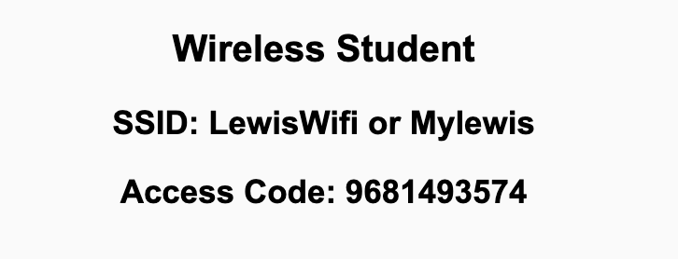
Preflight Check List
Sign into our Zoom meeting through our integrated Blackboard/Zoom link
Make sure that you can hear the conversation, see shared desktops, and view chat topics
Thank you if you choose to leave your camera on to help make our class more interactive
Be prepared to share your computer screen
Be prepared to utilize a headset with a microphone
In person participants also:
Make sure that your microphone and speakers are muted/off so that we don’t get an echo
Sit in a good spot near the classroom ceiling microphones if possible

Slide 2
Recordings
Discuss that recording are:
Opportunistic
Automatically available in Blackboard/Zoom
Start Recording

Slide 3
Agenda:
Prework
Review of Sebesta chapter 4 Basic JavaScript
Prework for Next Class
Lab
Discussion & Questions welcome at any time but please be present with no phones or email during our time together

Slide 4
Prework For Next Class
Complete through activity 11
Be prepared for Review of Sebesta chapter 4 Basic JavaScript

Slide 5
Review of Sebesta chapter 4 Basic JavaScript
Assign presenter
Team discusses topics while the presenter summarizes the topics below:
JavaScript is a scripting language that can be embedded in HTML
Main uses for JavaScript are input validation, communication, page updates
JavaScript objects can contain multiple properties which may be added dynamically
JavaScript is dynamically typed and uses call-by-value to pass function parameters
Regular expressions are a sequence of special characters used for denoting a pattern
In JavaScript, we can search for patterns using methods of String or using the RegExp object
Team sits back, relaxes, and acknowledges the bravery and dedication of the presenter

Slide 6
Prework For Next Class
Complete through activity 12
Be prepared for Quiz 2

Slide 7
Lab Part 1
Quick review of Web Resume updates
Notes:
git config –global pull.rebase false

Slide 8
Lab: Azure Web Applications with CI/CD
What is CI/CD?
How would we create and Azure based web application while focusing on CI/CD?
Prerequisites include Git, GitHub, Azure, Web Browser, Finder, Terminal, and VS Code
Review our example code to find a suitable basic web application
Create a GitHub repository
Add basic web application to the GitHub repository
Create an Azure website and link it to the GitHub repository
Update local Git repository with “git pull --no-edit” to update GitHub action
Update website, push changes, and review site
Regularly update and test Azure website during development
Notes:
git config –global pull.rebase false

Slide 9
Prework For Next Class
Complete through activity 11
Be prepared for Review of Sebesta chapter 4 Basic JavaScript

Slide 10
Lab (as time allows)
Review programming together tutorials

Slide 11
End of Session

