Slide 1

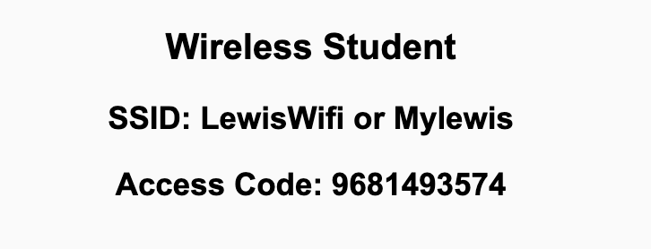
Preflight Check List
Sign into our Zoom meeting through our integrated Blackboard/Zoom link
Make sure that you can hear the conversation, see shared desktops, and view chat topics
Thank you if you choose to leave your camera on to help make our class more interactive
Be prepared to share your computer screen
Be prepared to utilize a headset with a microphone
In person participants also:
Make sure that your microphone and speakers are muted/off so that we don’t get an echo
Sit in a good spot near the classroom ceiling microphones if possible

Slide 2
Recordings
Discuss that recording are:
Opportunistic
Automatically available in Blackboard/Zoom
Start Recording

Slide 3
Agenda:
Prework
Progress Polling
Lab with Getting to Know Each Other
Prework for Next Class
Quiz 2
Discussion & Questions welcome at any time but please be present with no phones or email during our time together

Slide 4
Prework
Complete through activity 12... Be sure to add your photo to Zoom (let me know if you have difficulties)
Be prepared for Quiz 2

Slide 5
Lab
Getting To Know Each Other

Slide 6
Prework For Next Class
Everything is due Sunday!
Be prepared for Lab on Friday

Slide 7
Quiz 2
A sincere attempt at quiz 2 is due
before you leave class today.

Slide 8
End of Session

