Slide 1

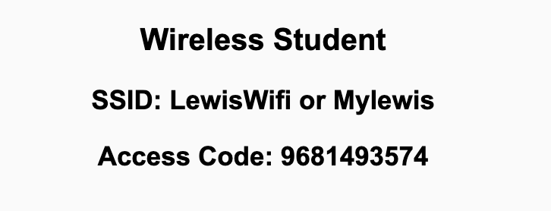
Preflight Check List
Sign into our Zoom meeting through our integrated Blackboard/Zoom link
Make sure that you can hear the conversation, see shared desktops, and view chat topics
Thank you if you choose to leave your camera on to help make our class more interactive
Be prepared to share your computer screen
Be prepared to utilize a headset with a microphone
In person participants also:
Make sure that your microphone and speakers are muted/off so that we don’t get an echo
Sit in a good spot near the classroom ceiling microphones if possible

Slide 2
Recordings
Discuss that recording are:
Opportunistic
Automatically available in Blackboard/Zoom
Load Polls… check
Sound Check… plus Video, and Desktop Sharing… check
Start Recording

Slide 3
Agenda:
Prework and Announcements
Friendly Conversation Topic: What is the Command Line Interface (CLI)?
Polling: Sprint Progress, Command Line Interfaces (CLI), and Directories
Scrum Team Discussion of Files, File Systems, and Directories
Prework for Next Class
Discussion & Questions welcome at any time but please be present with no phones or email during our time together

Slide 4
Prework For Today
Prior to our next class please:
Complete through activity 10 prior to next class
Suggestion: Don’t forget to take screenshots when completing Tools of the Trade
Be prepared for your Scrum Team review and report out of “Computer Science Illuminated” chapter 11 File Systems and Directories
Reminder: All Friday session are fully remote.

Slide 5
What is the Command Line Interface?
According to W3C
According to Hostinger Tutorials

Slide 6
Polling: Sprint Progress, Command Line Interfaces (CLI), and Directories

Slide 7
Let’s Launch PowerShell or Terminal

Slide 8
Breakout Discussion on Dale Chapter 11
Discuss chapter 11 on Files and File Systems by:
Assigning presenter
Discussing key chapter topics while the presenter summarizes the topics below:
Files and File Types… Are all text files also binary?
File Systems, Directories, and Directory Trees: Where would be a good place to store your class files? Why?
Review Lab question on where should and shouldn’t store you class files: How would you answer the question?
Hidden Files and Directories: Are hidden files a good way to keep information safe from hackers?
Can you and should you be able to find directories and files from a command line interface (CLI)?
Team sits back, relaxes, and acknowledges the bravery and dedication of the presenter

Slide 9
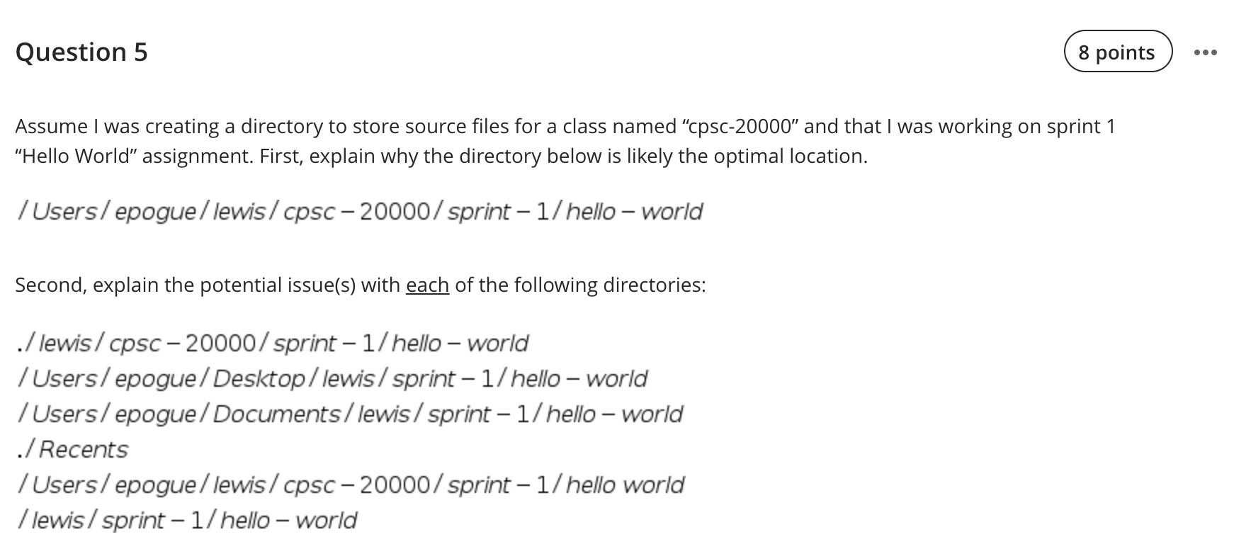
Review Lab 1 Question 5 on File Systems

Slide 10
Review Lab 1 Question on File Systems

Slide 11
Prework For Next Class
No class Monday due to the Labor Day holiday. Have a great holiday!
Prior to our Wednesday class please:
Complete through activity 13 prior to next class
Be mostly complete with activity 14
Be prepared for your Scrum Team review and report out on “Computer Science Illuminated” chapter 1
Be prepared for Quiz 1

Slide 12
End of Session

