Slide 1

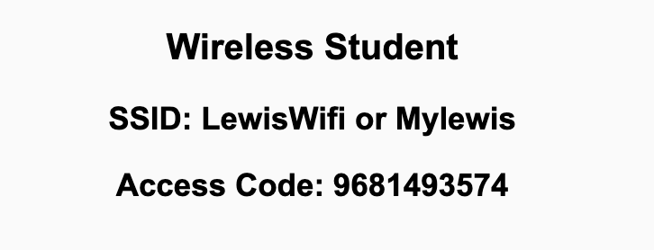
Preflight Checklist
Sign into our Zoom meeting through our integrated Blackboard/Zoom link
Make sure that you can hear the conversation, see shared desktops, and view chat topics
Thank you if you choose to leave your camera on to help make our class more interactive
Be prepared to share your computer screen
Be prepared to utilize a headset with a microphone
In person participants also:
Make sure that your microphone and speakers are muted/off so that we don’t get an echo
Sit in a good spot near the classroom ceiling microphones if possible

Slide 2
Preflight Checklist (continued)
Load Polling
Set Camera, Microphone, and Speakers
Share Desktop
… review that recordings are opportunistic and automatically available in Blackboard/Zoom
Start Recording
Start Recording

Slide 3
Agenda:
Prework and Announcements
Friendly Conversation Topic: What is a Package Manager?
Sprint Progress Polling and Package Managers
Breakout Discussion: Object-Oriented Programming Concepts & Practices
Prework for Next Class
Discussion & Questions welcome at any time but please be present with no phones or email during our time together

Slide 4
Prework For Today
Prior to our next class please:
Complete through activity 10 prior to next class
Suggestion: Don’t forget to take screenshots when completing Tools of the Trade
Be prepared for your Scrum Team review and report out of “Object-Oriented Programming Concepts and Practices”
Reminder: All Friday session are fully remote.

Slide 5
Polling: Sprint Progress, Package Managers, and Microsoft OpenJDK

Slide 6
Breakout Discussion
Object-Oriented Programming Concepts & Practices:
Assign presenter
Team discusses chapter topics while the presenter summarizes the topics below:
Classes and Objects
Properties (member variables) & Methods (member functions)
Encapsulation (information hiding)… Can it protect data from hackers?
Inheritance (abstraction)
Polymorphism
Composition & Aggregation
Team sits back, relaxes, and acknowledges the bravery and dedication of the presenter
Notes:
Object-Oriented Programming is the best way we know to reuse other people’s code.

Slide 7
Prework For Next Class
No class Monday due to the Labor Day holiday. Have a great holiday!
Prior to our Wednesday class please:
Complete through activity 13 prior to next class
Be certain that you have completed “Object-Oriented Programming Concepts & Practices”
Be prepared for continued Breakout Discussion on OOP Concepts & Practices
Attempt to install Microsoft OpenJDK… preferably using a Pack Manger
Be prepared for Quiz 1

Slide 8
End of Session

