Slide 1

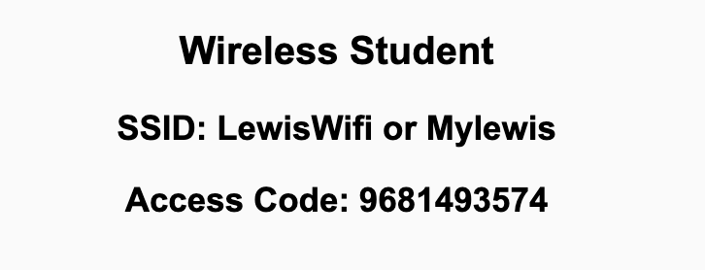
Preflight Check List
Sign into our Zoom meeting through our integrated Blackboard/Zoom link
Make sure that you can hear the conversation, see shared desktops, and view chat topics
Thank you if you choose to leave your camera on to help make our class more interactive
Be prepared to share your computer screen
Be prepared to utilize a headset with a microphone
In person participants also:
Make sure that your microphone and speakers are muted/off so that we don’t get an echo
Sit in a good spot near the classroom ceiling microphones if possible

Slide 2
Recordings
Discuss that recording are:
Opportunistic
Automatically available in Blackboard/Zoom
Load Polls… check
Sound Check… plus Video, and Desktop Sharing… check
Start Recording

Slide 3
Agenda:
Prework and Announcements
Sprint Progress Polling
Breakout Discussion of “Computer Science Illuminated” chapter 1
Prework for Next Class
Quiz 1
Discussion & Questions welcome at any time but please be present with no phones or email during our time together

Slide 4
Prework
No class Monday due to the Labor Day holiday.
Prior to our Wednesday class please:
Complete through activity 13 prior to next class
Be mostly complete with activity 14
Be prepared for your Scrum Team review and report out on “Computer Science Illuminated” chapter 1
Be prepared for Quiz 1
Reminder: Your initial Discussion 1 post was due Sunday.

Slide 5
Polling – Sprint Progress

Slide 6
Breakout Discussion on chapter 1 The Big Picture
Assign presenter
Team discusses chapter topics while the presenter summarizes the items below:
What is abstraction? Is it always good? Can you give a good and a bad example of abstraction?
What are the top two historical events in computing? Why?
What is algorithmic thinking and representation?
Describe programming and design? How much to they overlap?
Team sits back, relaxes, and acknowledges the bravery and dedication of the presenter

Slide 7
Prework For Next Class
Friday class is all virtual.
Prior to our class please:
Complete through activity 14 prior to next class
Be mostly complete with activity 15
Be prepared for working together on Lab 1 in class
Everything is due Sunday!

Slide 8
Quiz Expectations
Quiz Expectations include:
You may use any naturally available documentation including books, notes, and web browser
You may not use quiz specific content like question banks
The quiz is an individual assignment so asking others would be inappropriate**
You are welcome to ask me questions
**General topic conversations are encouraged… plus in class “Phone a Friend” sessions are fine.

Slide 9
Quiz 1
“Phone a Friend”

Slide 10
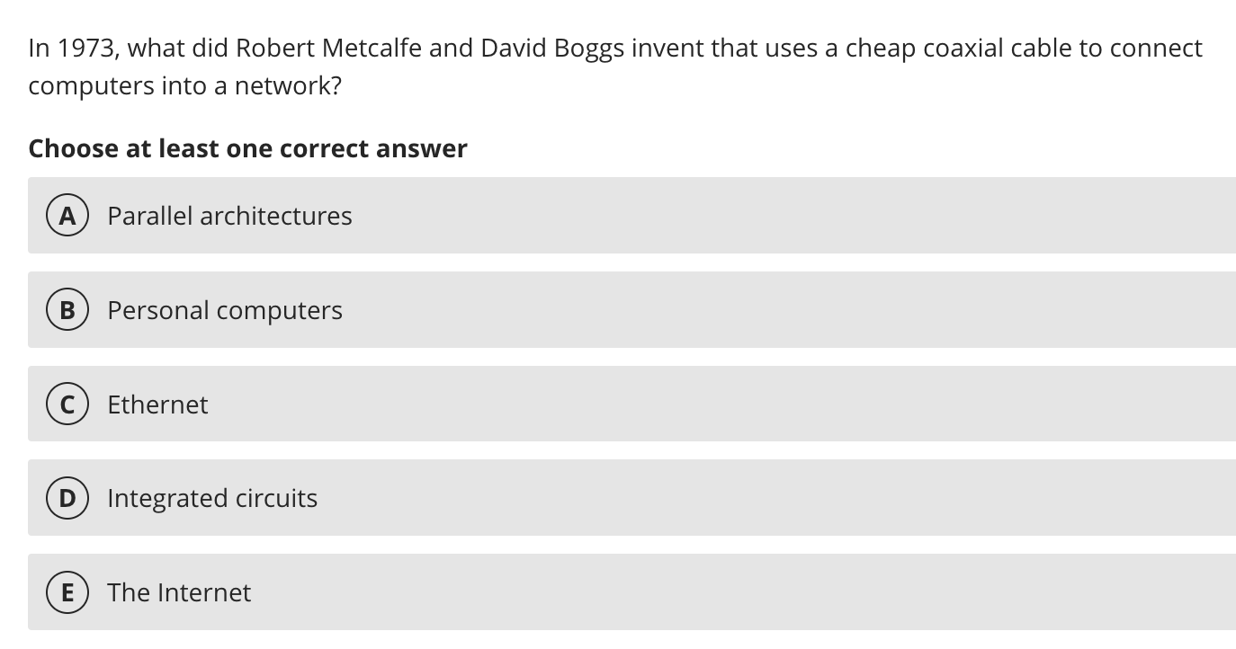

Slide 11
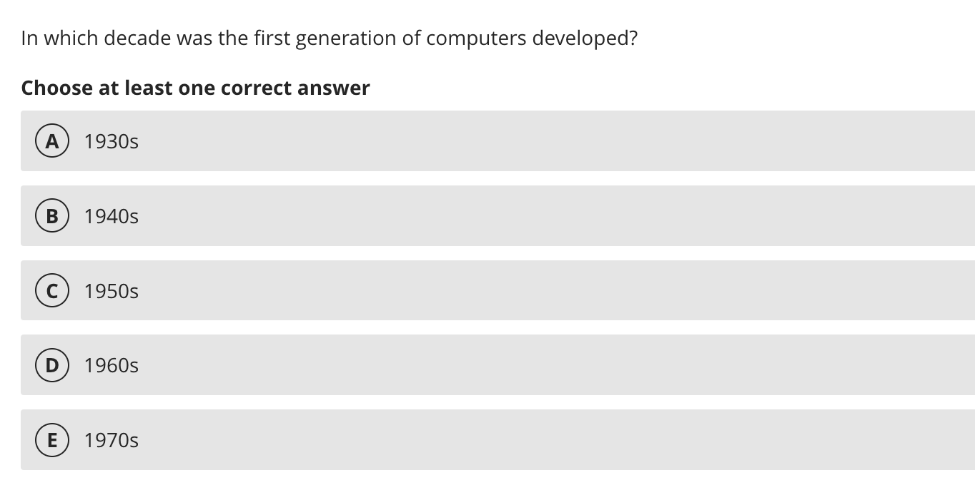

Slide 12
Quiz 1
A sincere attempt at quiz 1 is due
before you leave class today.

Slide 13
End of Session

