Slide 1

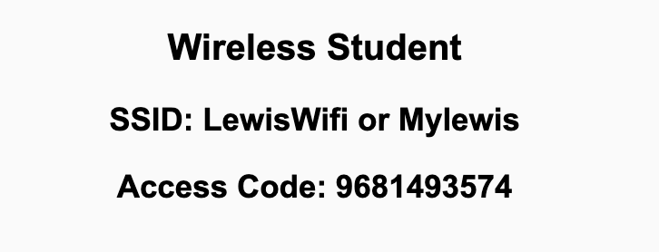
Preflight Checklist
Sign into our Zoom meeting through our integrated Blackboard/Zoom link
Make sure that you can hear the conversation, see shared desktops, and view chat topics
Thank you if you choose to leave your camera on to help make our class more interactive
Be prepared to share your computer screen
Be prepared to utilize a headset with a microphone
In person participants also:
Make sure that your microphone and speakers are muted/off so that we don’t get an echo
Sit in a good spot near the classroom ceiling microphones if possible

Slide 2
Preflight Checklist (continued)
Load Polling
Set Camera, Microphone, and Speakers
Share Desktop
… review that recordings are opportunistic and automatically available in Blackboard/Zoom
Start Recording
Start Recording

Slide 3
Agenda:
Prework and Announcements
Chris Breier / Associate Director of Career Services and Web Resume
Sprint 1 Demos
Sprint 1 Retrospective
Sprint 2 Planning
Prework for Next Class
Breakout Session: Sprint 2 Planning Review
Discussion & Questions welcome at any time but please be present with no phones or email during our time together

Slide 4
Prework For Next Class
Everything is due Sunday!
Be prepared for Sprint 1 Demos, Sprint 1 Retrospective, and Sprint 2 Planning next class.

Slide 5

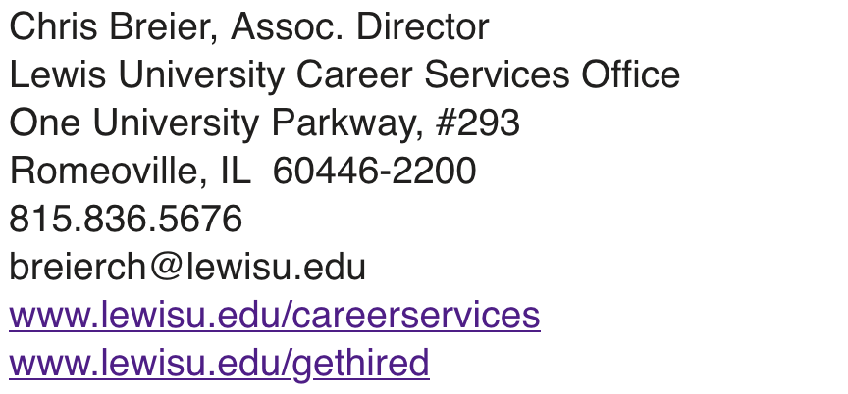
Chris Breier / Associate Director of Career Services and Web Resume

Slide 6
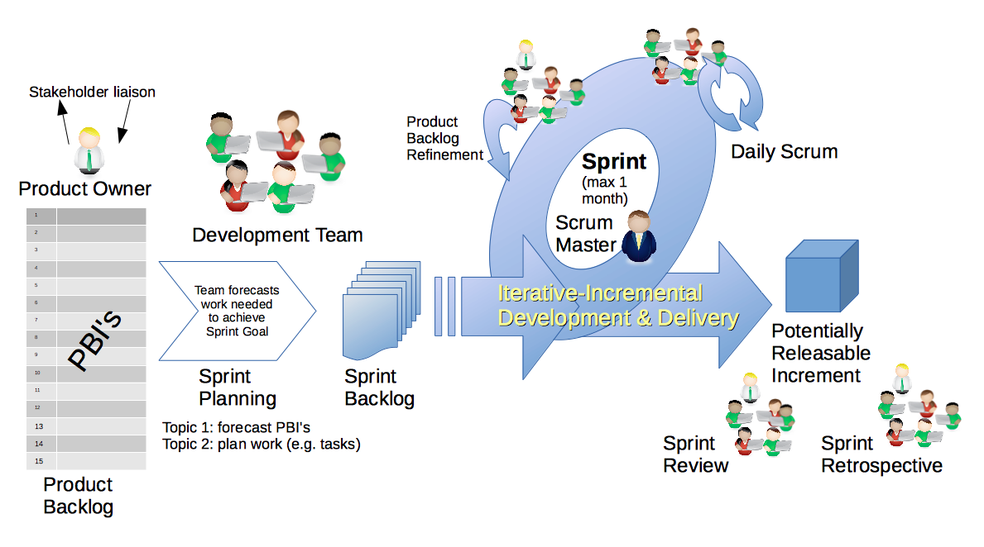
Scrum Process – Sprint Review & Demo
By Dr ian mitchell - Own work, CC BY-SA 4.0, Link

Slide 7

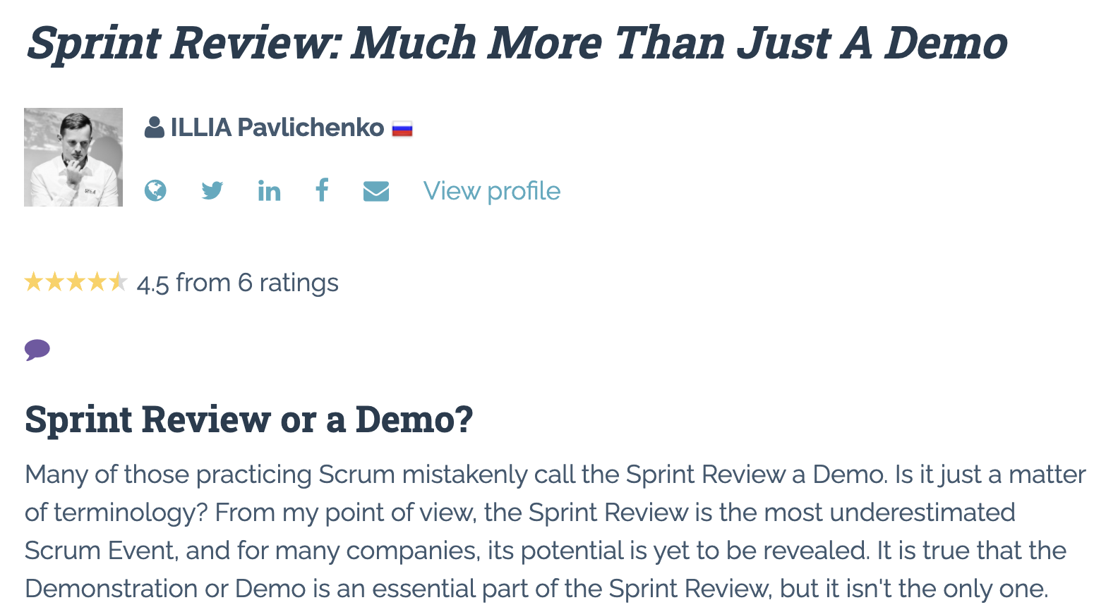

Slide 8
Demo Guidelines – Presenter
Everyone will give at least one demo of their work during the semester.
Your demo should be 2 to 5 minutes and can include any or all of the following:
Show your application running
Comment on your implementation
Show the source code
Explain how you organized the code
Talk about any challenges
You should not prepare slides or a presentation
**You will also need to complete the Demo assignment in Blackboard.

Slide 9
Demo Guidelines – Listener
Everyone will be listening to many demos during the semester.
Your listener responsibilities include:
Actively listening and watching what is being demoed
Come up with a meaningful yet easy to answer question
Ask your question if the presenter does not get sufficient questions from other listeners
Do not ask hard question or attempt to review the presenters code
Clap for the presenter at the end of the demo and thank them for presenting
Optionally follow up with the presenter later if you have what could be more difficult questions or if you have suggestions

Slide 10
Sprint Demos

Slide 11
Complete Sprint Demo Assignment

Slide 12
Scrum Process – Sprint Retrospective
By Dr ian mitchell - Own work, CC BY-SA 4.0, Link

Slide 13
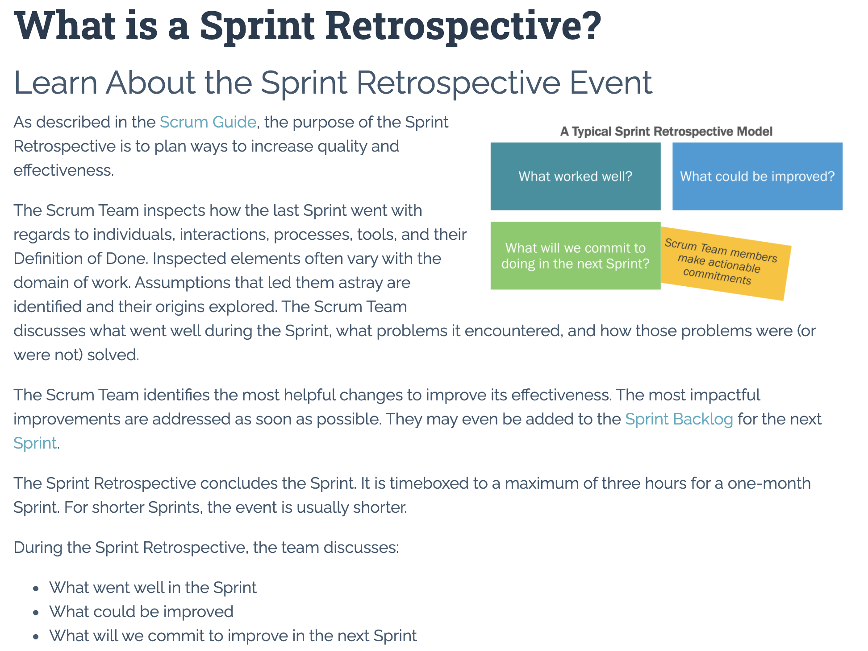

Slide 14
Submission Percentage

Slide 15
Class Retrospective
Feedback from Assignments & Reflections:
Great job turning assignments!
I’m being a little more demanding on fully answering questions
A few more unanswered questions than I am used to seeing... but more assignments submitted :-)
Be sure that you are comfortable with validating your HTML
What can I/we do to improve in sprint 2?
Scrum team discussions starting Thursday

Slide 16
Sprint Planning

Slide 17
Sprint Planning
Sprint 2 Changes:
Very similar to sprint 1 with sprint 2 including Discussion 2, Quiz 2, Lab 2, and Reflection 2
We will attempt our first scrum team discussion on Thursday

Slide 18
Scrum Process – Sprint Planning
By Dr ian mitchell - Own work, CC BY-SA 4.0, Link

Slide 19
Product Backlog vs Sprint Backlog

Slide 20
Scrum Process – Product Backlog to Sprint Backlog
By Dr ian mitchell - Own work, CC BY-SA 4.0, Link

Slide 21
Scrum Process – Sprint Planning
By Dr ian mitchell - Own work, CC BY-SA 4.0, Link

Slide 22
Review Activities List and Assignments

Slide 23
Prework For Next Class
Complete through activity 6 prior to next class
Be prepared for a scrum team discussion of chapter 6**
Be prepared for some programming together time focused on “Website Creation with GitHub and Microsoft Azure - 2020 Supplemental Edition”

Slide 24
Breakout Session: Sprint 2 Planning Review
As a scrum team:
Review sprint 2 activities & assignments in detail
Discuss questions/concerns and topics that need more clarification
Scrum master share your team’s top 2 questions/concerns during report out

Slide 25
End of Session

