Slide 1

Agenda:
Prework for Today
Friendly Conversation Topic: JamStack
Breakout: Chapter 6 SaaS Client Framework
React and MERN
Prework for Next Class
Breakout: Discussion 2 on Software Development Lifecycles (SDLCs)
Discussion & Questions welcome at any time but please be present with no phones or email during our time together

Slide 2
Prework for Today
Complete through activity 6 prior to next class
Be prepared for a scrum team discussion of chapter 6**
Be prepared for scrum team Discussion 2

Slide 3
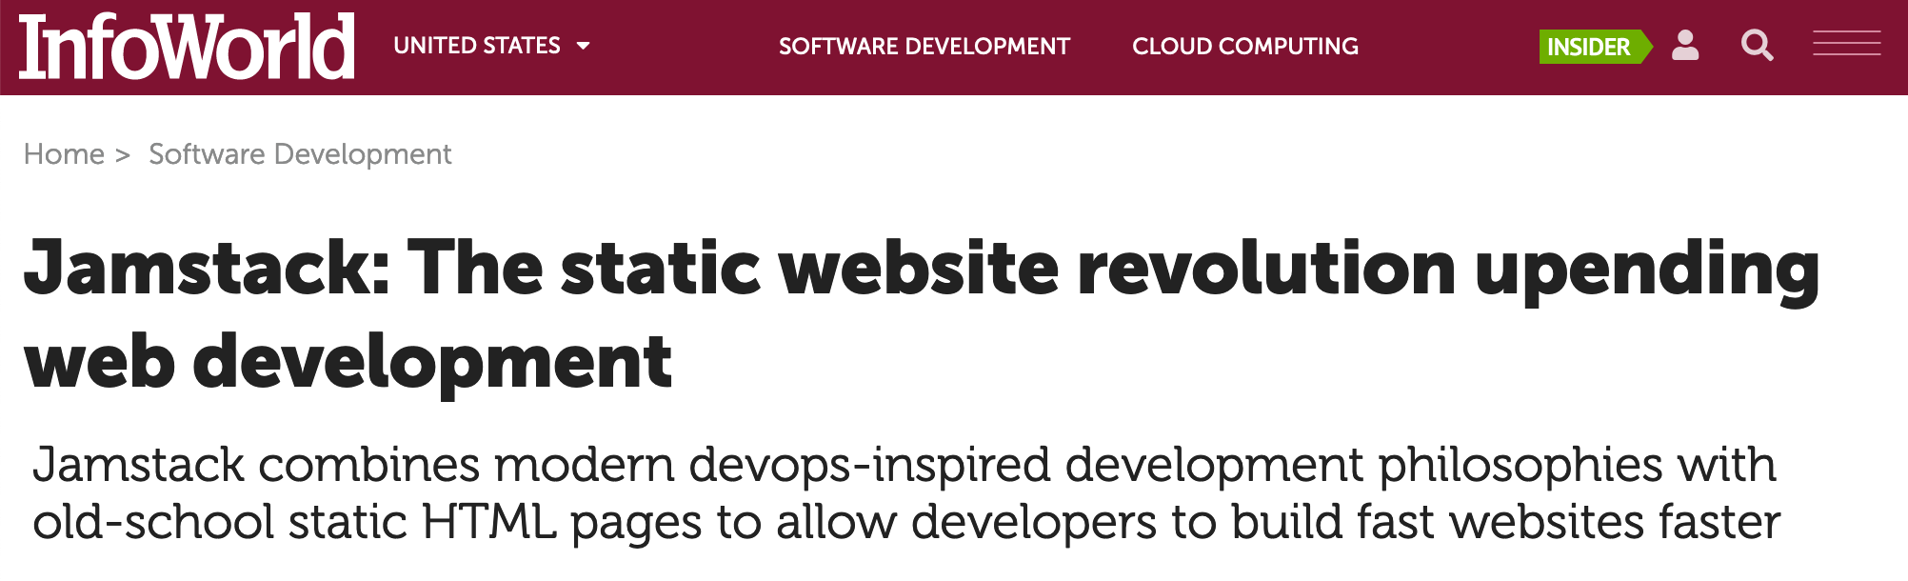
Jamstack
What is Jamstack? And why do we care?

Slide 4
Breakout: SaaS Client Framework (Fox chapter 6)
Assign presenter
Team discusses topics while the presenter summarizes the 5 topics below:
JavaScript and JavaScript with Ruby
AJAX and XML/JSON
Single-Page Web Applications
Angular, React, other single-page web application environments
Where does Ruby fit? Where does Jamstack fit?
Where does Node.js and MongoDB fit?
Team sits back, relaxes, and acknowledges the bravery and dedication of the presenter

Slide 5
React and MERN
Story Time with Eric’s Web Developer Evolution:
HTML, CSS, and JavaScript… Missing industrial strength tools (validation, debugging, encapsulation) and painful browser incompatibilities
Angular… Big, really big
React… Great tools including transpiling, validation, encapsulation, vastly simplified deployment
MERN… MongoDB seems like a wonderful tool, React (see above), Node.js / Express well okay

Slide 6
Prework for Next Class
Complete through activity 12 prior to next class
You may only be partially complete with activity 11 Web Resume
Be prepared for a scrum team discussion of chapters 3-5, A.6, and A.7
Be prepared for Quiz 2

Slide 7
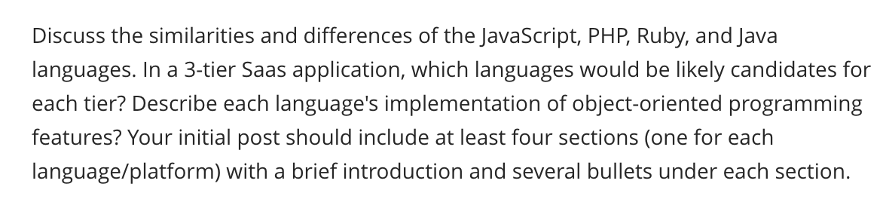
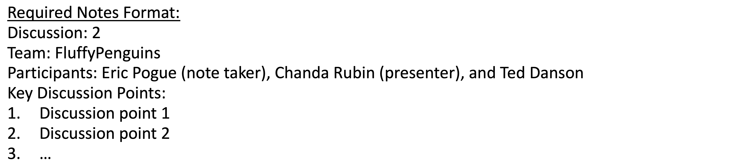
Scrum Team Discussion
Assign note taker and presenter roles to team members
Review and discuss topic
Note taker takes notes and presenter prepares a report out
Note taker share notes with all participating team members
Each team member pastes and submits an exact copy of the notes into their discussion board
Team sits back, relaxes, and tells the note taker and presenter what I wonderful job the did
Notes:
Seating chart and attendance tracker (virtual and in person)

Slide 8
End of Session

Slide 9
Scrum Team Chapter Discussion
Assign presenter
Team discussing chapter topics while the presenter summarizes the 5 topics below:
The importance of Branching is VCS systems (which VCS focused on branching)
Where should pared programming fit into the development process
The priority of specialization vs generalization in Agile vs Waterfall/Iterative
The relative importance of PMs in Agile vs Waterfall/Iterative
The two most important book on managing people and conflict (according to the author)
Team sits back, relaxes, and acknowledges the bravery and dedication of the presenter
Fox Chapter 10 on Project Management, Scrum, Pairs, and Version Control Systems

Slide 10
The Humble Text File
Notes:
Anybody else wonder how the simple text file remains the standard for building some of the most complex creations in the world?

Slide 11
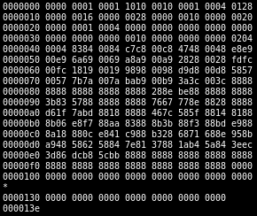
Files
All computer files are binary and can be represented in Hex
Some binary files can also be represented as text files
The term “binary file” is often incorrectly used to imply that a file is a “non-text” file.

Slide 12
In The Beginning There Were ASCII Text Files

Slide 13
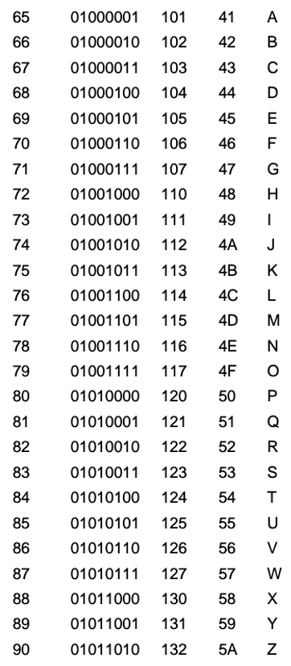
ASCII Files
Bytes are frequently used to hold individual characters in a text document. In the ASCII character set, each binary value between 0 and 127 is given a specific character. Most computers extend the ASCII character set to use the full range of 256 characters available in a byte. The upper 128 characters handle special things like accented characters from common foreign languages.

Slide 14
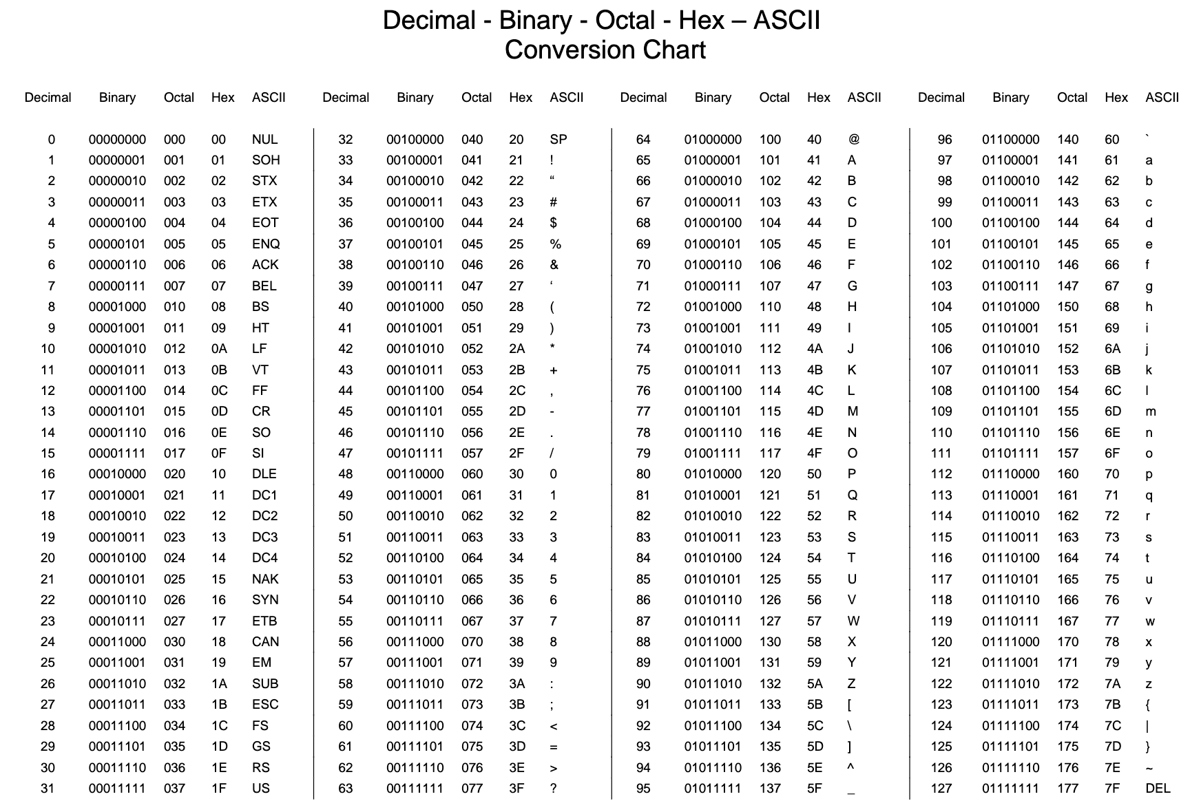

Slide 15
Unicode & UTF-16

Slide 16
Unicode, UTF-16, and UTF-8
Unlike ASCII, UTF-16 (Unicode) includes 65,536 possible combinations covering 154 modern and historical scripts, as well as multiple symbol sets [link]

Slide 17

Unicode, UTF-16, and UTF-8
Unicode
Unicode was a brave effort to create a single character set that included every reasonable writing system on the planet and some make-believe ones like Klingon, too. Some people are under the misconception that Unicode is simply a 16-bit code where each character takes 16 bits and therefore there are 65,536 possible characters. This is not, actually, correct. It is the single most common myth about Unicode, so if you thought that, don’t feel bad. [link]
“Oops!” -- Eric

Slide 18
Unicode, UTF-16, and UTF-8
Unicode: Code Points
UTF-16 Encoding: 2 bytes per character… plus some craziness

Slide 19
UTF-8

Slide 20
Unicode, UTF-16, and UTF-8
Unicode
For a while it seemed like that (UTF-16) might be good enough, but programmers were complaining. “Look at all those zeros!” they said, since they were Americans and they were looking at English text … Also they were liberal hippies in California who wanted to conserve (sneer). If they were Texans they wouldn’t have minded guzzling twice the number of bytes. But those Californian wimps couldn’t bear the idea of doubling the amount of storage it took for strings, and anyway, there were already all these doggone documents out there using various ANSI and DBCS character sets and who’s going to convert them all? Moi? For this reason alone most people decided to ignore Unicode for several years and in the meantime things got worse.
Thus was invented the brilliant concept of UTF-8. UTF-8 was another system for storing your string of Unicode code points, those magic U+ numbers, in memory using 8 bit bytes. In UTF-8, every code point from 0-127 is stored in a single byte. Only code points 128 and above are stored using 2, 3, in fact, up to 6 bytes.

Slide 21
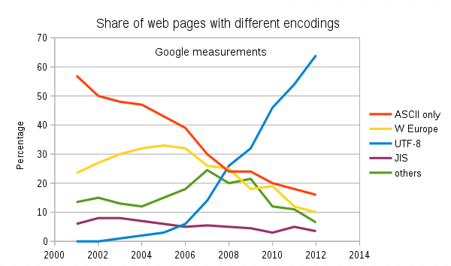
Text File Standards (Encoding)
ASCII
Unicode
UTF-8
Others

Slide 22
Text File End-Of-Line (EOL) and Encoding
Industry adoption of end-of-line encoding includes:
Windows: Both Carriage Return (CR, \r, 0x0d) and Line Feed (LF, \n, 0x0a) together.
Unix/Linux/OSX: Just Line Feed (LF, \n, 0x0a)
Mac (pre-OSX): Just Carriage Return (CR, \r, 0x0d)
Article on Windows Notepad supporting non-Windows EOF conventions [link]

Slide 23
HTML Character Entities

Slide 24

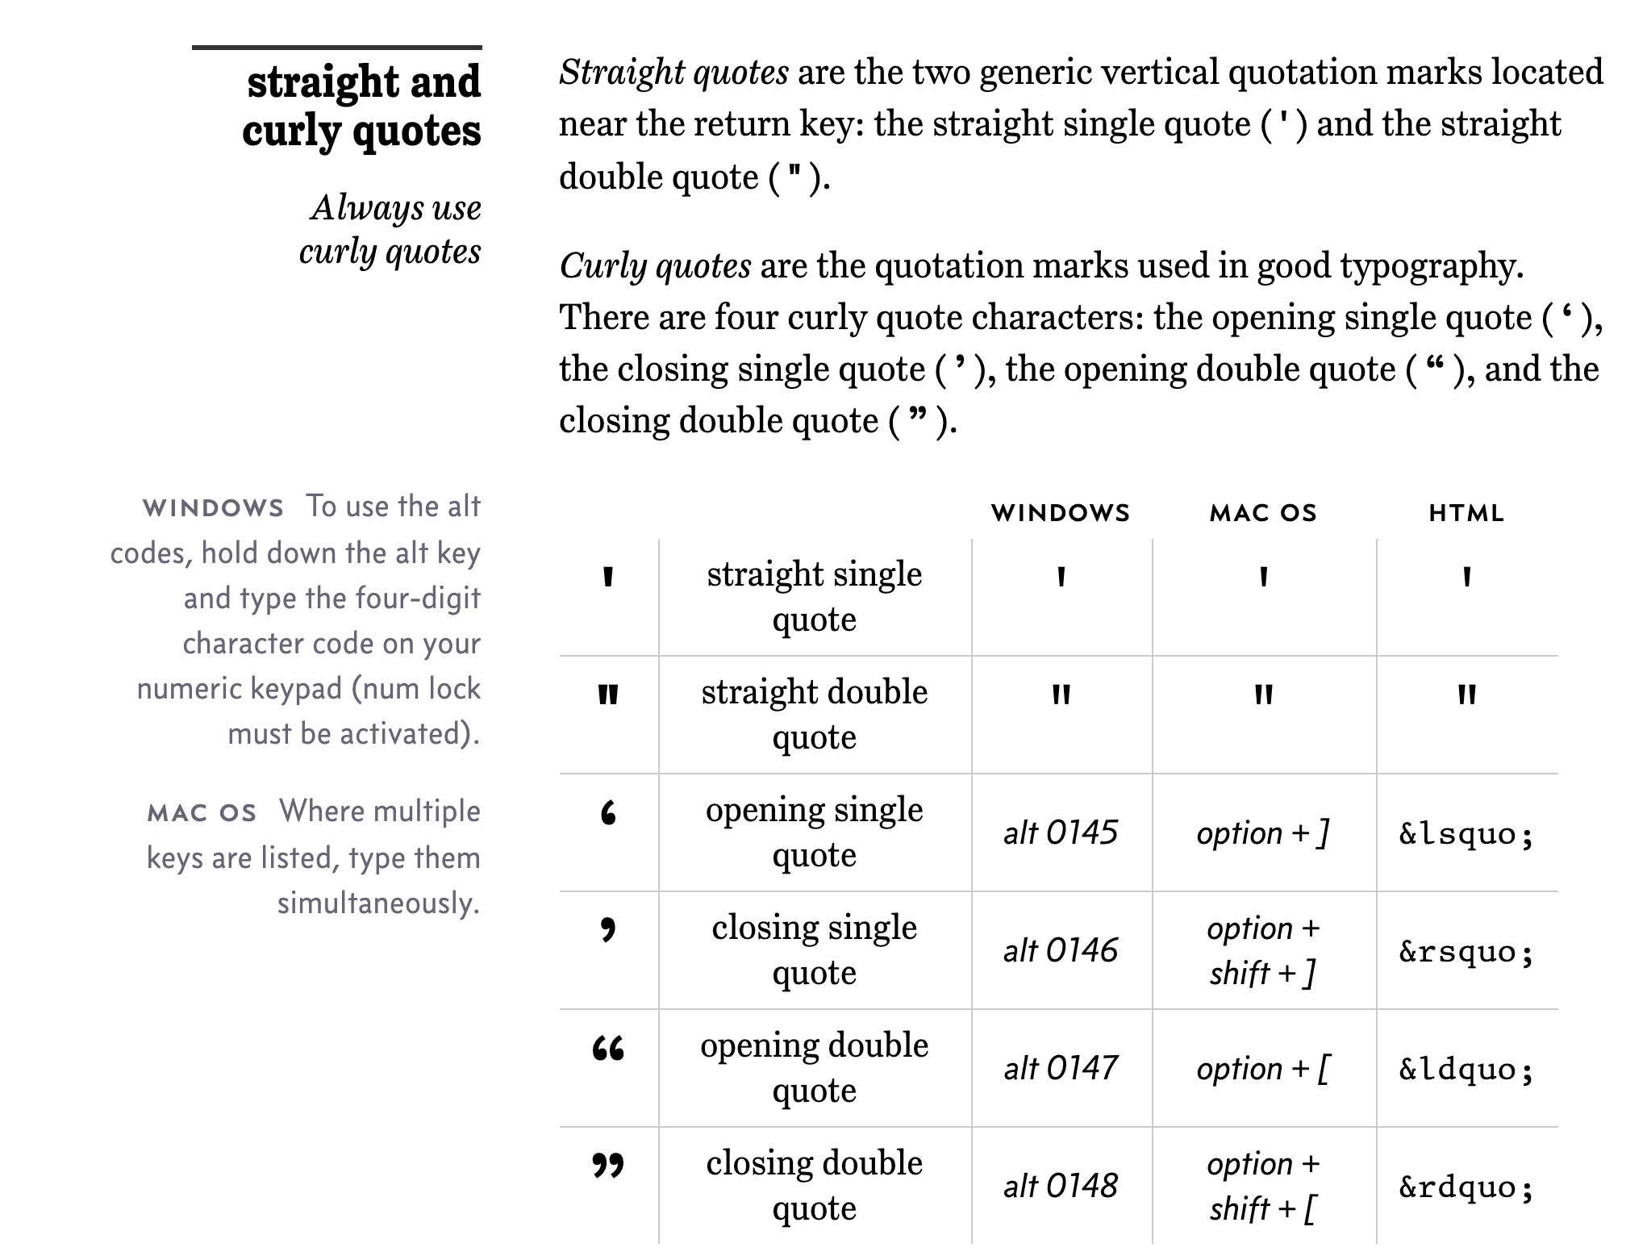
Straight vs Curly Quotes

Slide 25
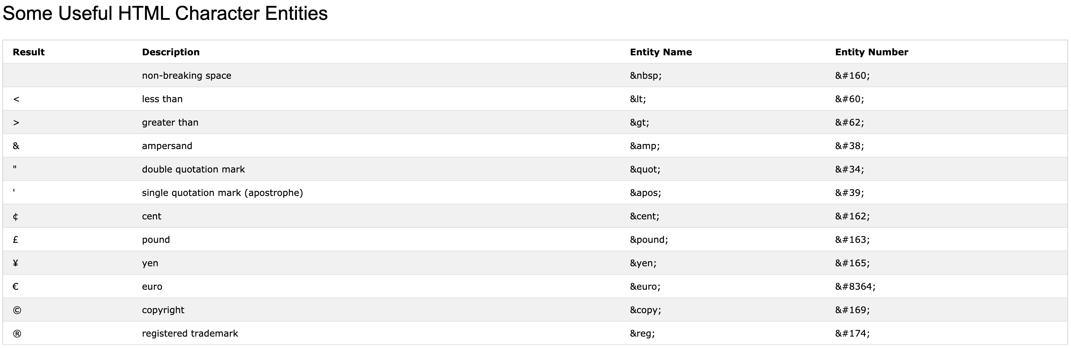
HTML Character Entities

Slide 26

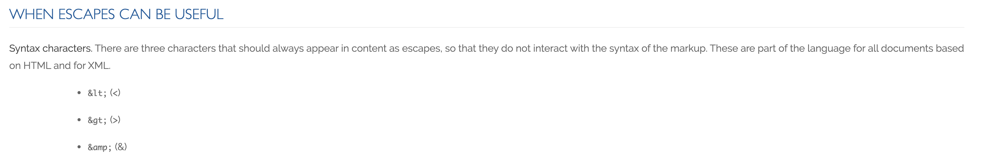
Always Escape

Slide 27
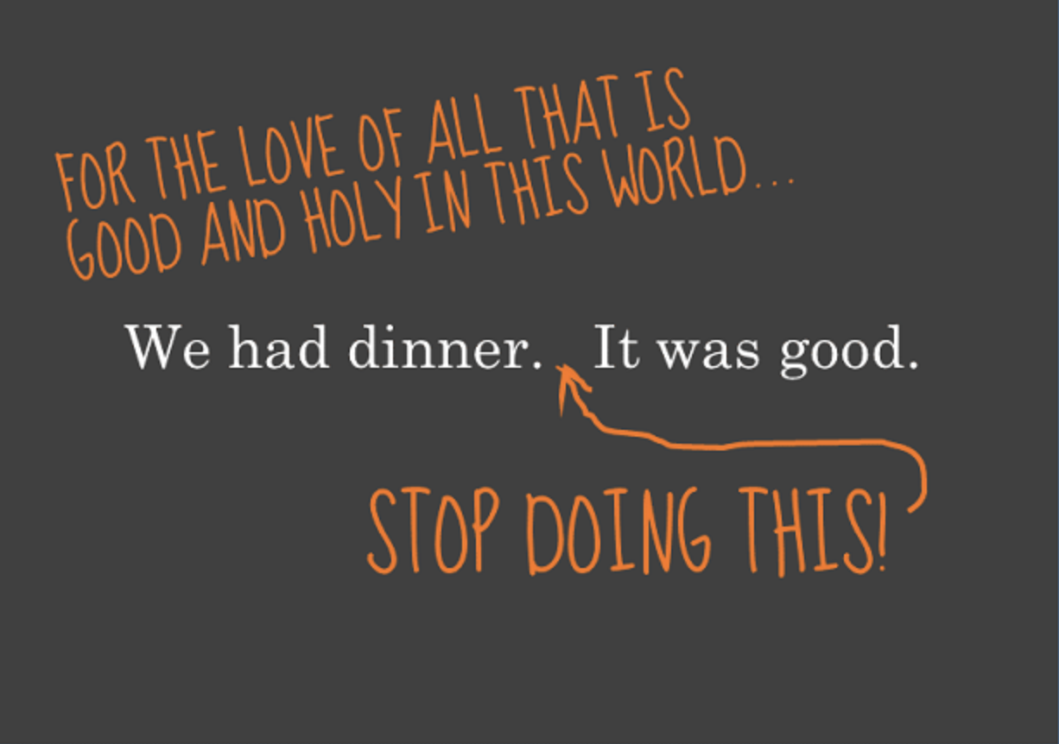
Oh yes, and…

