Slide 1

Agenda:
Prework for Today
Sprint 1 Demos
Sprint 1 Retrospective
Metrics (Rule #9)
The Beauty of Starting Early
Prework for Next Class
Breakout Session: Sprint 1 Retrospective
Discussion & Questions welcome at any time but please be present with no phones or email during our time together

Slide 2
Prework For Today
Complete through activity 5 prior to next class
Those scheduled to demo on Wednesday please be a couple of minutes early to class

Slide 3
Sprint Demos

Slide 4
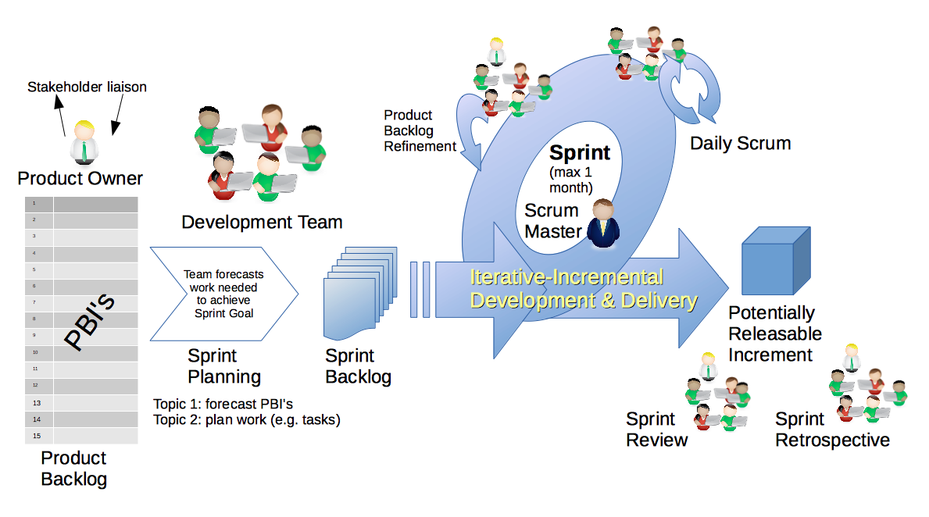
Scrum Process – Sprint Review & Demo
By Dr ian mitchell - Own work, CC BY-SA 4.0, Link

Slide 5
Demo Guidelines – Presenter
Everyone will give at least one demo of their work during the semester.
Your demo should be 2 to 5 minutes and can include any or all of the following:
Show your application running
Comment on your implementation
Show the source code
Explain how you organized the code
Talk about any challenges
You should not prepare slides or a presentation
**You will also need to complete the Demo assignment in Blackboard.

Slide 6
Demo Guidelines – Listener
Everyone will be listening to many demos during the semester.
Your listener responsibilities include:
Actively listening and watching what is being demoed
Come up with a meaningful yet easy to answer question
Ask your question if the presenter does not get sufficient questions from other listeners
Do not ask hard question or attempt to review the presenters code
Clap for the presenter at the end of the demo and thank them for presenting
Optionally follow up with the presenter later if you have what could be more difficult questions or if you have suggestions

Slide 7
Sprint Demos

Slide 8
Complete Sprint Demo Assignment

Slide 9
Scrum Process – Sprint Retrospective
By Dr ian mitchell - Own work, CC BY-SA 4.0, Link

Slide 10
Metrics (Rule #9)
“Anything that is measured and watched, improves.” – Bob Parsons

Slide 11
Submission Percentage

Slide 12
Class Retrospective
Feedback from Assignments & Reflections:
Wow! I’ve never seen a 100% submission percentage in sprint 1. Very well done.
Assignments are graded and you should have access to grades and quiz answers
All of the programming assignments in this class will be in Java
What can I/we do to improve in sprint 2?
What can we do to keep up the energy
Interesting in trying to start earlier?

Slide 13
The Beauty of Starting Early
“The difference of starting early instead of leaving everything for the last minute truly amazes me. I feel so much better about this Sprint. I was able to figure out how to make changes from the Python version of Matchmaker to the HTML version all on my own.
Thus, I am proud of myself for getting everything done and not feeling so overwhelmed as I usually did in the past Sprints. Overall, things are going great. I feel that I am getting more and more used to everything and am finally able to solve more problems out on my own.”
-- Justina Piwoni
Introduction to Computer Science, Sprint 6 Reflection

Slide 14
The Beauty of Starting Early
“The difference of starting early instead of leaving everything for the last minute truly amazes me. I feel so much better about this Sprint. I was able to figure out how to make changes from the Python version of Matchmaker to the HTML version all on my own.
Thus, I am proud of myself for getting everything done and not feeling so overwhelmed as I usually did in the past Sprints. Overall, things are going great. I feel that I am getting more and more used to everything and am finally able to solve more problems out on my own.”
Justina Piwoni
Introduction to Computer Science, Sprint 6 Reflection
Kaizen: Small improvements eventually result in huge benefits

Slide 15
Prework for Next Class
Complete through activity 7 prior to next class
Be prepared for Breakout Session on Patterns
Be prepared for team Discussion 2

Slide 16
Breakout Session: Sprint 1 Retrospective
As a scrum team consider:
How does your team feel about sprint 1 now that it is over?
What improvements should we make as a class, team, or individual in sprint 2?
Why did everyone in the class submit all of their assignments on time in sprint 1? (I’m asking because if there is something we/I did, I want to do it again)?
Would everyone on your team be willing to try starting early by investing 40 minutes of focused time on Getting to Know Each Other prior to class on Friday?
What can we do to recognize or celebrate our 100% submission?

Slide 17
End of Session

Slide 18
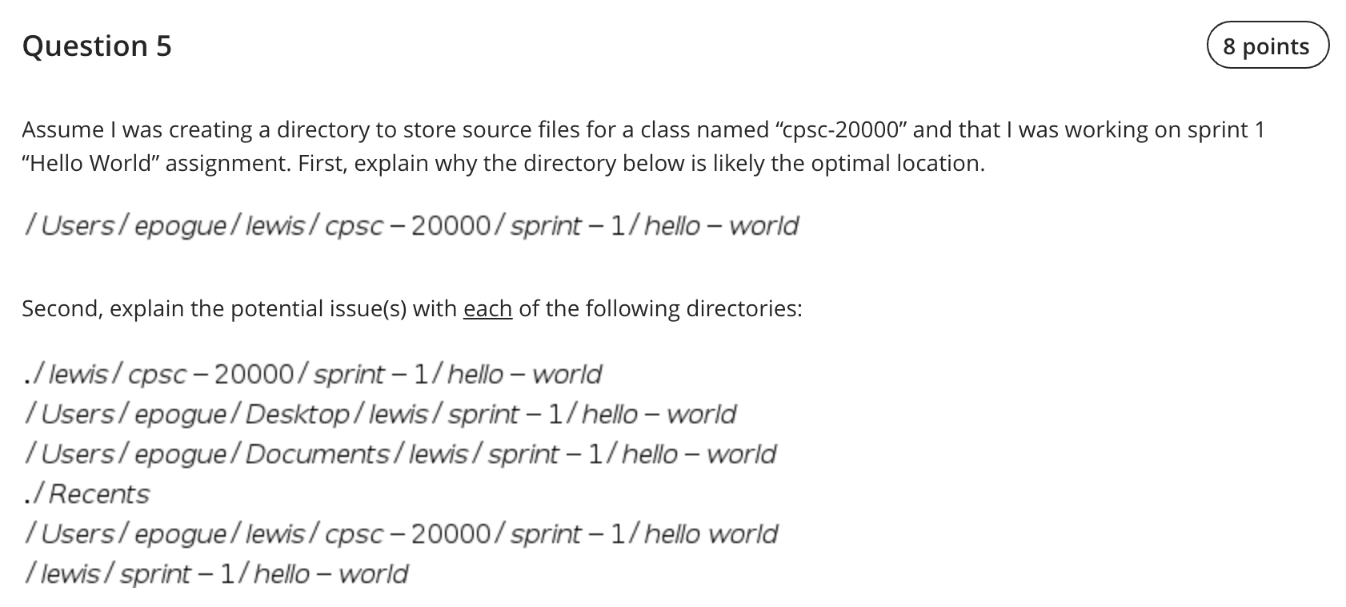
Lab 1 - Question 5

Slide 19
Agenda:
Prework and Announcements
Sprint 2 Planning
Prework for Next Class
Scrum Team Sprint 2 Planning Review
Review Demo Schedule for Wednesday
Discussion & Questions welcome at any time but please be present with no phones or email during our time together

Slide 20
Prework For Today
Everything is due Sunday!
Be prepared for Sprint 2 Planning Monday
Be prepared for Sprint 1 Demos, Sprint 1 Retrospective on Wednesday

Slide 21
Sprint Planning

Slide 22
Sprint Planning
Sprint 2 Changes:
Very similar to sprint 1 with sprint 2 including Discussion 2, Quiz 2, Lab 2, and Reflection 2
We will attempt our first Scrum Team Breakout Discussion on Friday
Should be a little easier since we don’t have a holiday during the sprint

Slide 23
Scrum Process – Sprint Planning
By Dr ian mitchell - Own work, CC BY-SA 4.0, Link

Slide 24
Review Activities List and Assignments

Slide 25
Scrum Team Planning Review
As a scrum team:
Review sprint 2 activities & assignments in detail
Discuss and document questions/concerns
Scrum master share your team’s top 2 questions/concerns during report out

Slide 26
Prework For Next Class
Complete through activity 5 prior to next class
Those scheduled to demo on Wednesday please be a couple of minutes early to class

Slide 27
Review Demo Schedule

Slide 28
End of Session

