Slide 1

Agenda:
Prework for Today
Programming Together with “HelloWorld Plus for the Web” and “HelloWorldPlus with Pictures”
Review Directories with Lab 1 – Question 5
Breakout Session: Binary Values and Numbering Systems (as time allows)
Prework for Next Class
Breakout Session: Discussion 2
Discussion & Questions welcome at any time but please be present with no phones or email during our time together

Slide 2
Prework for Today
Complete through activity 8 prior to next class
Be prepared for Breakout Session on The Information Layer / Binary Values and Numbering Systems
Be prepared for team Discussion 2

Slide 3
Programming Together
Programming Together with “HelloWorld Plus for the Web” and “HelloWorldPlus with Pictures”
Let’s complete the following activities together:
Review programming together tutorials
Review example code
Cloning example code
Execute applications

Slide 4
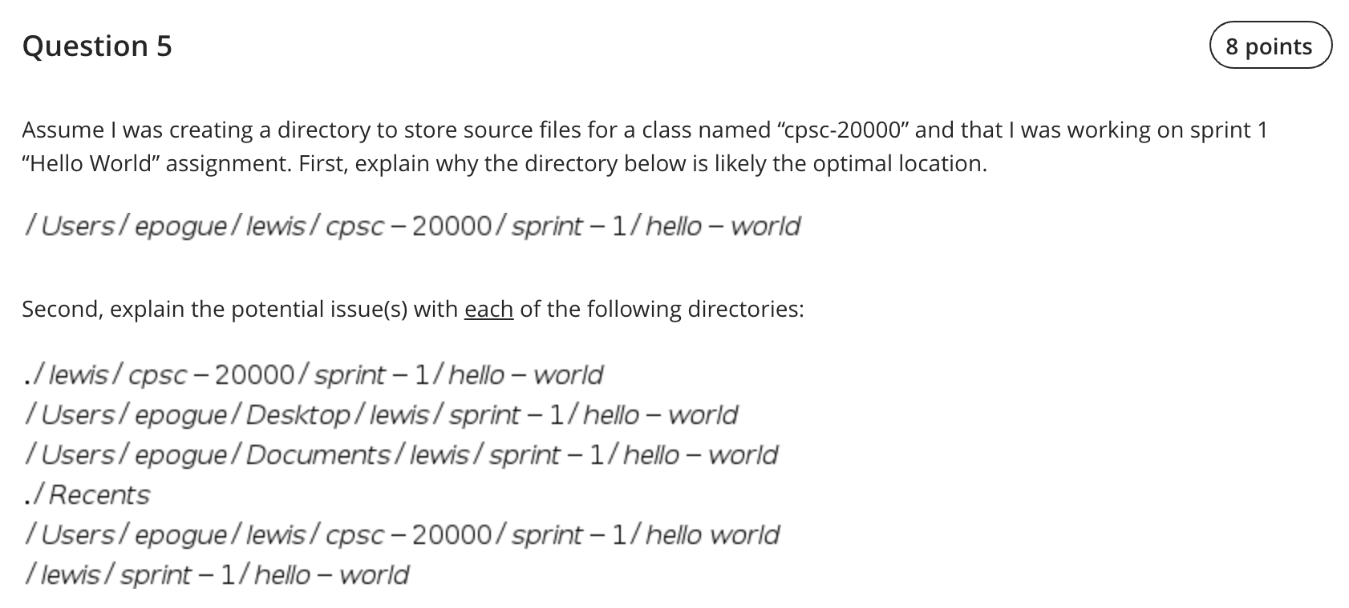
Review Directories with Lab 1 - Question 5

Slide 5
Breakout Session: Binary Values and Numbering Systems
Assign presenter
Team discusses topics while the presenter summarizes the topics below:
Numbers and Computing
Positional Notation
Binary, Octal, and Hexadecimal
Why Hex?
How does this relate to files?
Team sits back, relaxes, and acknowledges the bravery and dedication of the presenter

Slide 6
Prework for Next Class
Complete through activity 11 prior to next class
Complete Programming Together with “HelloWorld Plus for the Web”
Be prepared for Breakout Session: Binary Values and Numbering Systems

Slide 7
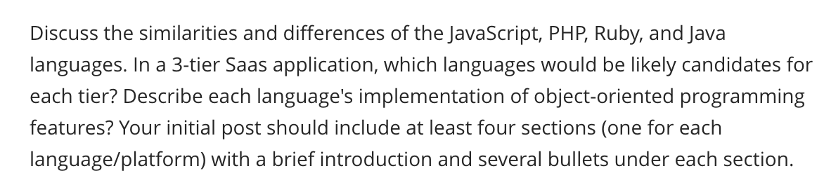
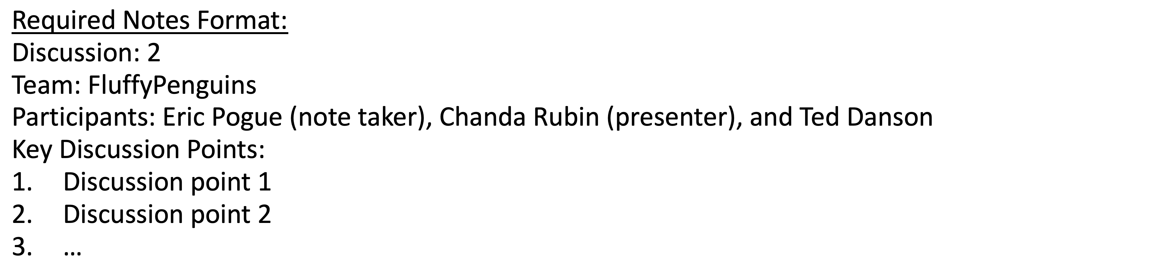
Breakout Session: Discussion 2
Assign note taker and presenter roles to team members
Review and discuss topic
Note taker takes notes and presenter prepares a report out
Note taker share notes with all participating team members
Each team member pastes and submits an exact copy of the notes into their discussion board
Team sits back, relaxes, and tells the note taker and presenter what I wonderful job the did
Notes:
Seating chart and attendance tracker (virtual and in person)

Slide 8
End of Session

