Slide 1

Agenda:
Prework and Announcements
Recall Representing the Humble Text Files
Breakout Discussion on Representation
Prework for Next Class
Quiz 2
Discussion & Questions welcome at any time but please be present with no phones or email during our time together

Slide 2
Prework for Next Class
Complete through activity 13 prior to next class
Start ““HelloWorldPlus with Pictures””
Be prepared for Breakout Session: Data Representation
Be prepared for Quiz 2

Slide 3
Recall: Representing the Humble Text File
Notes:
Anybody else wonder how the simple text file remains the standard for building some of the most complex creations in the world?

Slide 4
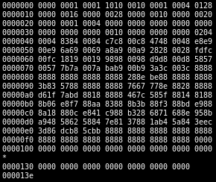
Files
All computer files are binary and can be represented in Hex
Some binary files can also be represented as text files
The term “binary file” is often incorrectly used to imply that a file is a “non-text” file.

Slide 5
In The Beginning There Were ASCII Text Files

Slide 6
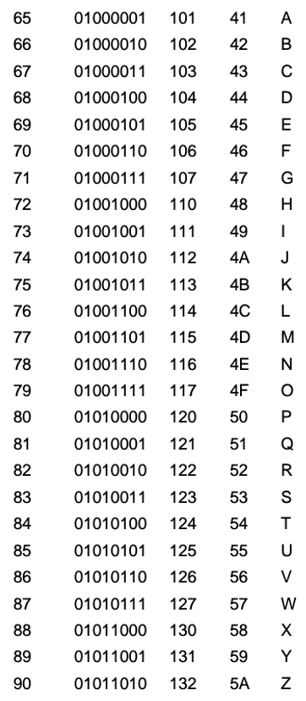
ASCII Files
Bytes are frequently used to hold individual characters in a text document. In the ASCII character set, each binary value between 0 and 127 is given a specific character. Most computers extend the ASCII character set to use the full range of 256 characters available in a byte. The upper 128 characters handle special things like accented characters from common foreign languages.

Slide 7
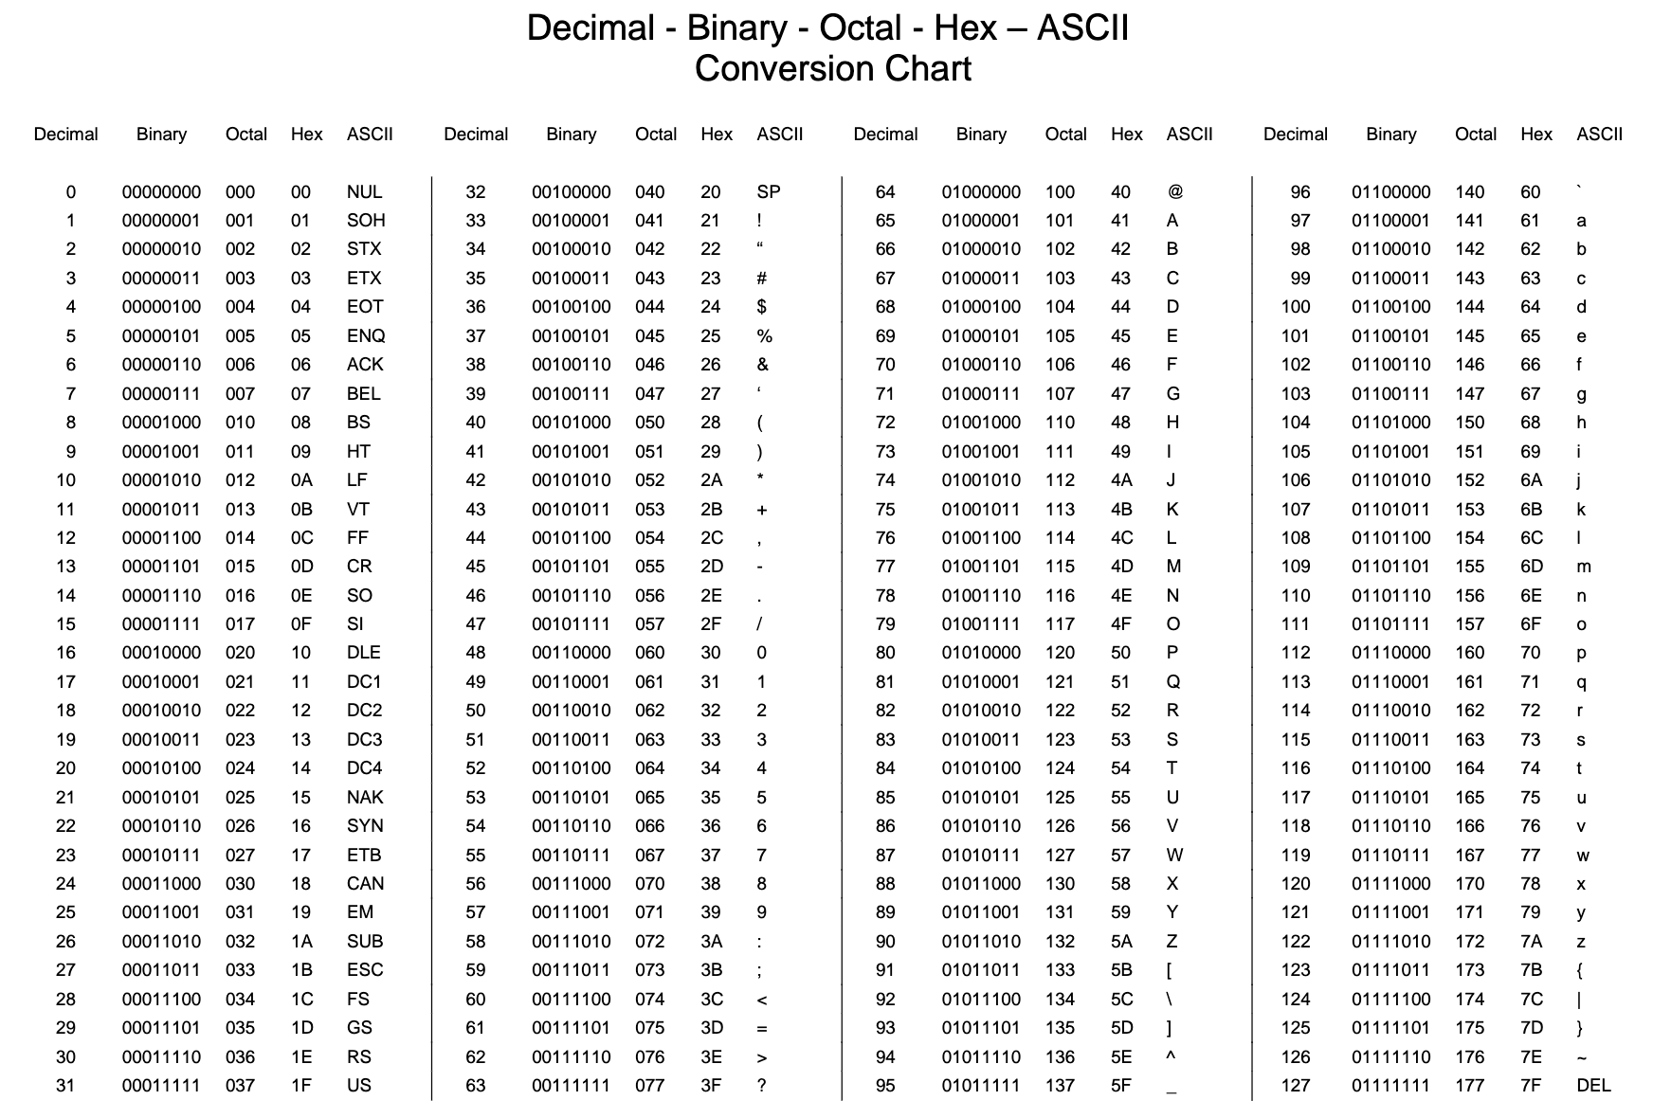

Slide 8
Unicode & UTF-16

Slide 9
Unicode, UTF-16, and UTF-8
Unlike ASCII, UTF-16 (Unicode) includes 65,536 possible combinations covering 154 modern and historical scripts, as well as multiple symbol sets [link]

Slide 10

Unicode, UTF-16, and UTF-8
Unicode
Unicode was a brave effort to create a single character set that included every reasonable writing system on the planet and some make-believe ones like Klingon, too. Some people are under the misconception that Unicode is simply a 16-bit code where each character takes 16 bits and therefore there are 65,536 possible characters. This is not, actually, correct. It is the single most common myth about Unicode, so if you thought that, don’t feel bad. [link]
“Oops!” -- Eric

Slide 11
Unicode, UTF-16, and UTF-8
Unicode: Code Points
UTF-16 Encoding: 2 bytes per character… plus some craziness

Slide 12
UTF-8

Slide 13
Unicode, UTF-16, and UTF-8
Unicode
For a while it seemed like that (UTF-16) might be good enough, but programmers were complaining.
“Look at all those zeros!” they said, since they were Americans and they were looking at English text
… Also they were liberal hippies in California who wanted to conserve (sneer). If they were Texans they wouldn’t have minded guzzling twice the number of bytes. But those Californian wimps couldn’t bear the idea of doubling the amount of storage it took for strings, and anyway,
… there were already all these doggone documents out there using various ANSI and DBCS character sets and who’s going to convert them all? Moi? For this reason alone most people decided to ignore Unicode for several years and in the meantime things got worse.
Thus was invented the brilliant concept of UTF-8. UTF-8 was another system for storing your string of Unicode code points, those magic U+ numbers, in memory using 8 bit bytes. In UTF-8, every code point from 0-127 is stored in a single byte. Only code points 128 and above are stored using 2, 3, in fact, up to 6 bytes.

Slide 14
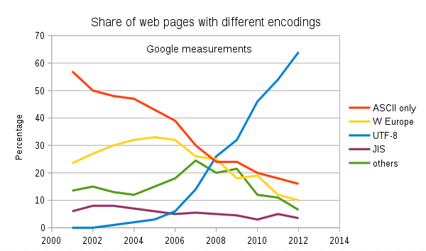
Text File Standards (Encoding)
ASCII
Unicode
UTF-8
Others

Slide 15
Representing the Humble Text File The End
Notes:
Anybody else wonder how the simple text file remains the standard for building some of the most complex creations in the world?

Slide 16
Breakout Session: Representation

Slide 17
Prework for Next Class
Complete through activity 13 and part way through 14
Complete “HelloWorldPlus with Pictures”
Be prepared for Lab

Slide 18
Quiz Expectations
Quiz Expectations include:
You may use any naturally available documentation including books, notes, and web browser
You may not use quiz specific content like question banks
The quiz is an individual assignment so asking others would be inappropriate**
You are welcome to ask me questions
**General topic conversations are encouraged… plus in class “Phone a Friend” sessions are fine.

Slide 19
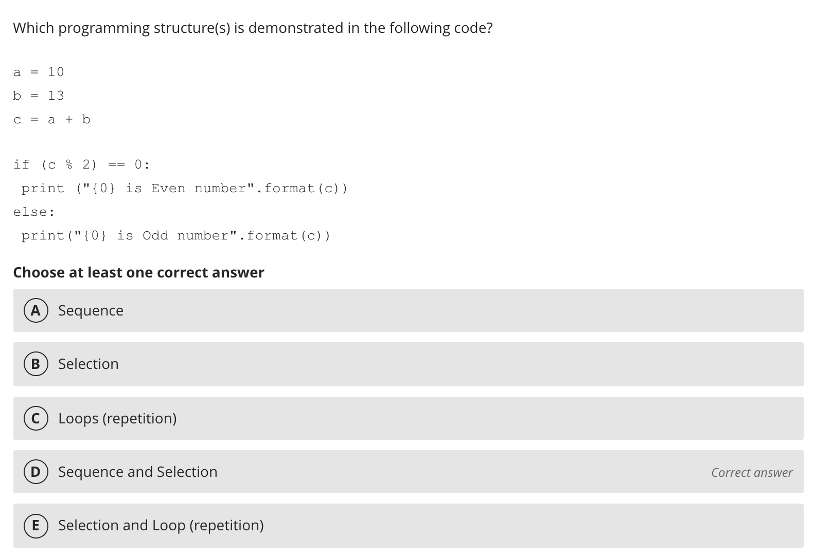
Quiz 2: Phone a Friend

Slide 20
Quiz 2
A sincere attempt at quiz 2 is due
before you leave class today.

Slide 21
End of Session

