Slide 1

Agenda:
Prework
Recall OOP Concepts and OOP Patterns
Breakout Discussion on OOP Principles
Prework for Next Class
Quiz 2
Discussion & Questions welcome at any time but please be present with no phones or email during our time together

Slide 2
Prework for Next Class
Complete through activity 14 prior to next class
Be prepared for Breakout Session: OOP Principles
Be prepared for Quiz 2

Slide 3
Recall
Object-Oriented Programming Concepts & Practices:
Assign presenter
Team discusses chapter topics while the presenter summarizes the topics below:
Classes and Objects
Properties (member variables) & Methods (member functions)
Encapsulation (information hiding)… Can it protect data from hackers?
Inheritance (abstraction)
Polymorphism
Composition & Aggregation
Team sits back, relaxes, and acknowledges the bravery and dedication of the presenter
Notes:
Object-Oriented Programming is the best way we know to reuse other people’s code.

Slide 4

Recall Design Patterns

Slide 5
Recall Breakout Session: OOP Patterns
Assign presenter
Team discusses topics while the presenter summarizes the topics below:
Who wrote “the book”, what is GOF, and which Pattern is the most important
Singleton
Factory
Delegation
Model-View-Controller
Team sits back, relaxes, and acknowledges the bravery and dedication of the presenter

Slide 6
Object-Oriented Programming
Concepts – powerful features that are indispensable to modern software development
Practices – everyday activities that software developers perform in order to delivery quality products utilizing key Concepts
Patterns – tried-and-true templates for forging powerful relationships between classes
Principles – guidelines that help you determine what classes are needed and how they should work together
Concepts & Practices: Many times a day
Patterns: A few times a month
Principles: Aspirational months, years, maybe never achieved
Notes:
Concepts/Patterns/Principles… Hours/Days/Months

Slide 7

Principles & Agile

Slide 8

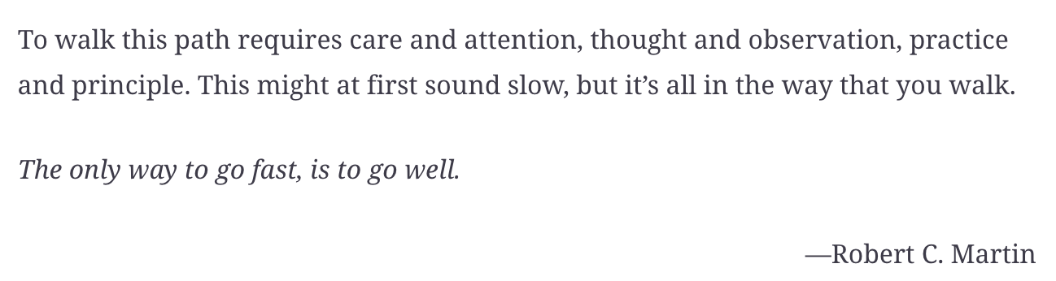
Principles & Architecture

Slide 9
Breakout Session: Object-Oriented Programming Principles Agile Software Devlepment Principles Design Principles

Slide 10
Prework for Next Class
Complete through activity 15 and part way through 16
Be prepared for Lab

Slide 11
Quiz Expectations
Quiz Expectations include:
You may use any naturally available documentation including books, notes, and web browser
You may not use quiz specific content like question banks
The quiz is an individual assignment so asking others would be inappropriate**
You are welcome to ask me questions
**General topic conversations are encouraged… plus in class “Phone a Friend” sessions are fine.

Slide 12
Quiz 2
A sincere attempt at quiz 2 is due
before you leave class today.

Slide 13
End of Session

Slide 14
UML and UML Class Diagrams

Slide 15

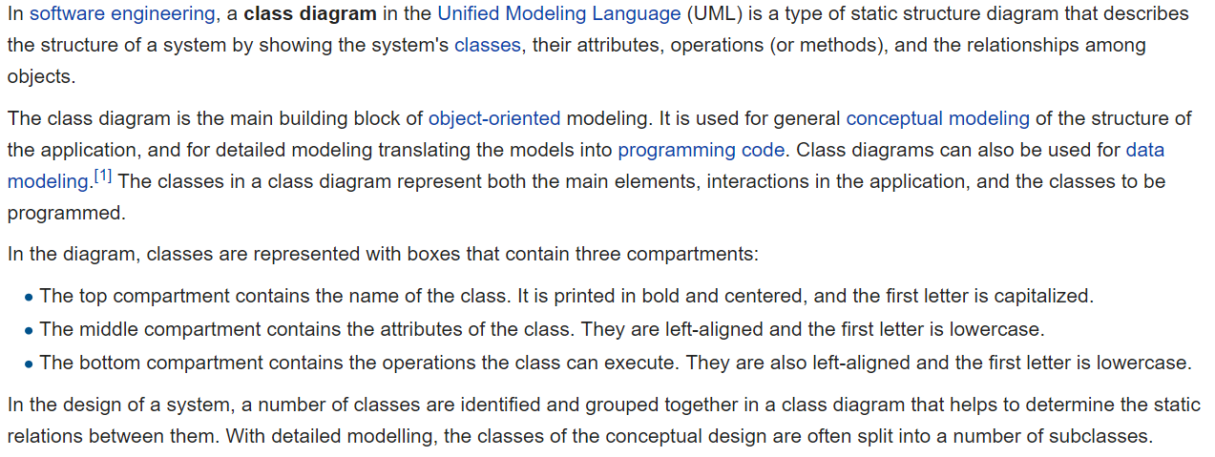
UML Class Diagram [link]

Slide 16
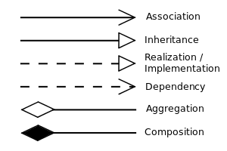


UML Class Diagram (continued) [link]

Slide 17
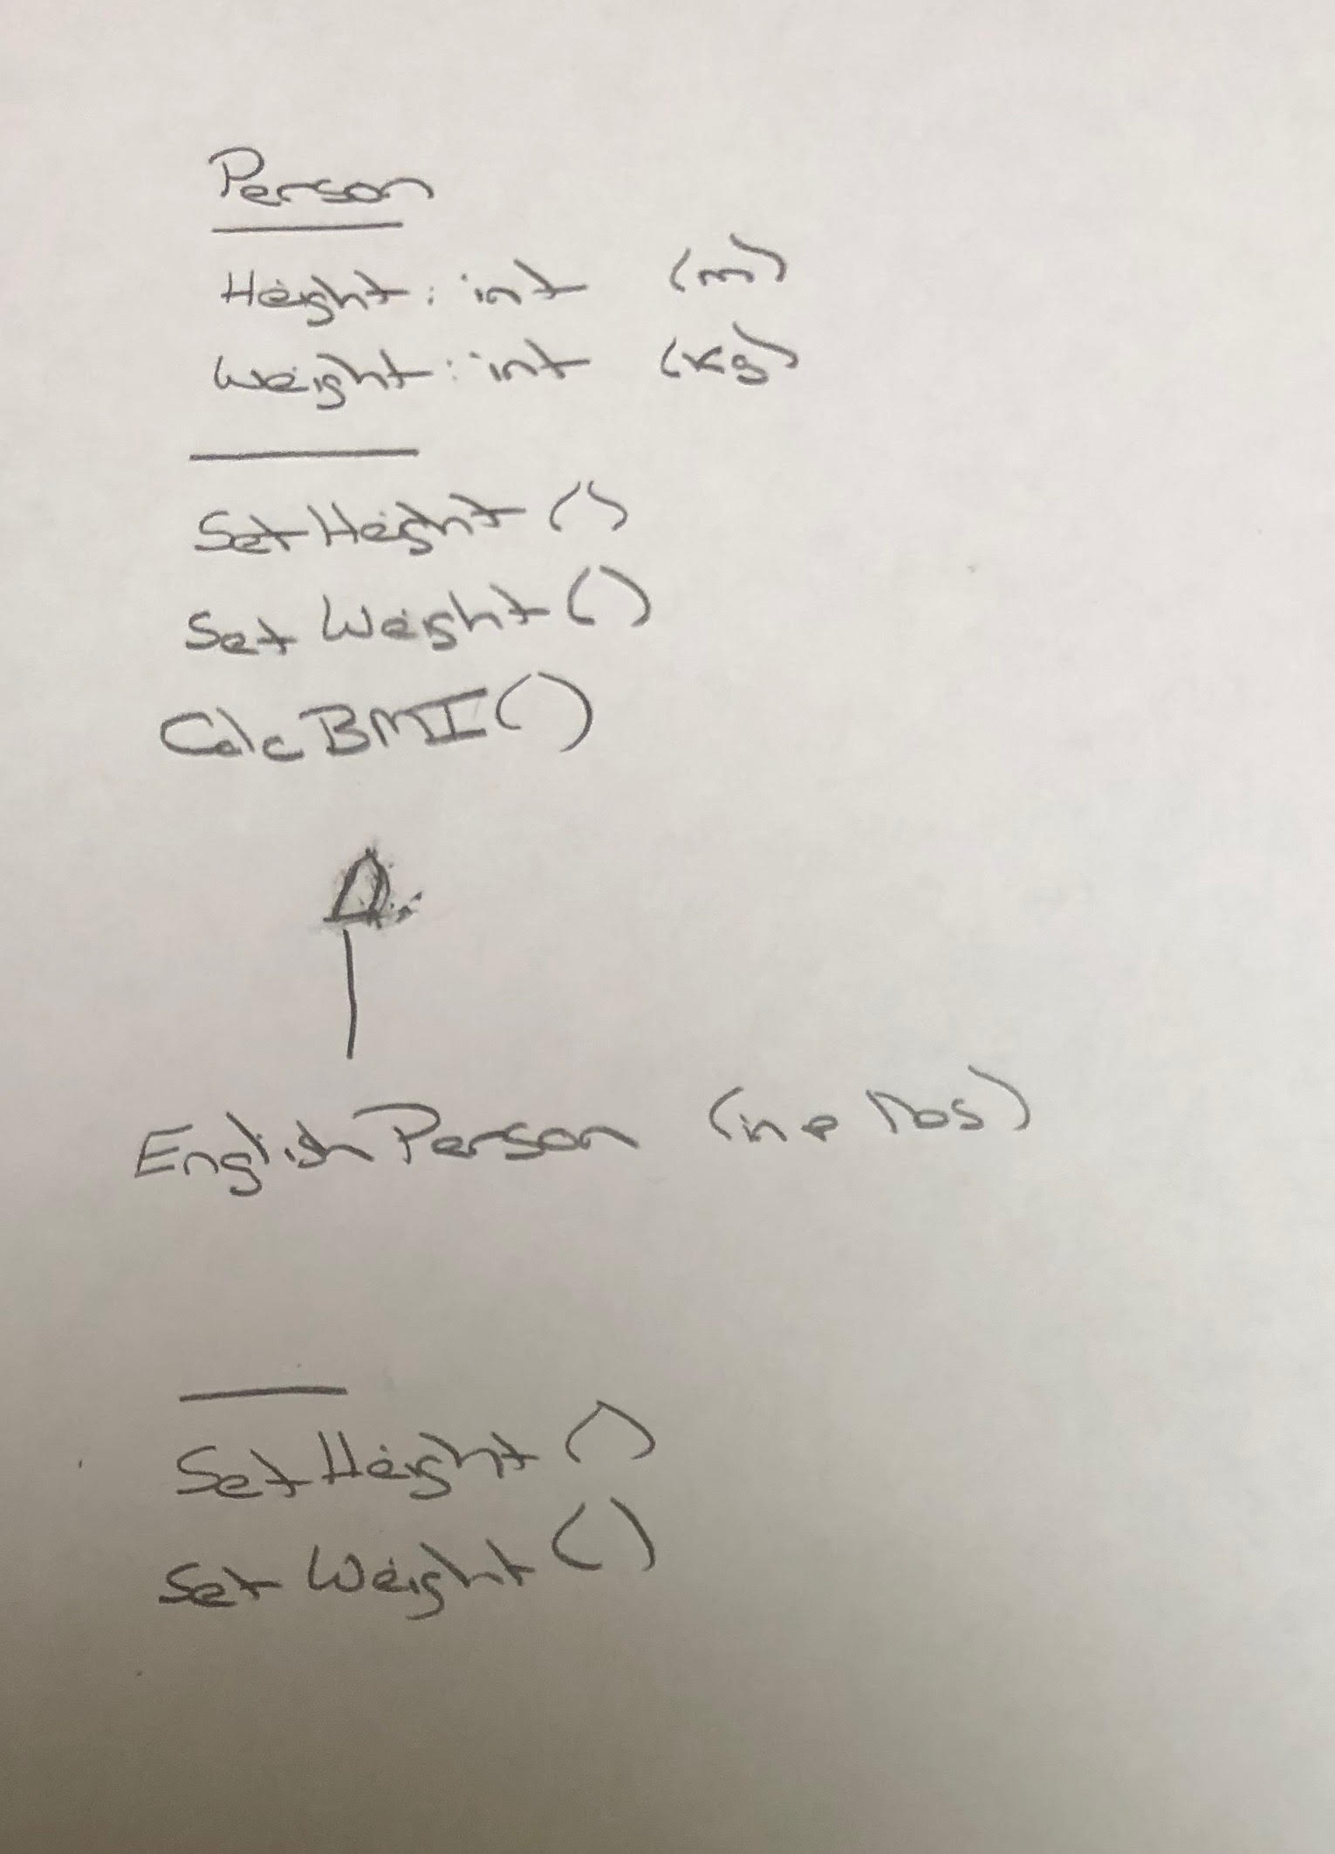
UML – BMI Calculator Plus

Slide 18
Is Object-Oriented Always Best?
Class Design vs
Relational Database Design

