Slide 1

Agenda:
Prework
Apologies
Prework for Next Class
Lab, Lab, Lab… and more Lab
Discussion & Questions welcome at any time but please be present with no phones or email during our time together

Slide 2
Prework for Next Class
Complete through activity 15 and part way through 16
Be prepared for Lab

Slide 3

Apologies
I was planning on bringing pastries today for Lab to celebrate our 100% assignment submission metric.
… It wasn’t until I was heading for the checkout this morning with a cart full of blueberry muffins, chocolate muffins, and chocolate cake pops that I remembered we were online today
I will bring treats Wednesday for sprint 2 demos. Sorry for the delay.

Slide 4
Prework For Next Class
Everything is due Sunday!
Monday will be Sprint 3 planning
Wednesday will Sprint 2 demos and retrospectives

Slide 5
Lab, Lab, Lab… and more Lab

Slide 6
UML and UML Class Diagrams

Slide 7

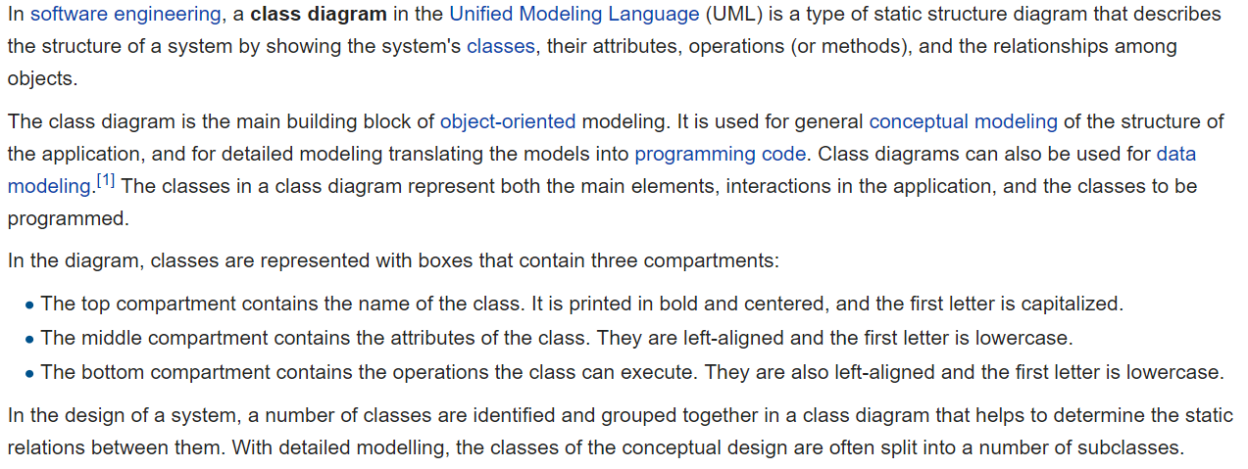
UML Class Diagram [link]

Slide 8
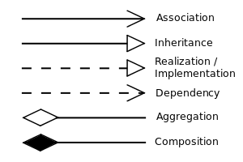


UML Class Diagram (continued) [link]

Slide 9
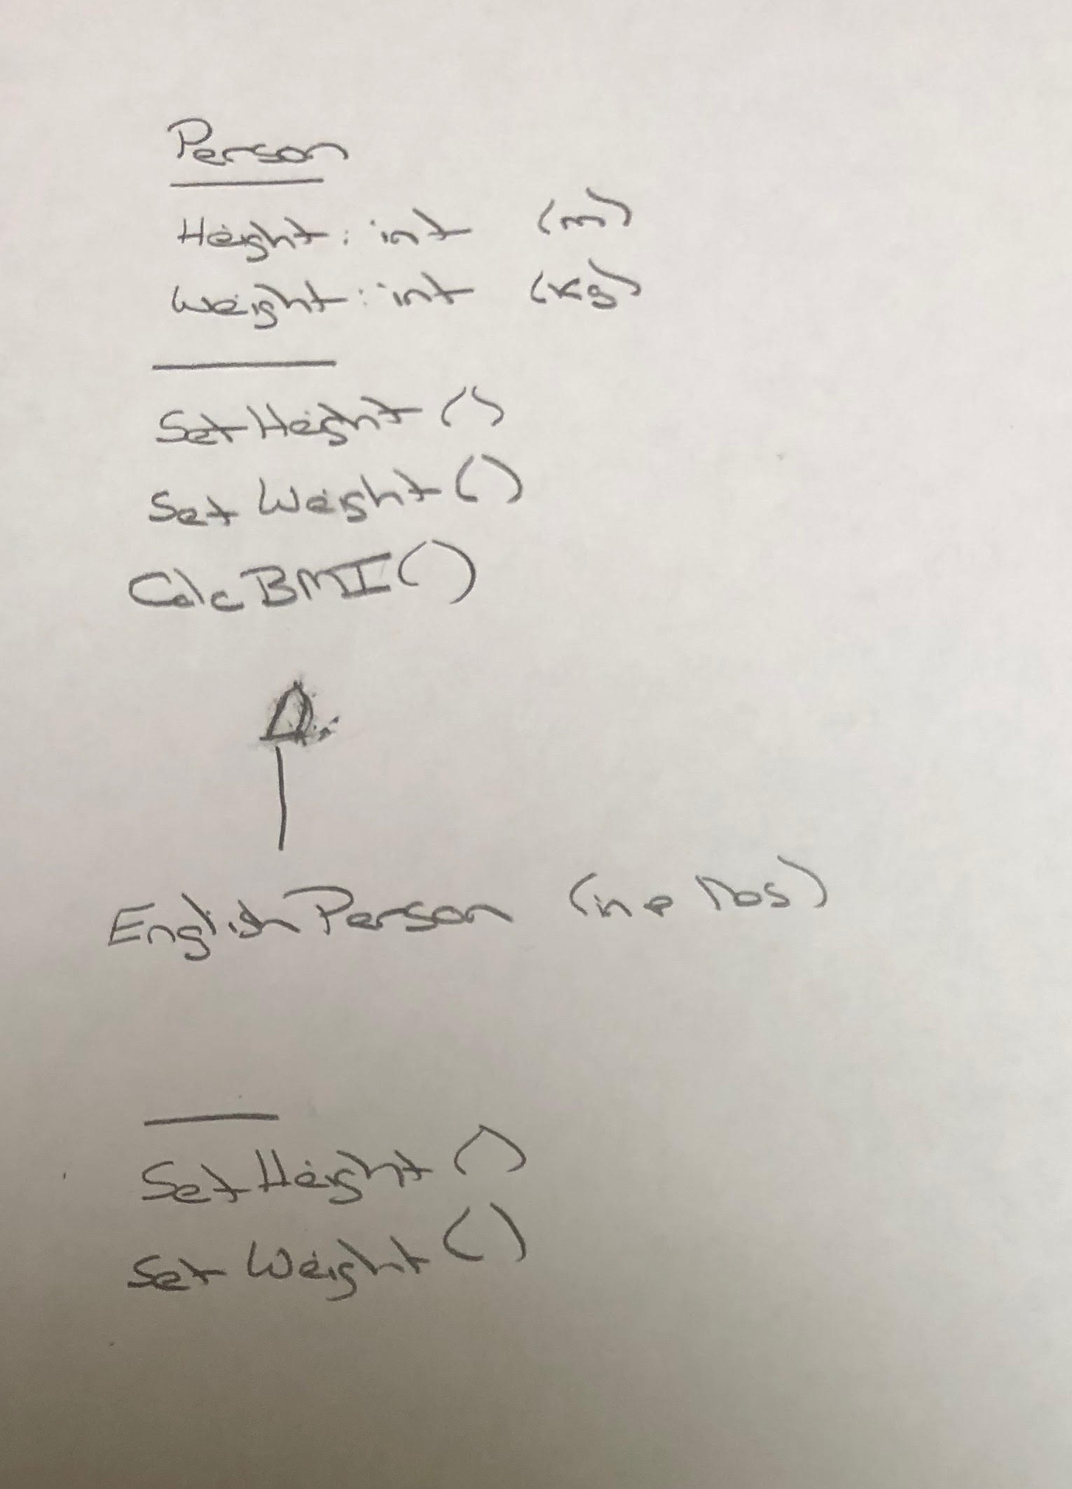
UML – BMI Calculator Plus

Slide 10
Is Object-Oriented Always Best?
Class Design vs
Relational Database Design

Slide 11
End of Session

