Slide 1

Agenda:
Prework
Sprint 2 Demos
Sprint 2 Retrospective
Sprint 3 Planning
Prework for Next Class
Breakout Session: Sprint 3 Planning Review
Discussion & Questions welcome at any time but please be present with no phones or email during our time together

Slide 2
Prework For Next Class
Everything is due Sunday!
Tuesday will be Sprint 2 demos and retrospective followed by sprint 3 planning

Slide 3
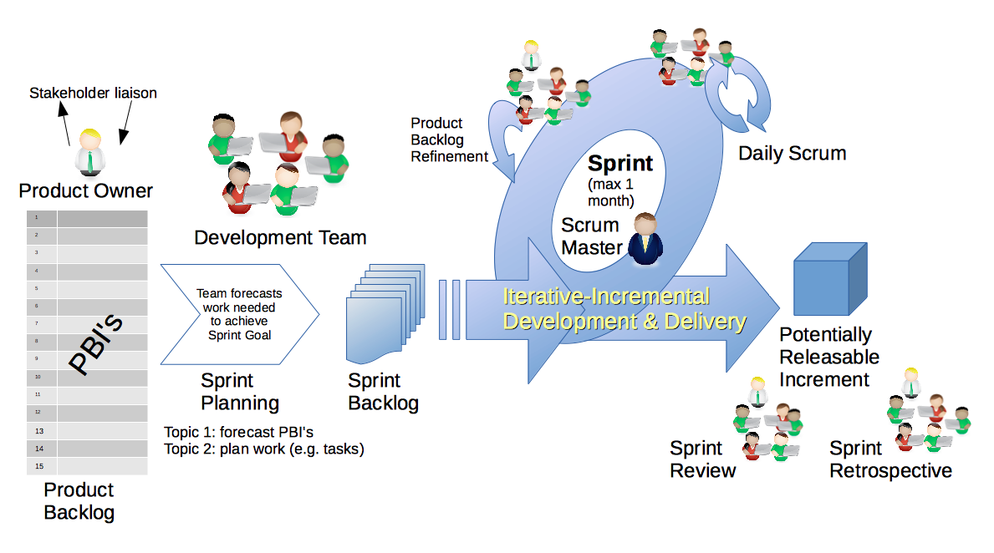
Scrum Process – Sprint Review & Demo
By Dr ian mitchell - Own work, CC BY-SA 4.0, Link

Slide 4

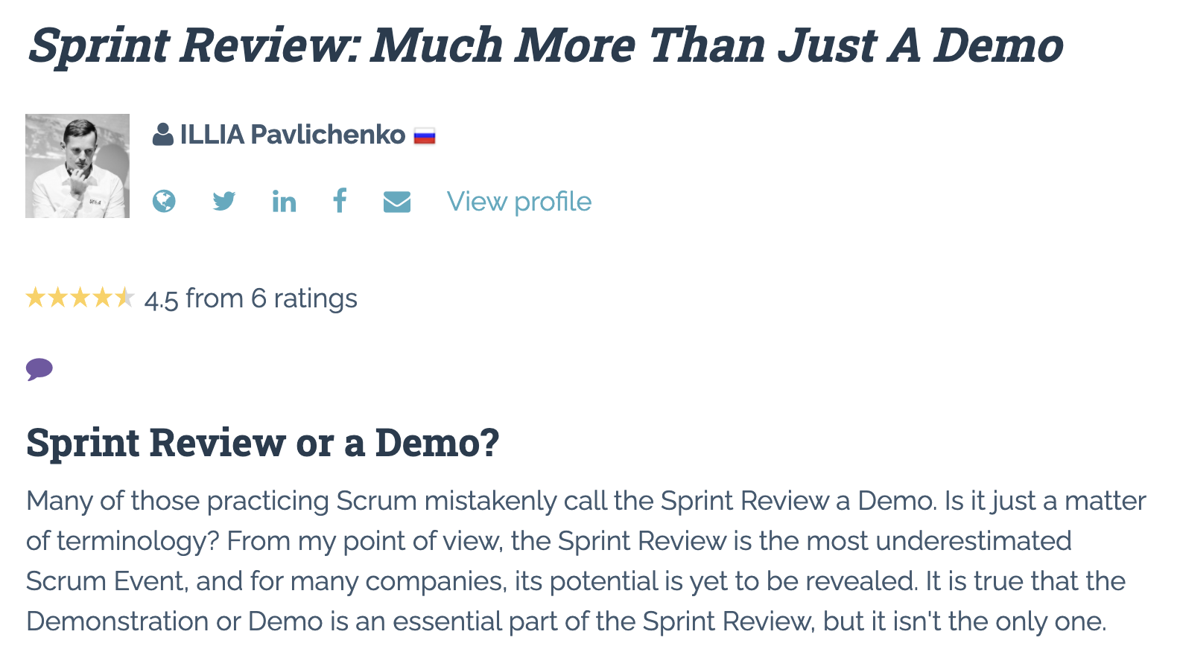

Slide 5
Demo Guidelines – Presenter
Everyone will give at least one demo of their work during the semester.
Your demo should be 2 to 5 minutes and can include any or all of the following:
Show your application running
Comment on your implementation
Show the source code
Explain how you organized the code
Talk about any challenges
You should not prepare slides or a presentation
**You will also need to complete the Demo assignment in Blackboard.

Slide 6
Demo Guidelines – Listener
Everyone will be listening to many demos during the semester.
Your listener responsibilities include:
Actively listening and watching what is being demoed
Come up with a meaningful yet easy to answer question
Ask your question if the presenter does not get sufficient questions from other listeners
Do not ask hard question or attempt to review the presenters code
Clap for the presenter at the end of the demo and thank them for presenting
Optionally follow up with the presenter later if you have what could be more difficult questions or if you have suggestions

Slide 7
Sprint Demos

Slide 8
Complete Sprint Demo Assignment

Slide 9
Scrum Process – Sprint Retrospective
By Dr ian mitchell - Own work, CC BY-SA 4.0, Link

Slide 10
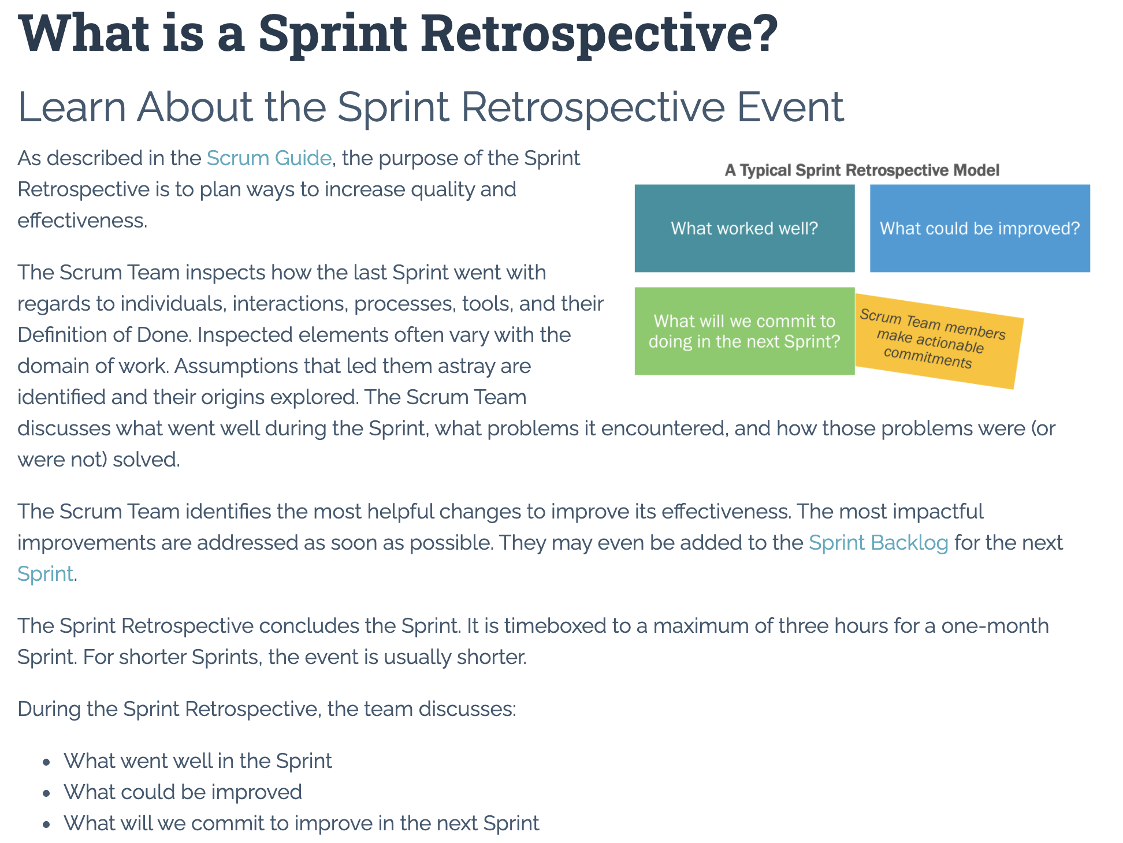

Slide 11
Submission Percentage

Slide 12
Class Retrospective
Feedback from Assignments & Reflections:
The missing assignments (particularly labs) does not feel very good :-(
Very well done with the HTML, CSS, and JavaScript work
All submitted assignments are graded and posted
Spiral and even Iterative in general don’t get much industry love any more
Elements of Scaled Agile seem to be making their way into normal Agile
GitHub/Azure deployments can be tedious, but the setup does not occur regularly for the class or in the real world
I looked back through Quiz 2 and felt okay about the questions… let me know if you have concerns
What can I/we do to improve in sprint 3?
Start early, allocate focused time, and submit assignments (if you are not already)

Slide 13
Sprint Planning

Slide 14
Sprint Planning
Sprint 3 Changes:
Very similar to sprint 2 with sprint 3 including Discussion 3, Quiz 3, Lab 3, and Reflection 3
We will continue to do our Scrum Team Breakout Discussion 3 on Friday
The two week sprint pattern should be getting routine

Slide 15
Scrum Process – Sprint Planning
By Dr ian mitchell - Own work, CC BY-SA 4.0, Link

Slide 16
Product Backlog vs Sprint Backlog

Slide 17
Scrum Process – Product Backlog to Sprint Backlog
By Dr ian mitchell - Own work, CC BY-SA 4.0, Link

Slide 18
Scrum Process – Sprint Planning
By Dr ian mitchell - Own work, CC BY-SA 4.0, Link

Slide 19
Review Activities List and Assignments

Slide 20
Prework For Next Class
Complete through activity 5 and start on activity 6 prior to next class
Be prepared for a scrum team discussion of chapter 7

Slide 21
Breakout Session
Sprint 2 Retrospective plus Sprint 3 Planning Review
As a scrum team:
Continuous Improvement: How could you and your team improve going forward
What are your thoughts about Web Resume
Review sprint 3 activities & assignments in detail
Discuss questions/concerns and topics that need more clarification
Who is the new sprint 3 scrum master
Scrum master share your team’s top 2 questions/concerns during report out

Slide 22
End of Session

