Slide 1

Agenda:
Prework
Sprint Progress Polling plus Lab Planning
Prework for Next Class
Lab, Lab, Lab… and more Lab
Discussion & Questions welcome at any time but please be present with no phones or email during our time together

Slide 2
Prework for Next Class
Complete through activity 13 and working on 14
Be prepared for Lab

Slide 3
Sprint Progress Polling plus Lab Planning

Slide 4
Prework For Next Class
Everything is due Sunday!
Tuesday will be Sprint 3 demos and retrospective followed by sprint 4 planning

Slide 5
Lab, Lab, Lab… and more Lab

Slide 6
Lab Ideas
Review and Explain Programming Together tutorials
Review Activities List and Assignments
Ethan Brown’s Handlebars… not that important overall
Programming Together with “Deploying Node.js on Microsoft Azure”
Notes:
git config –global pull.rebase false

Slide 7
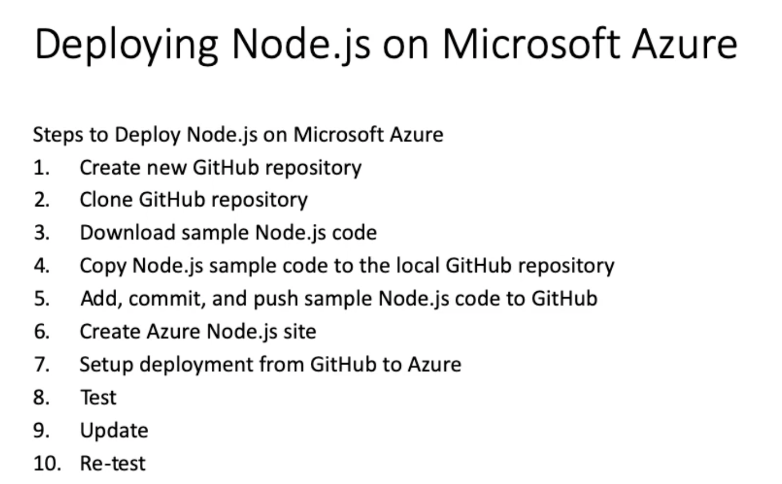
Lab: Programming Together with “Deploying Node.js on Microsoft Azure”
Notes:
git config –global pull.rebase false

Slide 8
End of Session

