Slide 1

Agenda:
Prework and Announcements
Computer Languages, Popularity, and Language Focus
Breakout Discussion on Computing Components
Prework for Next Class
Quiz 3
Discussion & Questions welcome at any time but please be present with no phones or email during our time together

Slide 2
Prework for Next Class
Complete through activity 11
Be prepared for Breakout Session: Computing Components
Be prepared for Quiz 3

Slide 3
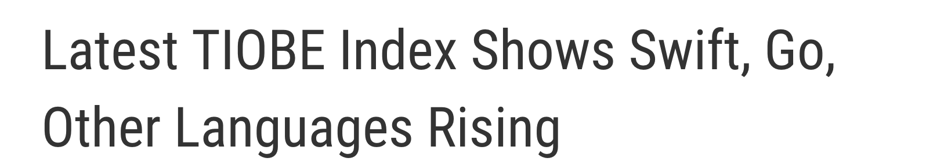

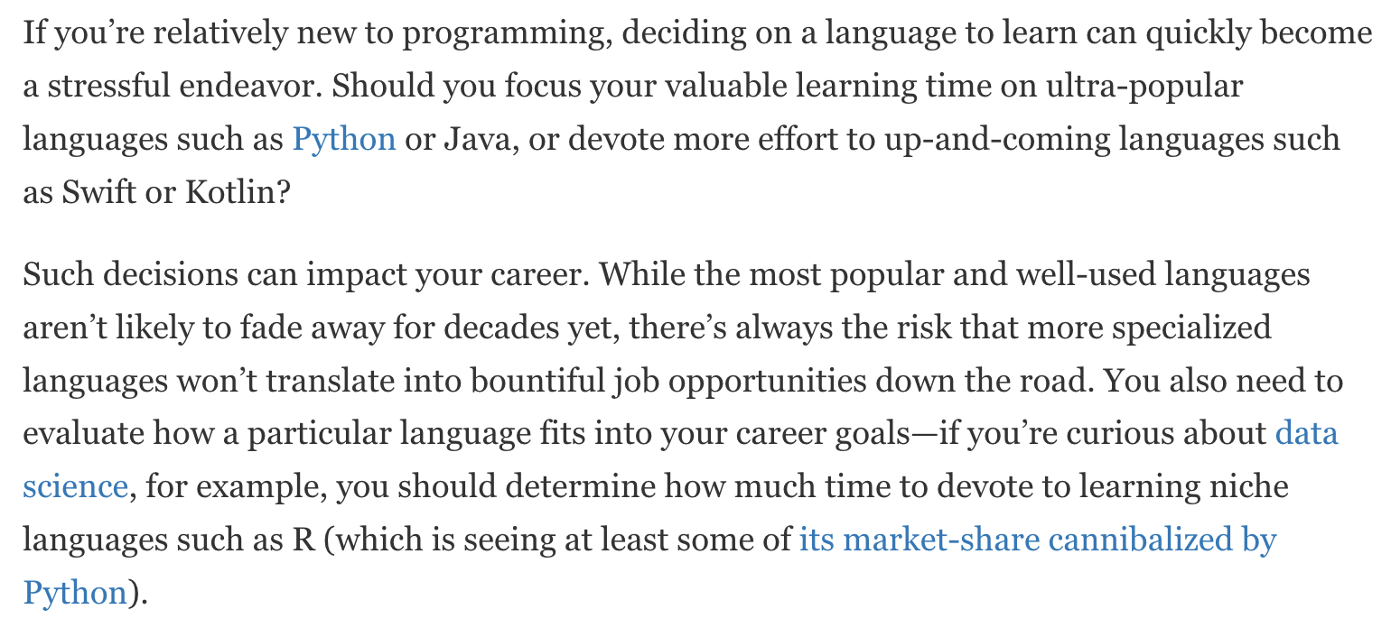

Slide 4
Breakout Session on Computing Components

Slide 5
Breakout Discussion: Computing Components
Assign presenter
Team discusses topics while the presenter summarizes the most important topics including the representation of:
Computing Components
Stored Program plus Von Neumann Architecture
Ram and Rom plus Secondary Storage
Embedded Systems
Parallel Architectures plus Classes of Parallel Hardware
Team sits back, relaxes, and acknowledges the bravery and dedication of the presenter

Slide 6
Quiz Expectations
Quiz Expectations include:
You may use any naturally available documentation including books, notes, and web browser
You may not use quiz specific content like question banks
The quiz is an individual assignment so asking others would be inappropriate**
You are welcome to ask me questions
**General topic conversations are encouraged… plus in class “Phone a Friend” sessions are fine.

Slide 7
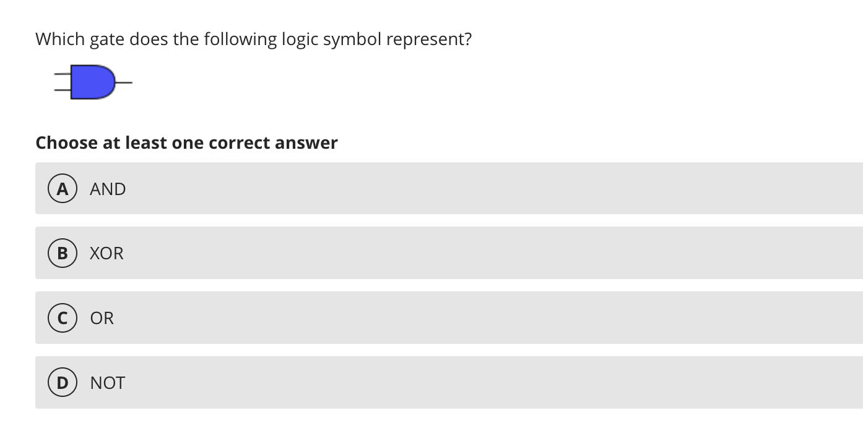
Quiz 2: Phone a Friend

Slide 8
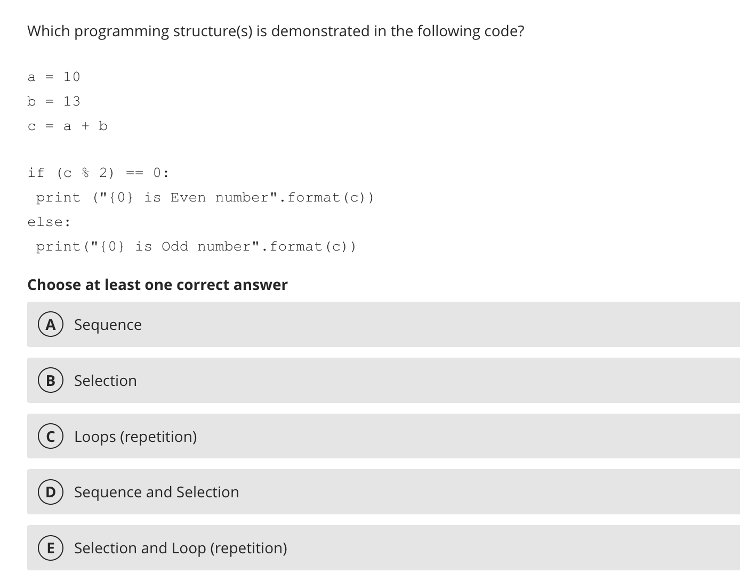
Quiz 2: Phone a Friend

Slide 9
Prework for Next Class
Complete through activity 13 and working on 14
Be prepared for lab
Everything is due Sunday!

Slide 10
Quiz 3
A sincere attempt at quiz 3 is due
before you leave class today.

Slide 11
End of Session

