Slide 1

Agenda:
Prework
Sprint 4 Planning
Breakout Session for Sprint 4 Planning
Review Demo Schedule for Wednesday
Prework for Next Class
Discussion & Questions welcome at any time but please be present with no phones or email during our time together

Slide 2
Prework For Today
Everything is due Sunday!
Monday will be Sprint 4 planning
Wednesday will Sprint 3 demos and retrospectives

Slide 3
Sprint Planning

Slide 4
Sprint Planning
Sprint 4 Changes:
Very similar to previous sprints with sprint 4 including Discussion 4, Quiz 4, Lab 4, and Reflection 4
We will continue to do our Scrum Team Breakout Discussion 4 on Friday
Spring Break will be at the end of the sprint which might make things challenging

Slide 5
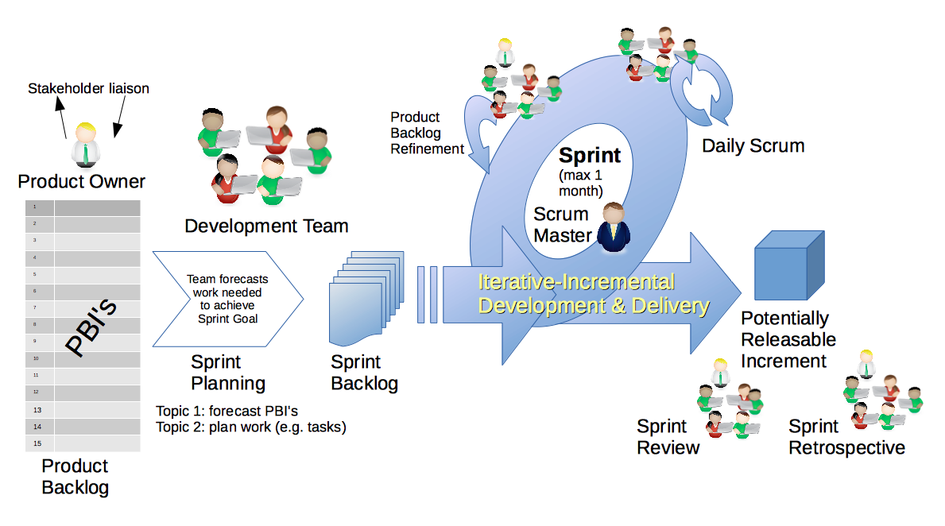
Scrum Process – Sprint Planning
By Dr ian mitchell - Own work, CC BY-SA 4.0, Link

Slide 6
Review Activities List and Assignments

Slide 7
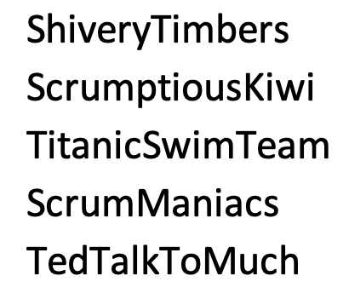
Scrum Team Planning Review
As a scrum team:
Review sprint 4 activities & assignments in detail
Discuss and identify questions/concerns
Scrum master share your team’s top 2 questions/concerns during report out
Anybody team members willing to make a team trade just to spice things up?

Slide 8
Review Demo Schedule

Slide 9
Prework For Next Class
Complete through activity 4 and start on activity 5 prior to next class
Those scheduled to demo on Wednesday please be a couple of minutes early to class

Slide 10
End of Session

