Slide 1

Agenda:
Prework
Sprint 4 Planning
Breakout Session for Sprint 4 Planning
Review Demo Schedule for Wednesday
Prework for Next Class
Discussion & Questions welcome at any time but please be present with no phones or email during our time together

Slide 2
Prework For Today
Everything is due Sunday!
Monday will be Sprint 4 planning
Wednesday will Sprint 3 demos and retrospectives

Slide 3
Sprint Planning

Slide 4
Sprint Planning
Sprint 4 Changes:
Very similar to previous sprints with sprint 4 including Discussion 4, Quiz 4, Lab 4, and Reflection 4
We will continue to do our Scrum Team Breakout Discussion 4 on Friday
Spring Break will be at the end of the sprint which might make things challenging

Slide 5
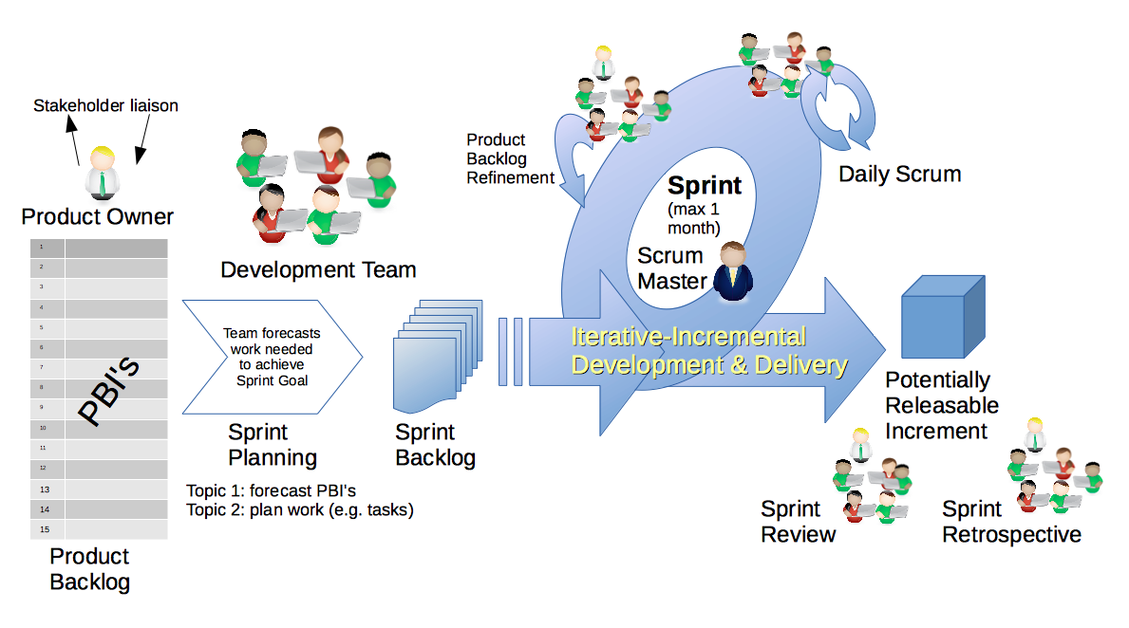
Scrum Process – Sprint Planning
By Dr ian mitchell - Own work, CC BY-SA 4.0, Link

Slide 6
Review Activities List and Assignments

Slide 7
Scrum Team Planning Review
As a scrum team:
Review sprint 4 activities & assignments in detail
Discuss and identify questions/concerns
Scrum master share your team’s top 2 questions/concerns during report out
Anybody team members willing to make a team trade just to spice things up?

Slide 8
Review Demo Schedule

Slide 9
Prework For Next Class
Complete through activity 5 prior to next class
Those scheduled to demo on Wednesday please be a couple of minutes early to class
Be ready to select a new Scrum Master

Slide 10
Agenda:
Prework
Sprint Progress Polling plus Lab Planning
Prework for Next Class
Lab, Lab, Lab… and more Lab
Discussion & Questions welcome at any time but please be present with no phones or email during our time together

Slide 11
Prework for Next Class
Complete through activity 9 and be actively working on 10
Be prepared for lab
Everything is due Sunday!

Slide 12
Sprint Progress Polling plus Lab Planning

Slide 13
Lab, Lab, Lab… and more Lab

Slide 14
Lab Ideas
Review issues in Programming Together tutorials
Review Activities List and Assignments
Share current programming assignment and/or ask questions
Time to work on Lab 3
Notes:
git config –global pull.rebase false

Slide 15
End of Session

