Slide 1

Agenda:
Prework
Sprint 3 Demos
Sprint 3 Retrospective
Sprint 4 Planning
Prework for Next Class
Breakout Session: Sprint 4 Planning Review
Discussion & Questions welcome at any time but please be present with no phones or email during our time together

Slide 2
Prework For Next Class
Everything is due Sunday!
Tuesday will be Sprint 3 demos and retrospective followed by sprint 4 planning

Slide 3
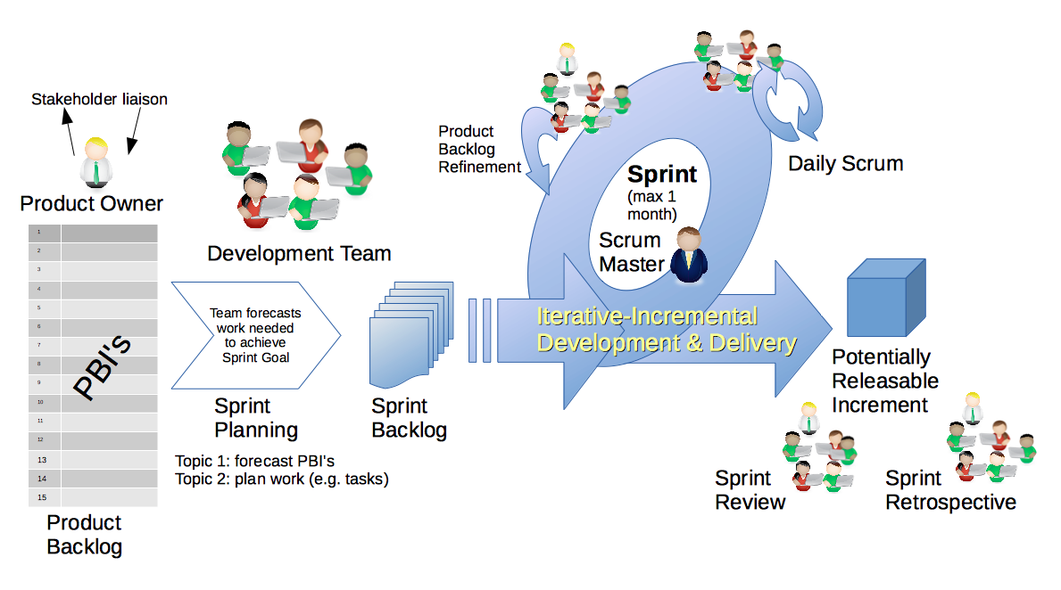
Scrum Process – Sprint Review & Demo
By Dr ian mitchell - Own work, CC BY-SA 4.0, Link

Slide 4

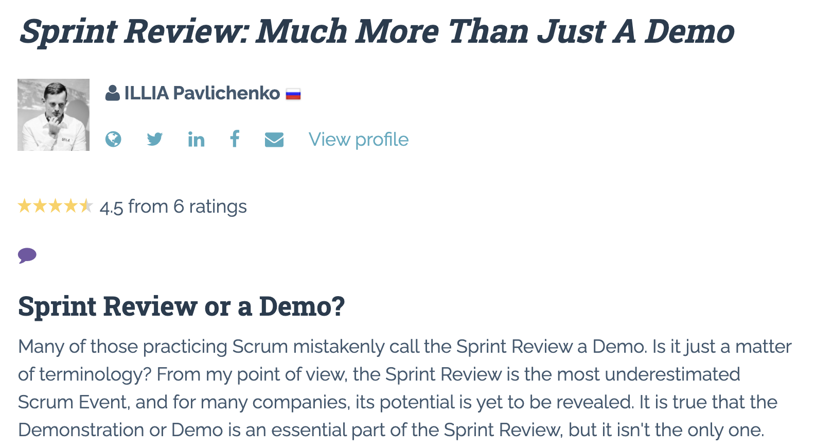

Slide 5
Demo Guidelines – Presenter
Everyone will give at least one demo of their work during the semester.
Your demo should be 2 to 5 minutes and can include any or all of the following:
Show your application running
Comment on your implementation
Show the source code
Explain how you organized the code
Talk about any challenges
You should not prepare slides or a presentation
**You will also need to complete the Demo assignment in Blackboard.

Slide 6
Demo Guidelines – Listener
Everyone will be listening to many demos during the semester.
Your listener responsibilities include:
Actively listening and watching what is being demoed
Come up with a meaningful yet easy to answer question
Ask your question if the presenter does not get sufficient questions from other listeners
Do not ask hard question or attempt to review the presenters code
Clap for the presenter at the end of the demo and thank them for presenting
Optionally follow up with the presenter later if you have what could be more difficult questions or if you have suggestions

Slide 7
Sprint Demos

Slide 8
Complete Sprint Demo Assignment

Slide 9
Scrum Process – Sprint Retrospective
By Dr ian mitchell - Own work, CC BY-SA 4.0, Link

Slide 10
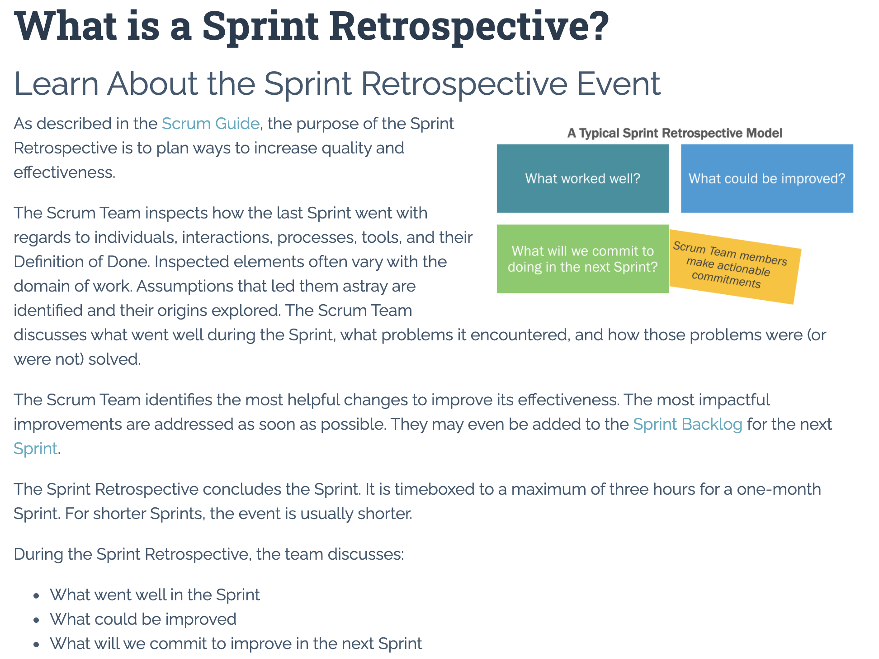

Slide 11
Submission Percentage From Last Sprint

Slide 12
Submission Percentage

Slide 13
Class Retrospective
Feedback from Assignments & Reflections:
Very nice improvement in Submission Percentage
All submitted assignments are graded and posted
Really nice Node.js to Azure tutorials identified in Discussion 3
Please do NOT paste large volumes of text in your Reflection… it seems to lock up Blackboard making it very difficult for me to grade Reflections
On the other hand, entering the value of PI up to a couple hundred digits is way cool
Reflection comments are limited this sprint in part because I spent about 30 minutes figuring out why I was not able to grade Reflections… which eventually discovered was because of Blackboard limitations on the size of text in a Reflection
Consolidating knowledge from all the various (often conflicting) sources is hard and necessary
Some concern about where Node.js fit into the plan

Slide 14
Sprint Planning

Slide 15
Sprint Planning
Sprint 4 Changes:
Very similar to sprint 3 with sprint 4 including Discussion 4, Quiz 4, Lab 4, and Reflection 4
We will continue to do our Scrum Team Breakout Discussion 4 on Thursday
Spring Break will be at the end of the sprint which might make things challenging
Get ready to be guiding these rituals yourself for your scrum team in sprint 5!

Slide 16
Scrum Process – Sprint Planning
By Dr ian mitchell - Own work, CC BY-SA 4.0, Link

Slide 17
Product Backlog vs Sprint Backlog

Slide 18
Scrum Process – Product Backlog to Sprint Backlog
By Dr ian mitchell - Own work, CC BY-SA 4.0, Link

Slide 19
Scrum Process – Sprint Planning
By Dr ian mitchell - Own work, CC BY-SA 4.0, Link

Slide 20
Review Activities List and Assignments

Slide 21
Prework For Next Class
Complete through activity 5 and start on activity 6 prior to next class
Be prepared for a scrum team discussion of chapter 8

Slide 22
Breakout Session
Sprint 3 Retrospective plus Sprint 4 Planning Review
As a scrum team:
Continuous Improvement: How could you and your team improve going forward
Review sprint 4 activities & assignments in detail
Discuss questions/concerns and topics that need more clarification
Scrum master share your team’s top 2 questions/concerns during report out
Who would be willing to change teams to spice things up?

Slide 23
End of Session

