Slide 1

Agenda:
Prework for Today
Breakout: Test-Driven Development (Fox chapter 8)
Recall from last sprint Discussion 3 on Node.js and Azure
Optional: Programming Together with Node.js, Express, and Azure
Breakout: Discussion 4 on Software Failures and Testing
Prework for Next Class
Discussion & Questions welcome at any time but please be present with no phones or email during our time together

Slide 2
Prework For Next Class
Complete through activity 5 and start on activity 6 prior to next class
Be prepared for a scrum team discussion of chapter 8

Slide 3
Test-Driven Development (Fox chapter 8)
Assign presenter
Team discusses topics while the presenter summarizes the topics below:
Cost of fixing defects over time
Test under Waterfall, Iterative, and Agile
Verification vs. Validation under Waterfall, Iterative, and Agile
FIRST, TDD, and Red-Green-Refactor
Expectations, Mocks, Stubs, and Example Setup & Teardown
Types of Automated Testing and Pros & Cons of each
Performance Testing associated challenges
Team sits back, relaxes, and acknowledges the bravery and dedication of the presenter

Slide 4
Recall from last sprint Discussion 3 on Node.js and Azure
Notes:
Critical Path… Light Weight long-term planning

Slide 5
Optional: Programming Together with Node.js, Express, and Azure
Notes:
Critical Path… Light Weight long-term planning

Slide 6
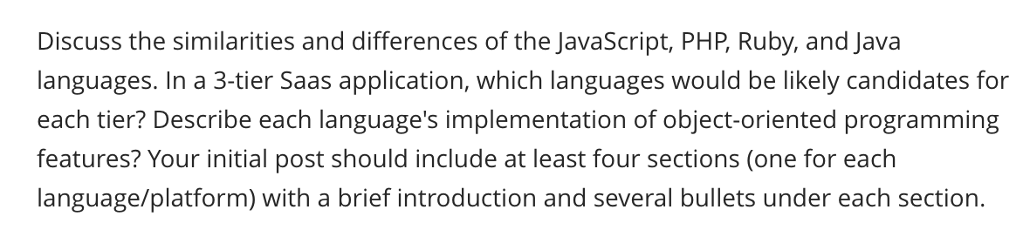
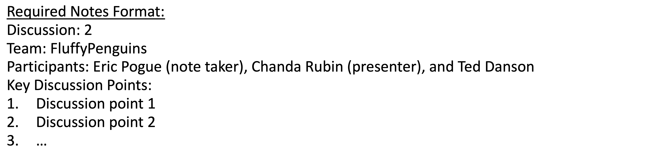
Scrum Team Discussion 4
Assign note taker and presenter roles to team members
Review and discuss topic
Note taker takes notes and presenter prepares a report out
Note taker share notes with all participating team members
Each team member pastes and submits an exact copy of the notes into their discussion board
Team sits back, relaxes, and tells the note taker and presenter what I wonderful job the did
Notes:
Seating chart and attendance tracker (virtual and in person)

Slide 7
Prework For Next Class
Complete through activity 8
Be prepared Breakout Session on Test-Driven Development
Be prepared for Quiz 4

Slide 8
Prework For Next Class
Everything is due Sunday!
Tuesday will be Sprint 3 demos and retrospective followed by sprint 4 planning

Slide 9
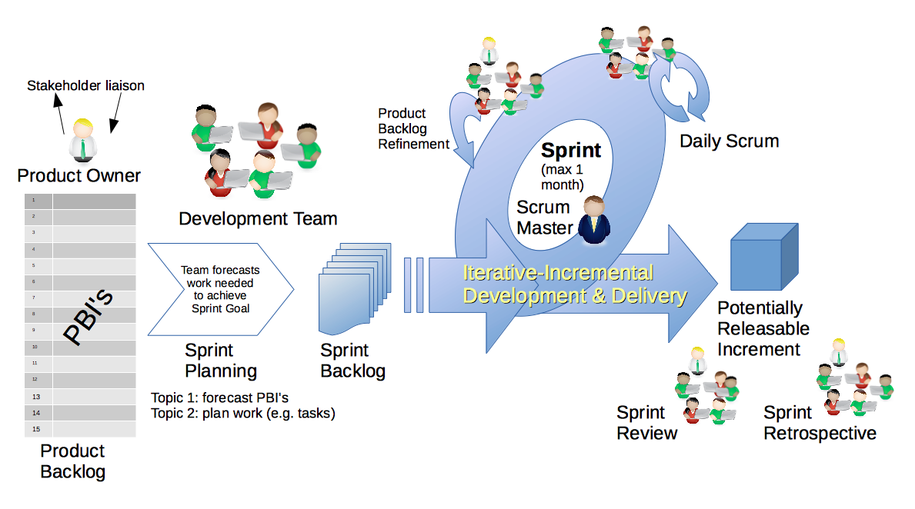
Scrum Process – Sprint Review & Demo
By Dr ian mitchell - Own work, CC BY-SA 4.0, Link

Slide 10

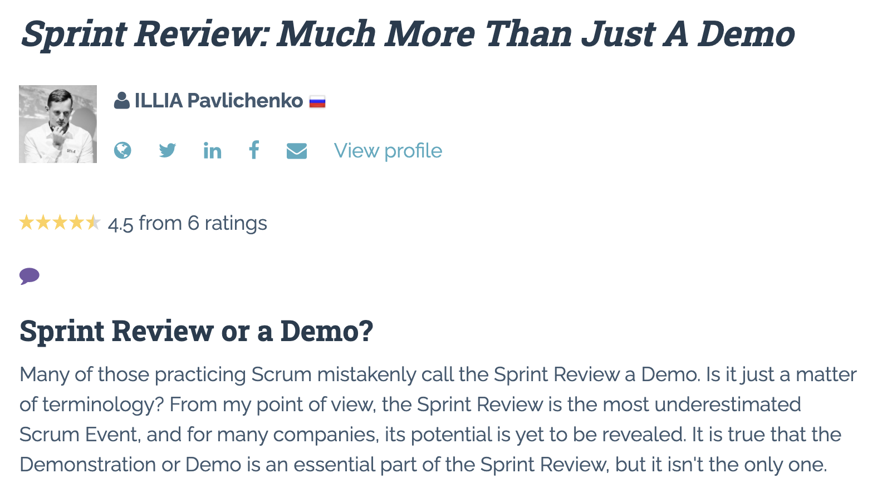

Slide 11
Demo Guidelines – Presenter
Everyone will give at least one demo of their work during the semester.
Your demo should be 2 to 5 minutes and can include any or all of the following:
Show your application running
Comment on your implementation
Show the source code
Explain how you organized the code
Talk about any challenges
You should not prepare slides or a presentation
**You will also need to complete the Demo assignment in Blackboard.

Slide 12
Demo Guidelines – Listener
Everyone will be listening to many demos during the semester.
Your listener responsibilities include:
Actively listening and watching what is being demoed
Come up with a meaningful yet easy to answer question
Ask your question if the presenter does not get sufficient questions from other listeners
Do not ask hard question or attempt to review the presenters code
Clap for the presenter at the end of the demo and thank them for presenting
Optionally follow up with the presenter later if you have what could be more difficult questions or if you have suggestions

Slide 13
Sprint Demos

Slide 14
Complete Sprint Demo Assignment

Slide 15
Scrum Process – Sprint Retrospective
By Dr ian mitchell - Own work, CC BY-SA 4.0, Link

Slide 16
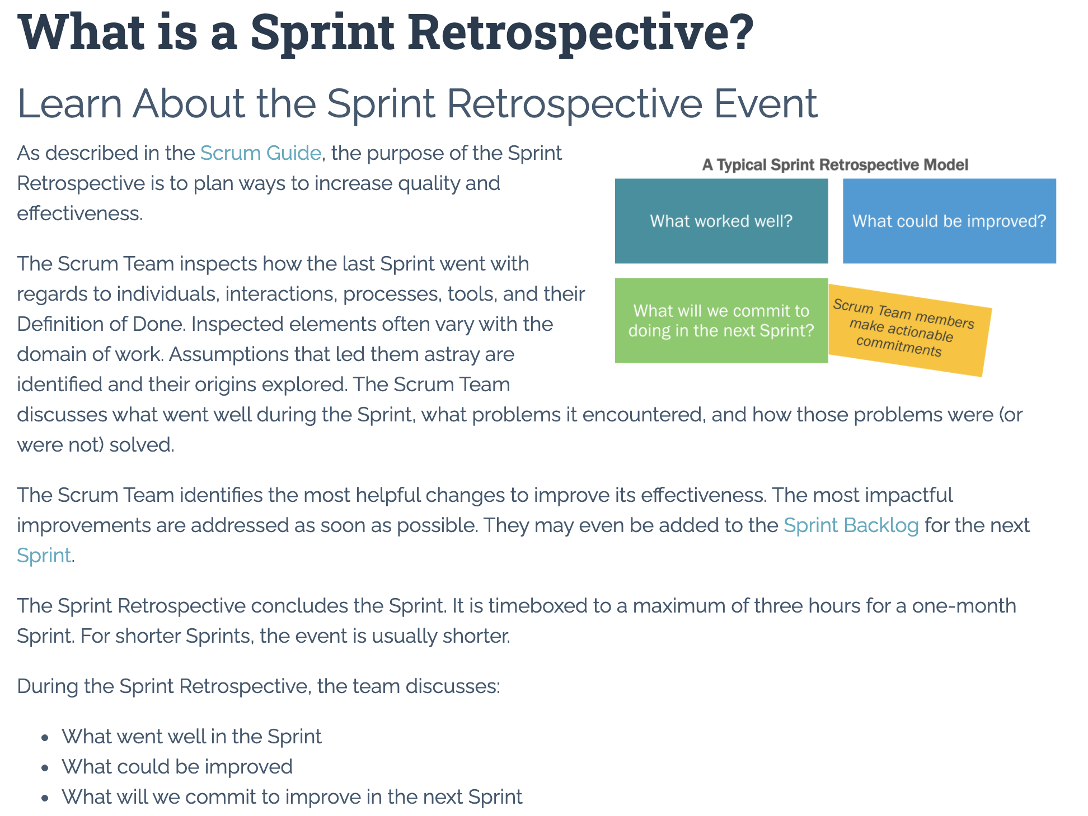

Slide 17
Submission Percentage From Last Sprint

Slide 18
Submission Percentage

Slide 19
Class Retrospective
Feedback from Assignments & Reflections:
Very nice improvement in Submission Percentage
All submitted assignments are graded and posted
Really nice Node.js to Azure tutorials identified in Discussion 3
Please do NOT paste large volumes of text in your Reflection… it seems to lock up Blackboard making it very difficult for me to grade Reflections
On the other hand, entering the value of PI up to a couple hundred digits is way cool
Reflection comments are limited this sprint in part because I spent about 30 minutes figuring out why I was not able to grade Reflections… which eventually discovered was because of Blackboard limitations on the size of text in a Reflection
Consolidating knowledge from all the various (often conflicting) sources is hard and necessary
Some concern about where Node.js fit into the plan

Slide 20
Sprint Planning

Slide 21
Sprint Planning
Sprint 4 Changes:
Very similar to sprint 3 with sprint 4 including Discussion 4, Quiz 4, Lab 4, and Reflection 4
We will continue to do our Scrum Team Breakout Discussion 4 on Thursday
Spring Break will be at the end of the sprint which might make things challenging
Get ready to be guiding these rituals yourself for your scrum team in sprint 5!

Slide 22
Scrum Process – Sprint Planning
By Dr ian mitchell - Own work, CC BY-SA 4.0, Link

Slide 23
Product Backlog vs Sprint Backlog

Slide 24
Scrum Process – Product Backlog to Sprint Backlog
By Dr ian mitchell - Own work, CC BY-SA 4.0, Link

Slide 25
Scrum Process – Sprint Planning
By Dr ian mitchell - Own work, CC BY-SA 4.0, Link

Slide 26
Review Activities List and Assignments

Slide 27
Prework For Next Class
Complete through activity 5 and start on activity 6 prior to next class
Be prepared for a scrum team discussion of chapter 8

Slide 28
Breakout Session
Sprint 3 Retrospective plus Sprint 4 Planning Review
As a scrum team:
Continuous Improvement: How could you and your team improve going forward
Review sprint 4 activities & assignments in detail
Discuss questions/concerns and topics that need more clarification
Scrum master share your team’s top 2 questions/concerns during report out
Who would be willing to change teams to spice things up?

Slide 29
End of Session

