Slide 1

Agenda:
Prework for Today
Sprint 3 Demos
Sprint 3 Retrospective
Breakout Session: Sprint 3 Retrospective
Prework for Next Class
Discussion & Questions welcome at any time but please be present with no phones or email during our time together

Slide 2
Prework
Complete through activity 4 and be working on activity 5
Those scheduled to demo on Wednesday please be a couple of minutes early to class

Slide 3
Sprint Demos

Slide 4
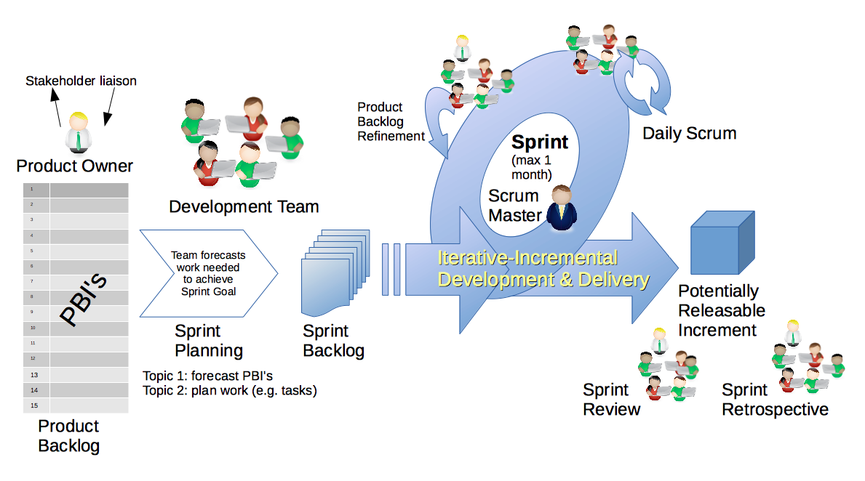
Scrum Process – Sprint Review & Demo
By Dr ian mitchell - Own work, CC BY-SA 4.0, Link

Slide 5
Demo Guidelines – Presenter
Everyone will give at least one demo of their work during the semester.
Your demo should be 2 to 5 minutes and can include any or all of the following:
Show your application running
Comment on your implementation
Show the source code
Explain how you organized the code
Talk about any challenges
You should not prepare slides or a presentation
**You will also need to complete the Demo assignment in Blackboard.

Slide 6
Demo Guidelines – Listener
Everyone will be listening to many demos during the semester.
Your listener responsibilities include:
Actively listening and watching what is being demoed
Come up with a meaningful yet easy to answer question
Ask your question if the presenter does not get sufficient questions from other listeners
Do not ask hard question or attempt to review the presenters code
Clap for the presenter at the end of the demo and thank them for presenting
Optionally follow up with the presenter later if you have what could be more difficult questions or if you have suggestions

Slide 7
Sprint Demos

Slide 8
Complete Sprint Demo Assignment

Slide 9
Scrum Process – Sprint Retrospective
By Dr ian mitchell - Own work, CC BY-SA 4.0, Link

Slide 10
Submission Percentage

Slide 11
Class Retrospective
Feedback from Assignments & Reflections:
Excellent submission percentage. Very well done.
Assignments are graded and you should have access to grades and quiz answers
FaceDraw was challenging!
Some issues with compiling and executing FaceDraw applications
What if you did not do as well as you wanted on FaceDraw?
Focus on sprint 4 and Mosaic
If your FaceDraw did not compile or execute, you can resubmit an updated zip file via email no later than 6 AM tomorrow (Thursday) morning and I will review it to see if I can give you a few more points
Please do NOT paste large volumes of text in your Reflection… it seems to lock up Blackboard making it very difficult for me to grade Reflections

Slide 12
Class Retrospective
What can I/we do to improve in sprint 4?
Stay focused and stay optimistic
Keep up the energy
Focus on Mosaic

Slide 13
Breakout Session: Sprint 3 Retrospective
As a scrum team consider:
How does your team feel about sprint 3 now that it is over?
What could could be done for future classes to make sprint 3 more manageable?
What improvements should we make as a class, team, or individual in sprint 4?

Slide 14
Prework for Next Class
Complete through activity 7 prior to next class
Be prepared for team Discussion 4
Be prepared for Lab

Slide 15
End of Session

