Slide 1

Agenda:
Prework
Breakout Session on Testing and Test-Driven Development
More Programming Together with Node.js on Azure
Prework for Next Class
Discussion & Questions welcome at any time but please be present with no phones or email during our time together

Slide 2
Prework
Complete through activity 9 and working on 10
Be prepared for Breakout Session on Chapter 8 Test-Driven Development
Be prepared for Lab

Slide 3
Testing and Test-Driven Development
Notes:
Project Plans, Tracking, Managing

Slide 4
Breakout Session on Testing and Test-Driven Development
Assign presenter(s)
Team discusses topics while the presenter summarizes the 5 topics below:
Relationship between Testing and Test-Driven Development
Cost of fixing a defect over time
RESTFUL APIs and JSON
FIRST, TDD, and Red-Green-Refactor
Mocks, Stubs, and refactoring
Types of testing including Unit, Integration, System, and Regression plus Verification vs. Validation
Team sits back, relaxes, and acknowledges the bravery and dedication of the presenter

Slide 5
Recall Test-driven Development (TDD)
Test-driven development (TDD) is a software development process that relies on the repetition of a very short development cycle: requirements are turned into very specific test cases, then the code is improved so that the tests pass. This is opposed to software development that allows code to be added that is not proven to meet requirements.
American software engineer Kent Beck, who is credited with having developed or "rediscovered"^{[1]} the technique, stated in 2003 that TDD encourages simple designs and inspires confidence.^{[2]}
Test-driven development is related to the test-first programming concepts of extreme programming, begun in 1999,^{[3]} but more recently has created more general interest in its own right.^{[4]}
Programmers also apply the concept to improving and debugging legacy code developed with older techniques.^{[5]}
From Wikipedia, the free encyclopedia
Notes:
What is the term that Jeremy used for doing it in the place?

Slide 6
The Righteous Triangle of Software Development
People & Organizations
Technology & Tools
Process & Roles

Slide 7
Software Testing
Consider:
The goal should not be better testing. It should be avoiding defects in the first place, and then finding and fixing those unavoidable defects sooner.
You can’t afford to test in quality. Developers must be responsible for the technical product quality and defects.
Notes:
Final Topics:

Slide 8
Software Testing Overview
Software Testing [link] is important because, if done right, it can help us find and fix problems earlier and make our system delivery process less immobile, rigid, and fragile.
As future Software Engineers , we are going to:
Understand testing within the various Software Development Lifecycles
Understand testing terminology
Know how to develop applications that are easier to test
Understand Unit Testing and Automated Testing
Notes:
Never underestimate the value of good design and implementation (for testability, encapsulation, etc.) on the economics of testing. You can’t afford to test in quality!
Developers are responsible for product quality. Tester should be able to minimize that chance that a defect makes it to production.
We test to find defects and/or to validate that we have not introduced new defects.
Defects are exponentially more expensive to fix the longer the exist.
Performance issues are often the most difficult and expensive defects to fix. They are often not found until the application if running under production load… which is often only when it is in production.
Unit - $200
Integration - $600
User Acceptance - $6,000
Production - $100,000+
The permutations of modern software features, data, tools, environments, etc. quickly becomes unmanageable. Testability needs to be goal of nearly all non-trivial applications.
Dave Cutler of Windows NT fame had a quote. I wish I could remember the exact words, but it went something like, “I hate having testers because they give developers the false hope that someone else can save them from their sins.”

Slide 9
Software Testing “Truths”
Never underestimate the value of good design and implementation (for testability, encapsulation, etc.) on the economics of testing… You can’t afford to test in quality!
Defects are exponentially more expensive to fix the longer the exist.
Unit - $200
Integration - $600
User Acceptance - $6,000
Production - $100,000+
Performance issues are often the most difficult and expensive defects to fix. They are often not found until the application if running under production load… which is often only when it is in production.
The permutations of modern software features, data, tools, environments, etc. quickly becomes unmanageable. Testability needs to be goal of nearly all non-trivial applications.

Slide 10
Software Testing “Truths” (continued)
Developers need to be responsible for product quality. Tester should be able to minimize that chance that a defect makes it to production.
Dave Cutler of Windows NT fame had a quote. I wish I could remember the exact words, but it went something like, “I hate having testers because they give developers the false hope that someone else can save them from their sins.”

Slide 11
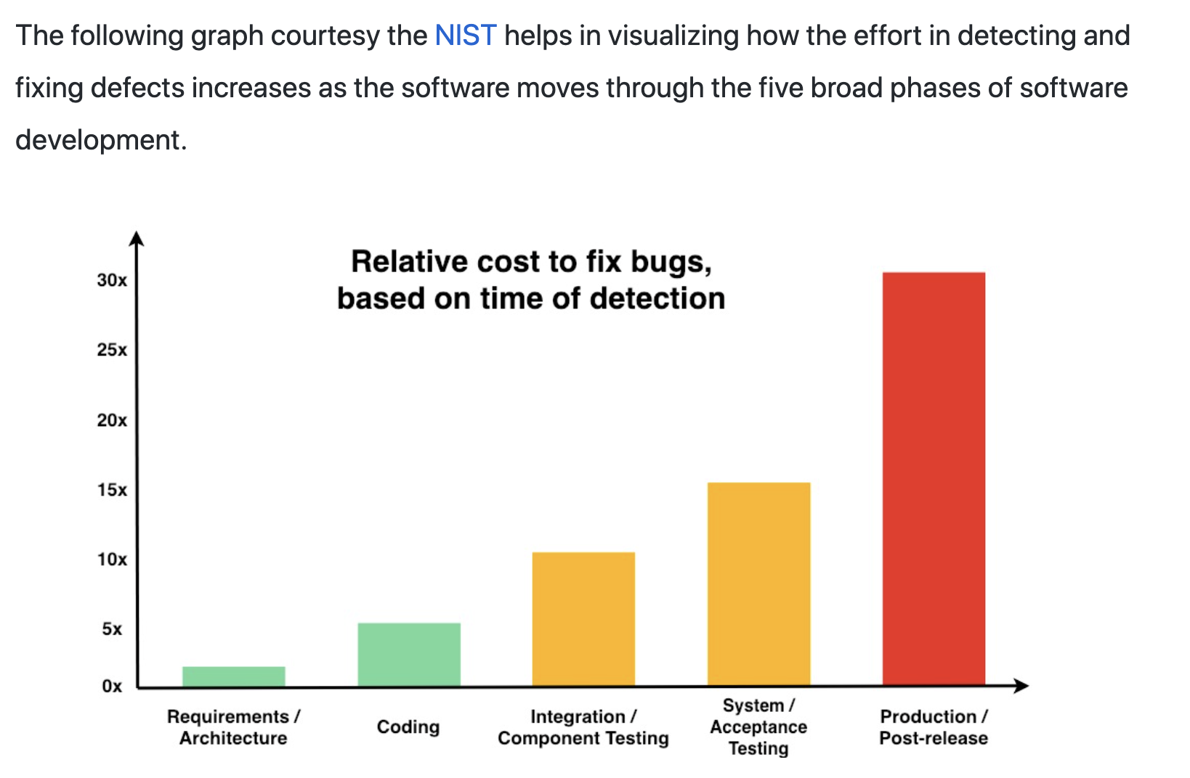

The Cost of Fixing a Defect Increases Exponentially

Slide 12
Waterfall vs Iterative vs Agile Requirements
 | Waterfall | Iterative | Agile
References | United States Department of Defense: DOD-STD-2167A (1985) | Rational Unified Process (RUP) Open Unified Process | Scrum Kanban Scaled Agile Framework (SAFe)
Priorities | Planning and predictability | Architecture, modeling, and efficiency through early detection & fixing of issues (verification) | Responsiveness to feedback, efficiency through engineering practices, early detection & fixing of issues, and validation
Principles | Execute phases sequentially: Requirements Analysis Design Coding Testing and Operations Define and commit to Scope, Cost, and Timeline “early” Implement strict Change Control | Manage requirements Develop and test iteratively Use components Model visually Verify quality Control changes | Capture lightweight near term requirements Allow requirements to evolve but maintain fixed timelines Develop, test, deploy, and release iteratively Empower teams Apply engineering practices and systems thinking Integrate early user feedback into remaining plan Maintain a collaborative approach between all stakeholders
Notes:
The views on testing and change management have changed dramatically as organizations have moved from Waterfall to Iterative to Agile development lifecycles.
Successful Agile (and Iterative) Development REQUIRES better application design, development techniques, and testing practices.
Testing and lack of defects are not the end goal. A higher quality more usable more cost-effective product is the goal.
Requirements:
Waterfall:
Full project requirements upfront
Inconsistent industry capture techniques
Tend to be verbose requirements with formal signoff
Change requests needed
Estimation bottom up detailed estimates sometimes function points
Iterative:
Mostly upfront

Slide 13
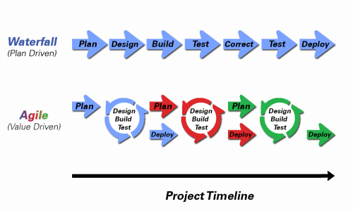
Object-Oriented Programming within Various Development Methodologies
Notes:
Development Methodology and Software Development Lifecycle (SDLC) are often used interchangeably.
The Iterative development methodology is not depicted here as even the mainstays and inventors of the Iterative development methodology seem to be moving toward agile. Plus as Waterfall “holdouts” move, they seem to be moving directly toward Agile. Can you start to see my biases?
Development Methodologies (SDLCs) are a future Bonus Topic. There are several optional slides t the end of this deck. Let me know if you would like to have a more formal overview of the topic as part of this class. I have a passion in this area.
Object oriented-programming concepts/practices evolve and reprioritize depending on the development methodology.
For example, in Waterfall (as well as in Iterative) object-oriented design often play a critical role in the (big upfront) design activities. UML diagrams and project artifacts are often important to the overall project success. (opinion) Practical reality has been that these design artifacts often do not reflect the actual implementation and are rarely maintained or updated.
The Agile practitioners do not reject these design artifacts. However, the focus on shorter time horizons, evolving architecture, and working code changes the value proposition for object-oriented practices to more focus on the build, test, enhance activities.

Slide 14
Testing Terms
Important testing terms include:
Unit Testing: developer testing their own code
Integration Testing: development team testing their full code
System Testing: multiple development teams testing a full system or systems
Performance Testing: testing performance at the Unit, Integration, and/or System level
Manual Testing: a person using the application often running test scenarios
Automated Testing: a group of automated tests that run on the application in the Unit, Integration, System, or Performance testing areas
UI Automated Testing attempts to exercise the application be reproducing user events (key & mouse events)
API Automated Testing occurs at the function/method API level (JUnit for example)

Slide 15
Testing Terms
Important testing terms (continued):
Verification: does the application perform as expected (i.e. meets specifications)
Validation: does the application provide the business benefit that was expected (i.e. meets customer needs)
Behavioral Testing: verifying that the correct functions were called with the correct parameters
State Testing: focuses on the results of those calls

Slide 16
Automated Testing
Unit testing can be done in two ways − manual testing and automated testing.
Automated testing has become a more important part of effective software testing. The pros of Automated Testing include:
Repeatable tests that are quick to run and can support Iterative and Agile development
Very effective in validating environments and doing “smoke tests” to make sure a new build meets a minimal set of requirements
Supports Performance Testing very effectively
Very inexpensive and quick to repeat testing and validate fixes
Various implications include UI, API, and Unit automation tests… each has a very different set of pros and cons
Notes:
False positives versus valid defects found.
Manual Testing and Automated Testing can be supportive of each other.

Slide 17
Automated Testing
Unit testing can be done in two ways − manual testing and automated testing.
Some of the benefits of Automated Testing have been oversold. Some of the challenges include:
Developers rarely can come up with scenarios in scripts that they would not already have tested in their normal unit testing… they often don’t know what they don’t know
UI focused Automated Testing (key & mouse events) are often challenging and create/maintain a great number of false-positives
API Level Automated Testing (i.e. REST) scripts are often more useful and easier to maintain
Environmental verification, API, and finally UI Automated testing is generally the best order to show value quickly with Automated Testing
Automated Testing investment is often not prioritized or tracked so it is difficult to know its effectiveness
Scripts can be expensive to develop and maintain
Notes:
False positives versus valid defects found.
Manual Testing and Automated Testing can be supportive of each other.

Slide 18
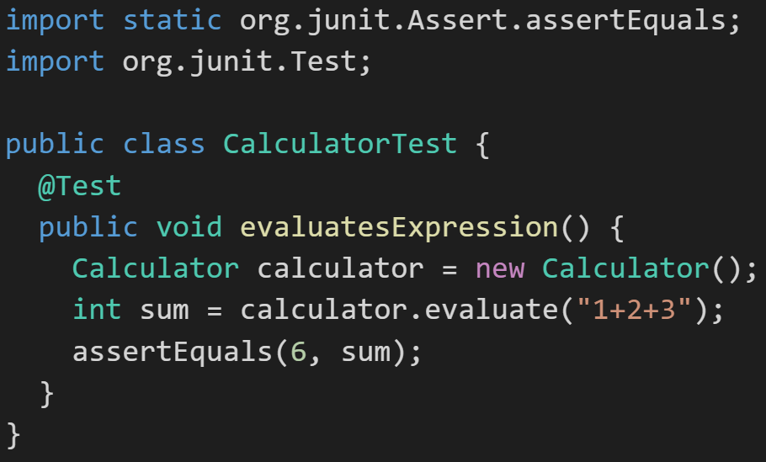
Automated Unit Testing Example: JUnit
Unit testing can be done in two ways − manual testing and automated testing.
JUnit [link] is a Automated Testing framework focused on developing and running Unit test for Java applications. JUnit:
Is a Java opensource extension
Provides annotations to identify test methods.
Provides assertions for testing expected results.
Provides test runners for running tests.
JUnit tests allow you to write codes faster, which increases quality.
JUnit is elegantly simple. It is less complex and takes less time.
JUnit tests can be run automatically and they check their own results and provide immediate feedback. There's no need to manually comb through a report of test results
Notes:
@Test
identifies the method as a test method (remember, method and function are synonyms)
@Test(expected = Exception.class)
fails if the method does not throw the named exception
@Test(timeout=100)
fails if the method takes longer than 100 milliseconds
@Before
public void method()
This method is executed before each test. It is used to prepare the test environment.
@After
public void method()
This method is executed after each test. It is used to clean up the test environment, including cleaning up expensive memory structures.
@BeforeClass
public static void method()
This method is executed once, before any test is done. It is used to do time-intensive tasks before any test is done.

Slide 19
Final Thoughts
Notes:
Project Plans, Tracking, Managing

Slide 20
Prework for Next Class
Everything is due the Sunday before we get back from Spring Break!

Slide 21
More Programming Together with Node.js, Express, and Azure Review Programming Together Video

Slide 22
End of Session

Slide 23
Friendly Conversation Topic
Who made the following statement?
This is my reality. I am not an emotionally empathetic kind of person and that probably doesn't come as a big surprise to anybody. Least of all me. The fact that I then misread people and don't realize (for years) how badly I've judged a situation and contributed to an unprofessional environment is not good. This week people in our community confronted me about my lifetime of not understanding emotions. My flippant attacks in emails have been both unprofessional and uncalled for. Especially at times when I made it personal. In my quest for a better patch, this made sense to me. I know now this was not OK and I am truly sorry. The above is basically a long-winded way to get to the somewhat painful personal admission that hey, I need to change some of my behavior, and I want to apologize to the people that my personal behavior hurt and possibly drove away from kernel development entirely. I am going to take time off and get some assistance on how to understand people’s emotions and respond appropriately.

Slide 24

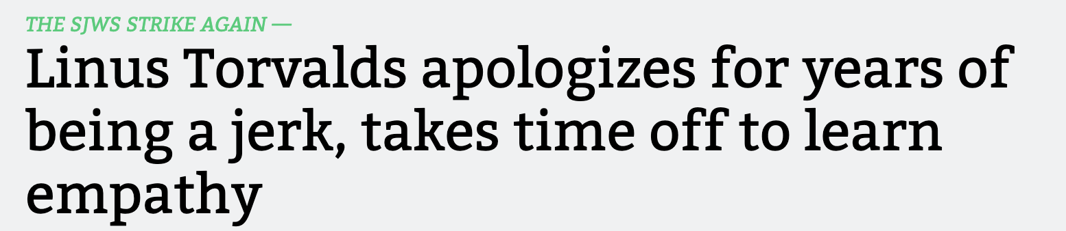
Friendly Conversation Topic

Slide 25

