Slide 1

Agenda:
Prework
Sprint 4 Demos
Sprint 4 Retrospective
Breakout Session: Sprint 4 Sprint Team Retrospective
Sprint 5 Planning (possibly continued Thursday)
Prework for Next Class
Discussion & Questions welcome at any time but please be present with no phones or email during our time together

Slide 2
Prework for Next Class
Everything is due the Sunday before we get back from Spring Break!

Slide 3
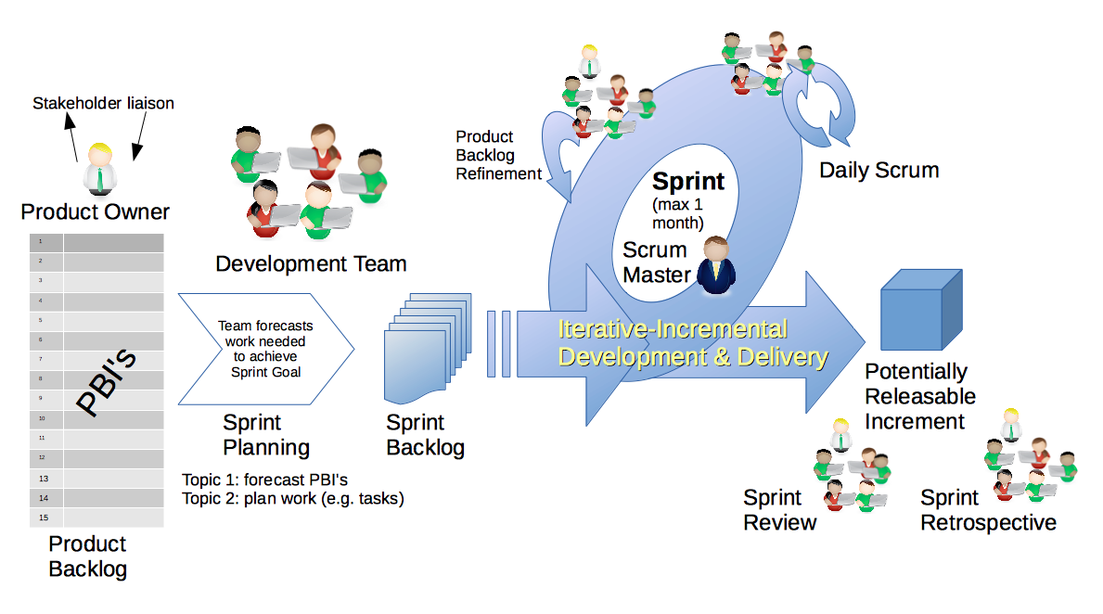
Scrum Process – Sprint Review & Demo
By Dr ian mitchell - Own work, CC BY-SA 4.0, Link

Slide 4
Demo Guidelines – Presenter
Everyone will give at least one demo of their work during the semester.
Your demo should be 2 to 5 minutes and can include any or all of the following:
Show your application running
Comment on your implementation
Show the source code
Explain how you organized the code
Talk about any challenges
You should not prepare slides or a presentation
**You will also need to complete the Demo assignment in Blackboard.

Slide 5
Demo Guidelines – Listener
Everyone will be listening to many demos during the semester.
Your listener responsibilities include:
Actively listening and watching what is being demoed
Come up with a meaningful yet easy to answer question
Ask your question if the presenter does not get sufficient questions from other listeners
Do not ask hard question or attempt to review the presenters code
Clap for the presenter at the end of the demo and thank them for presenting
Optionally follow up with the presenter later if you have what could be more difficult questions or if you have suggestions

Slide 6
Sprint Demos

Slide 7
Special callout to Matt, Mathew, and Rayo for their implementation of Health Insurance Risk Calculator
Bonus Demo?

Slide 8
Complete Sprint Demo Assignment

Slide 9
Scrum Process – Sprint Retrospective
By Dr ian mitchell - Own work, CC BY-SA 4.0, Link

Slide 10
Submission Percentage

Slide 11
Class Retrospective
Feedback from Assignments & Reflections:
Solid Submission Percentage metrics
Submitted assignments are graded or posted
Several teams struggled to effectively work together sprint 4
We will need to improve quickly because it is hard to work in teams and it does not get easier
Before I share more of my opinion(s) I would like to hear from you…

Slide 12
Scrum Team Retrospective
We need to dig deep today to help our teams improve
What worked and did not work for your team in sprint 4 working?
What do you think were the underlying causes that made the situation challenging?
How much in-person and/or synchronous time is your team spending together?
What can You, I, and/or your scrum team do in sprint 5 to improve the situation?
Team Report-out

Slide 13
Sprint Planning
Sprint 5 Changes:
Sprint 5 marks the beginning of your team’s final project
Effectively working together as a team will be essential

Slide 14
Scrum Process – Sprint Planning
By Dr ian mitchell - Own work, CC BY-SA 4.0, Link

Slide 15
Review Activities List and Assignments

Slide 16
Prework For Next Class
Complete through activity 5 prior to next class
Be prepared to complete Discussion 6 in class as a team

Slide 17
End of Session

